Slide 1

Theme: “Growth for the African Reinsurance Industry—Navigating Global Volatility and Growing Risk Complexity”
Presentation Topic
Financial Upheaval: From Sanctions to Tariffs
By Dr. Phocas NYANDWI – Regional Director, Africa Re, Nairobi Regional Office,
at the
AIO’s 29th African Reinsurance Forum in Harare

Slide 2

Global Financial Upheaval: 2020—2025 | It’s a VUCA World!
Financial Upheaval
War & Geopolitical Risks
US Tariffs/Aid cuts
Rise of Protectionism, Sanctions and Economic Sovereignty
Political Violence/Terrorism & SRCC
Volatility, Uncertainty, Complexity, Ambiguity (VUCA) in the African Insurance Industry
Trade Reorientation & Supply Chain diversification
Economic Volatility, Inflation, Currency Risks, Energy & and Resource Pressures
Geo-economic Fragmentation & Regionalization
Hardly had economies recovered from the effects of Covid-19 and Russia/Ukraine & Ukraine/Gaza war that Tariffs and aid cuts came to add more volatility and uncertainty in 2025 and beyond.
2

Slide 3
Global Financial Upheaval: 2023—2025 | Sanctions on Selected African countries
Country | Sanctions Rating | Risk Rationale
Sudan |  | Active OFAC E.O.14098 + EU regime with 2025 expansions (broad blocking risk)
Libya |  | Active OFAC/EU programs; arms embargo; frequent listings tied to oil/petro flows
South Sudan |  | Longstanding OFAC/EU targeted sanctions with periodic 2025 updates
DRC |  | OFAC program + EU Mar 2025 additions; mining/logistics exposure
Central African Republic (CAR) |  | OFAC/EU frameworks; security actors frequently listed
Somalia |  | OFAC (terror) + EU counter‑terror: high SDN exposure
Mali |  | Targeted listings; EU regime in force; elevated political/military exposure
Niger |  | EU regime (democratic‑order); targeted designations;
Ethiopia |  | OFAC E.O.14046 targeted; licensing/humanitarian carve‑outs; screen Eritrea links
Sanctions mean restricted trade for/with the sanctioned countries
For (Re)insurers: Complexity around Compliance Screenings – a Big Headache for (Re)insurers in Africa
3

Slide 4
Financial Upheaval in Africa | FX Risk—Volatility of African Currencies
Nigeria
~70%+ loss since mid‑2023 FX reforms; trend to stabilization following significant volatility
Egypt
>66% loss since early 2022 after staged devaluations and 2024 float
Ghana
>50% plunge in 2022; recurrent volatility despite 2025 rally
Ethiopia
Float on Jul 29 2024 led to an immediate ~30% drop, then further weakness >30% in following days/weeks → Reinsurers’ USD production and ETB Cash holdings impacted.
Malawi
Two-step devaluations (‑25% in 2022; ‑30% in 2023) → Increase in the cost of claims/ social inflation.
Impacts
FX mismatch > Credit risk
Capital & liquidity
Claims inflation & underinsurance
Wordings &
Terms & Conditions
4

Slide 5
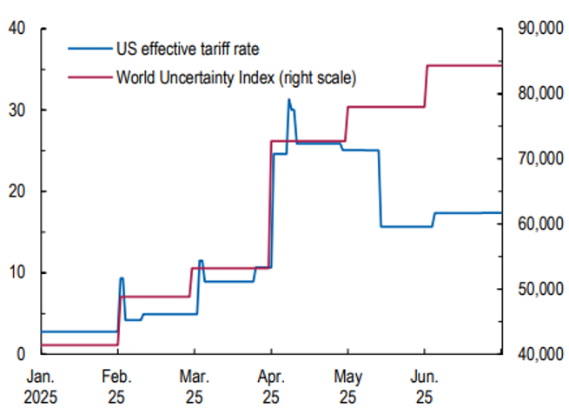


US Reciprocal Tariffs Impact | Sustained Uncertainty
US began 2025 by raising Tariffs massively…
The US effective tariff rate has gone down since April
YET….
The World Uncertainty Index (Red line) has continued an upward climb.
Source: IMF
5

Slide 6
Global Financial Upheaval: 2025 | U.S. Tariffs – Africa Impact, 2025
Country |  | Current Tariff | Key sectors impacted
Lesotho |  | 15% | Textiles & apparel
Madagascar |  | 47% | Textiles (AGOA exports heavily hit)
Mauritius |  | 40% | Textile, sugar
Botswana |  | 37% | Diamonds, beef
Angola |  | 32% | Oil products, minerals
Libya |  | 31% | Oil & petroleum
South Africa |  | 30% | Automobiles, wine, citrus
Algeria |  | 30% | Hydrocarbons, petrochemicals
Tunisia |  | 28% | Textiles, Olive Oil
Cote d'ivoire |  | 21% | Cocoa, cashew
Namibia |  | 21% | Beef, minerals
Zimbabwe |  | 18% | Tobacco, platinum
Zambia |  | 17% | Copper
Malawi |  | 17% | Tobacco, tea
Mozambique |  | 16% | Aluminium, cashews
U.S. Reciprocal (Independence Day) Tariffs
Trade & Margins
Tariffs compress exporter margins
Leads to re-sourcing & order volatility;
Working Capital needs go up.
Logistics & BI
Production slowdowns,
Idle capacity and shipment deferrals
Heightens cargo & contingent BI exposures.
Credit & Surety
Higher defaults risk on receivables;
Strain on performance.
U.S. Tariffs on selected African countries, Sep 29, 2025
6

Slide 7
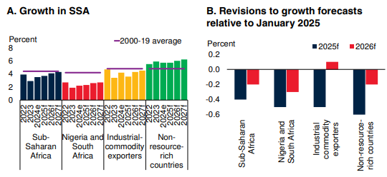
IMF World Economic Outlook (WEO) for SSA | Downward Revision—July 2025
Charts—IMF July 2025 World Economic Outlook (WEO): Sub-Saharan Africa growth forecasts have been revised downward since the January WEO update – due to tariffs, sanctions and aid cuts.
Source: IMF July 2025 World Economic Outlook
7

Slide 8
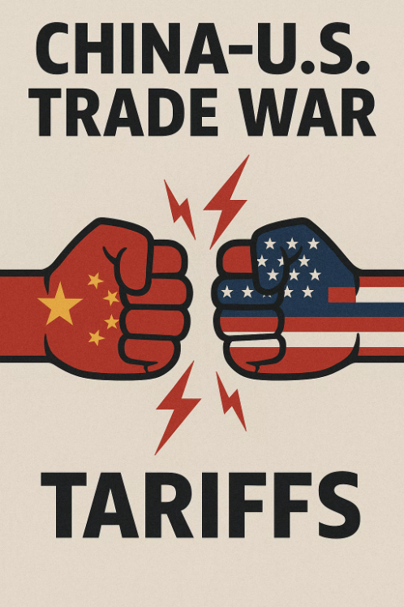

US Reciprocal Tariffs Impact | The Pivot to China
China imports to Africa surged 25% year-on-year in the first seven months of 2025. -Bloomberg
Shifts in trade partnerships are expected in 2025 and beyond.
Notes:
Lesotho and their jeans. Institute for Insecurity studies – 53 countries in Africa have signed some sort of deal relating to the belt and road initiative. https://issafrica.org/iss-today/africa-has-much-to-gain-from-a-more-contained-bri?utm African imports of Chinese goods surged 25% year-on-year to $122bn in the first seven months of 2025, according to an analysis of China Customs data by Bloomberg. https://www.bloomberg.com/news/articles/2025-08-26/china-is-pouring-exports-into-africa-faster-than-anywhere-else

Slide 9


Global Financial Upheaval 2023–2025 | Donor/Aid Retrenchment
Donor Aid Pause ➔ Impact on Community Projects ➔ Lower Insurance demand, Credit risk, etc.
PRE-CONTEMPLATION
CONTEMPLATION
PREPARATION
ACTION
MAINTENANCE
1
2
3
4
(RE)INSURERS
Pause of USAID, Other Programs
Knock‑on
effects
Credit
Risk
Underwriting Signals
Pauses/reprogramming in some major-donor portfolios and stricter compliance slowed grant‑financed projects and NGO procurement. Staff layoffs
Delayed public infrastructure/health procurements, lower premium flow in project, assets, medical, life and liability classes of insurance
Credit risk increased for providers reliant on donor disbursements; longer receivables cycles and higher cancellation risk on tenders.
Policy cancellations; Lower sums insured, leading to decline in premium income. There may be need to put Warranties around funding availability and cancellation terms.
ENABLEMENT ZONE
ENGAGEMENT ZONE

Slide 10
Impact of Tariffs - Case for Regional Integration
Promote Increased regional integration/regional trade agreements
Accelerate of the Agenda for the African Continental Free Trade Area (AfCFTA)
The AfCFTA will open new corridors between existing economic communities.
However, it is still at its infancy stage and needs to be accelerated in order to make meaningful impact
Increased regional trade would mitigate at least partly the impact of tariffs
While promoting regional integration, defend preferential access to developed markets
African (Re)insurers
Regional integration alone may not fully compensate for the reduced access to large markets like US, hence the need for African countries to continue defending the preferential access.
Revise risk models;
Adapt their product offering;
Review policy terms and conditions;

Slide 11
Global Financial Upheaval: How has the African (Re)insurance Sector been impacted?
Marine & Cargo
Aviation & PVT
Red Sea/Suez diversions → longer voyages, higher war surcharges and accumulation; rerouting raises claims severity and BI / CBI extensions’ exposure.
Middle‑East tensions and sanctions spillovers → higher risk pricing, tighter aggregate limits, stricter territorial scope clauses.
Property/Engineering
Supply‑chain delays push contract periods and DSUs (delay in startup for CAR covers); materials inflation raises SI adequacy gaps.
Trade Credit & Surety/Bonds
Tariffs/sanctions/FX volatility causes—
spikes in buyer defaults;
tighter insurance limits,
Collateral requirement, and
sectoral exclusions.
Life & Health Insurance
Donor programs variability (e.g. USAID cuts) and inflation affect medical loss ratios;
Requires repricing and minimum attachment points..
Operational/Payments Risk
Payments de‑risking (banks) and verification of origin → slower premium flows, blocked transfers, and higher compliance costs.

Slide 12
The Impact Card | How Resilient is the (Re)insurance Industry?
The Global Reinsurance Industry is largely resilient
AM Best: Outlook Positive
S&P: Outlook Stable
Fitch: Outlook Deteriorating
Moody’s: Outlook Stable
Is the African Insurance Industry Holding Up?
The African insurance industry is not immune to socio-economic shocks. The challenge to increase significantly the insurance penetration across countries is reflective of struggle to tap into the uninsured segment of the population.
Tariffs/aid cuts makes the problem worse and will have an impact on growth
Although the industry has shown resilience to shocks, there is need for more innovation solutions to make the insurance sector more inclusive and stay afloat.
12

Slide 13
What Can We Do Now? | Onboard a Robust Risk Management model
BANI
What does it Mean?
Example of Insurer Response Actions
Brittle
Brittle — systems seem robust but fail suddenly.
Stress tests
Concentration risk: avoid single points of failure
Anxious
Anxious — fear and sentiment drive overreactions
Insurers to communicate the logic for rate changes (if any) and renewal coverage early to avoid churn.
Nonlinear
Nonlinear — small triggers create outsized outcomes
Adverse loss development: Keep scenario tails in pricing;
Watch accumulation hotspots
Incomprehensible
Incomprehensible — signals defy interpretation
Product/Contract certainty: Pilot new covers, stage capacity, and insist on clear wordings
We should not be too confident! – Stress Test Balance sheet – Communicate clearly with customers – Avoid Concentration Risk – Conservative Loss reserves
13

Slide 14
What Can We Do Now? Strengthen Operations, Systems & Capital
Financial upheaval is a wake up call for (Re)insurers to Strengthen Operations, Capital and Balance Sheet Protection
Compliance-by-design
Centralized screening/origin checks;
Periodic training for staff on compliance
Treasury Management
Manage pro-actively currency risks where possible;
Diversify banking options to reduce settlement friction.
Use advanced data capabilities to track risk metrics on - sanctions, supply chain disruptions / marine risk and other volatility risks.
Data advantage
Adequate Reinsurance/Retro & capital
Secure adequate reinsurance/retrocession covers to avoid gaps (monetary and other terms & Conditions).
Client advisory
Regular ‘Trade & Sanctions Pulse’ guidance;
Stay up-to-date with wordings/ endorsements.

Slide 15
What Can We Do Now? Underwriting Guidelines
Insurers and reinsurers have an obligation to de-risk exposure in the underwritten portfolio
Explicit sanctions warranty
Premium Payment de‑risking
Agree premium payment clauses allowing alternative channels, escrow, or agent collection;
Clarify non‑payment remedies – impact of PPW clauses.
Explicit sanctions clauses
Require origin/beneficial‑owner attestations on breach consequences
Inspection /
Audits
Claims
Management
Add right‑to‑audit provisions for claims validity.
Document supply-chain delays consequences in policies to avoid contentions on claims.
Set clear evidence standards for proximate cause and mitigation.

Slide 16
What Can We Do Now? Build a Sustainable Portfolio & Products
Financial Upheaval and Uncertainty presents Opportunities for insurers
(Re)insurers should restructure their offerings toward Resilient and Sustainable Portfolios and Products
1
2
3
4
5
Take advantage of technological advancements
Product Design
Dynamic
Pricing
Partnerships
Parametric
Solutions
Design products that can enable to reach the unsinsured segment of the population, including distribution channels and payment platforms. Develop skills for emerging products such as PR/Credit and Cyber insurance
Use Dynamic (not static) rates, less complex rating structures and policy wordings where necessary.
Partnerships with Government institutions involved in structuring insurance the schemes, banks, telcoms, cooperatives…
Make use of Parametric Solutions for climate related products and other classes for better product structuring and quicker payouts
Use of AI and other advanced technological platforms to analyse data and make quicker and more informed decisions.

Slide 17

Concluding Remarks | Our Moment. Our Mandate.
AGILITY | PARTNERSHIPS | INNOVATION | TECHNOLOGY
In aviation, a pilot once remarked:
“Headwinds double the effort, but they also sharpen the wings and make the destination more meaningful.”
They test our strength. But they also sharpen us.
If we innovate, collaborate, and reimagine our industry, these very headwinds will lift us—to a more resilient, more inclusive, and more self-reliant African insurance market.
Strategy
Orientation for Agility, Resilience
Financial Strength
Protect Capital, Shareholder Value
The Customer
Satisfy the Customer
Our People
Get Skills, Talent for a VUCA world
Internal Processes
Focus on Operational Excellence, Underwriting Discipline, Innovation, Technology & Digitalization.
So, let us not fear the storm. Let us use it to fly higher.
17

Slide 18

Thank You

