Slide 1
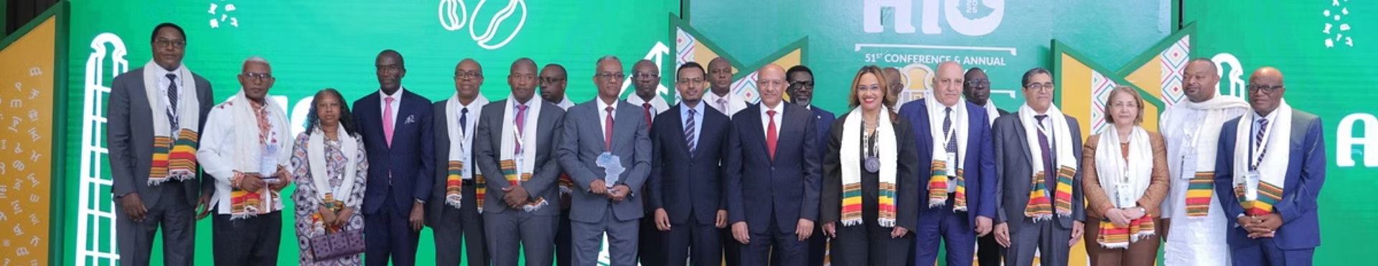
Africa Fit for the Future:
Unlocking Infrastructure Investment Opportunities
Welcome to this strategic session on how re/insurance can power African infrastructure development.
Over 1,900 insurance leaders from 93 countries gather to build Africa's destiny.
Dr. Anselmi Anselmi
Moderator
27th May 2025, Skylight Hotel, Addis Ababa Ethiopia

Slide 2
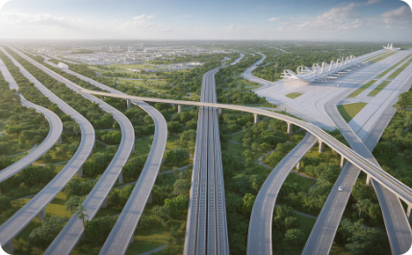
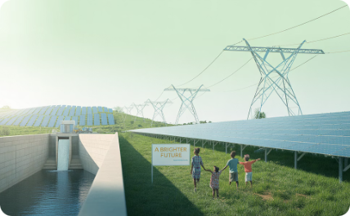
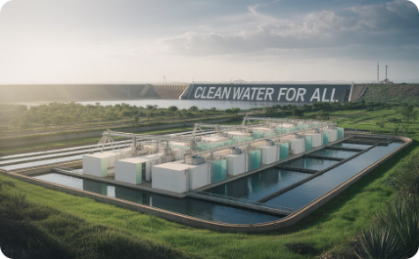


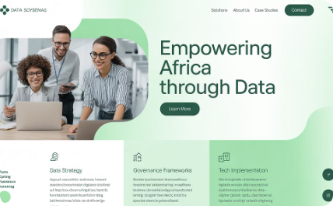
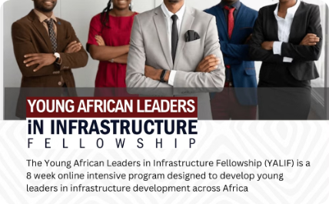
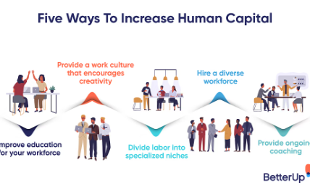
Infrastructure Types
Africa's development requires investment in both physical assets and enabling systems
Transport Networks
Energy Systems
Water Resources
ICT Networks
Roads, railways, ports, and airports connecting communities and markets
Power generation, transmission and distribution infrastructure
Dams, irrigation, water supply and sanitation systems
Telecommunications, internet and digital technologies
Soft Infrastructure
Trade Facilitation
Data Systems
Financial & Legal Structures
Human Capital
Customs procedures, regulatory frameworks and trade agreements
Information management and digital governance frameworks
Banking systems, capital markets and regulatory environments
Education, skills development and knowledge systems

Slide 3
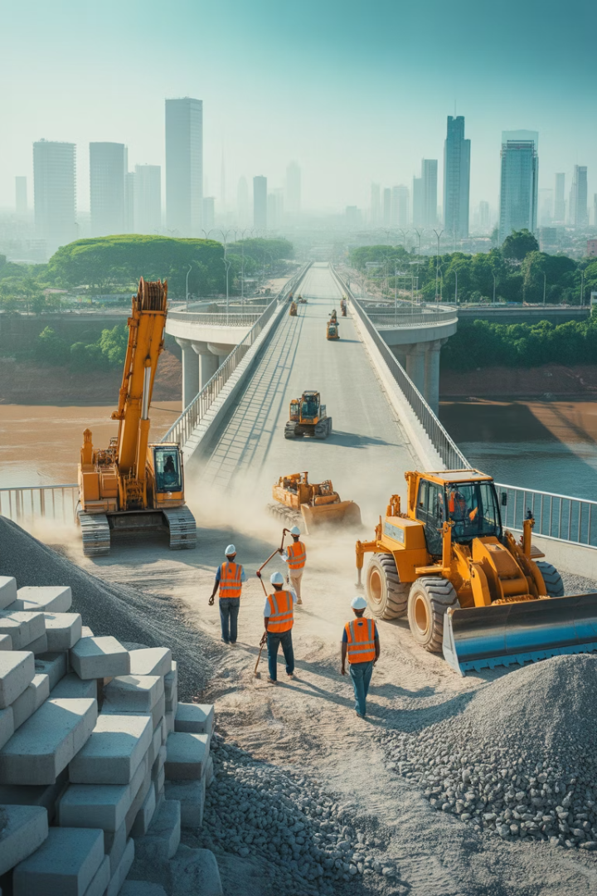



The Infrastructure Statistics
$130-170 billion
$68-107 billion
Annual infrastructure needs
Current funding gap
2% GDP reduction
Annual cost of infrastructure gap

Slide 4




Key Challenges
High Capital Requirements
Risk Perception
Infrastructure projects in Africa require massive funding, creating significant barriers to entry for many investors.
Negative bias toward African investments persists, despite data showing potential for strong returns in many markets.
Lack of Bankable Projects
FX Risks
Limited well-structured investment opportunities hamper deployment of available capital into African infrastructure.
Currency volatility concerns create additional challenges for long-term infrastructure investment planning.

Slide 5
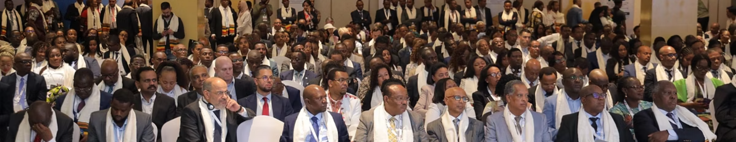
The Opportunity
1.9%
4.2%
40%
Default Rate
GDP Growth
Private Funding
Africa's infrastructure debt default rate
Expected African average in 2025
Current private sector share in infrastructure

Slide 6
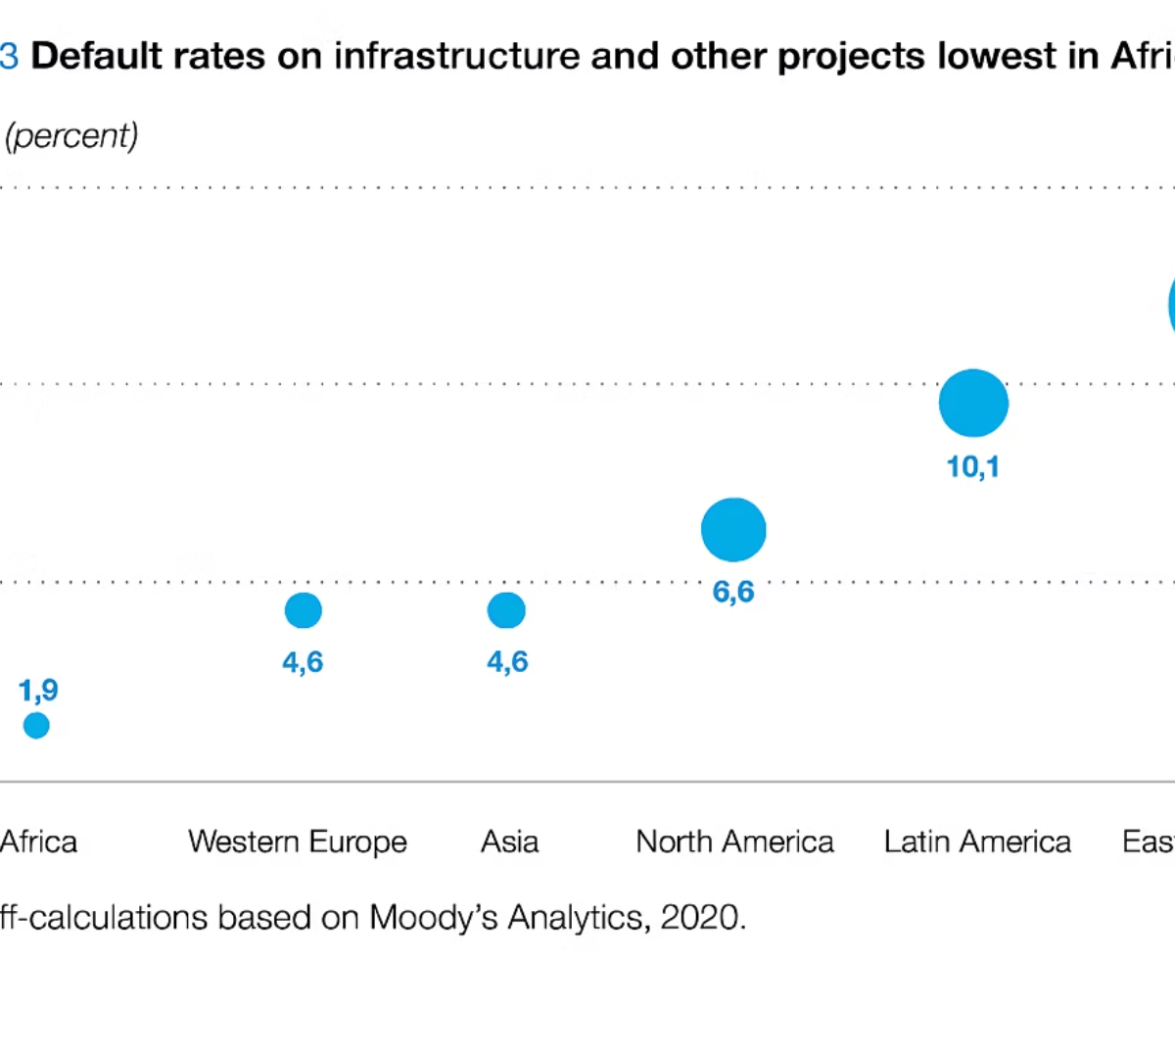
Africa Lowest Default Rate

Slide 7
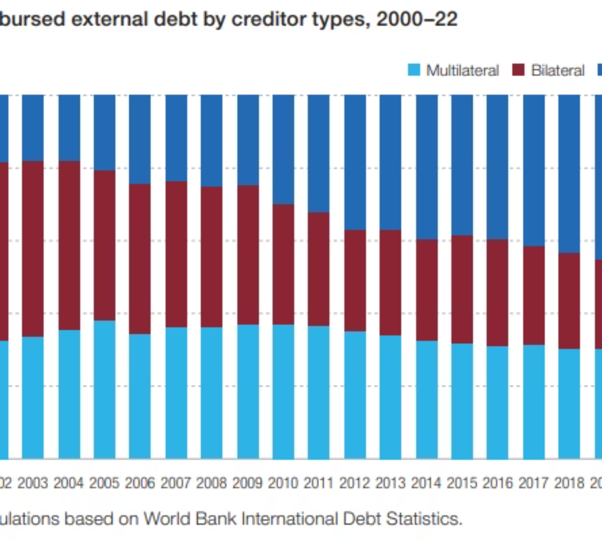
Private sector share of credit

Slide 8
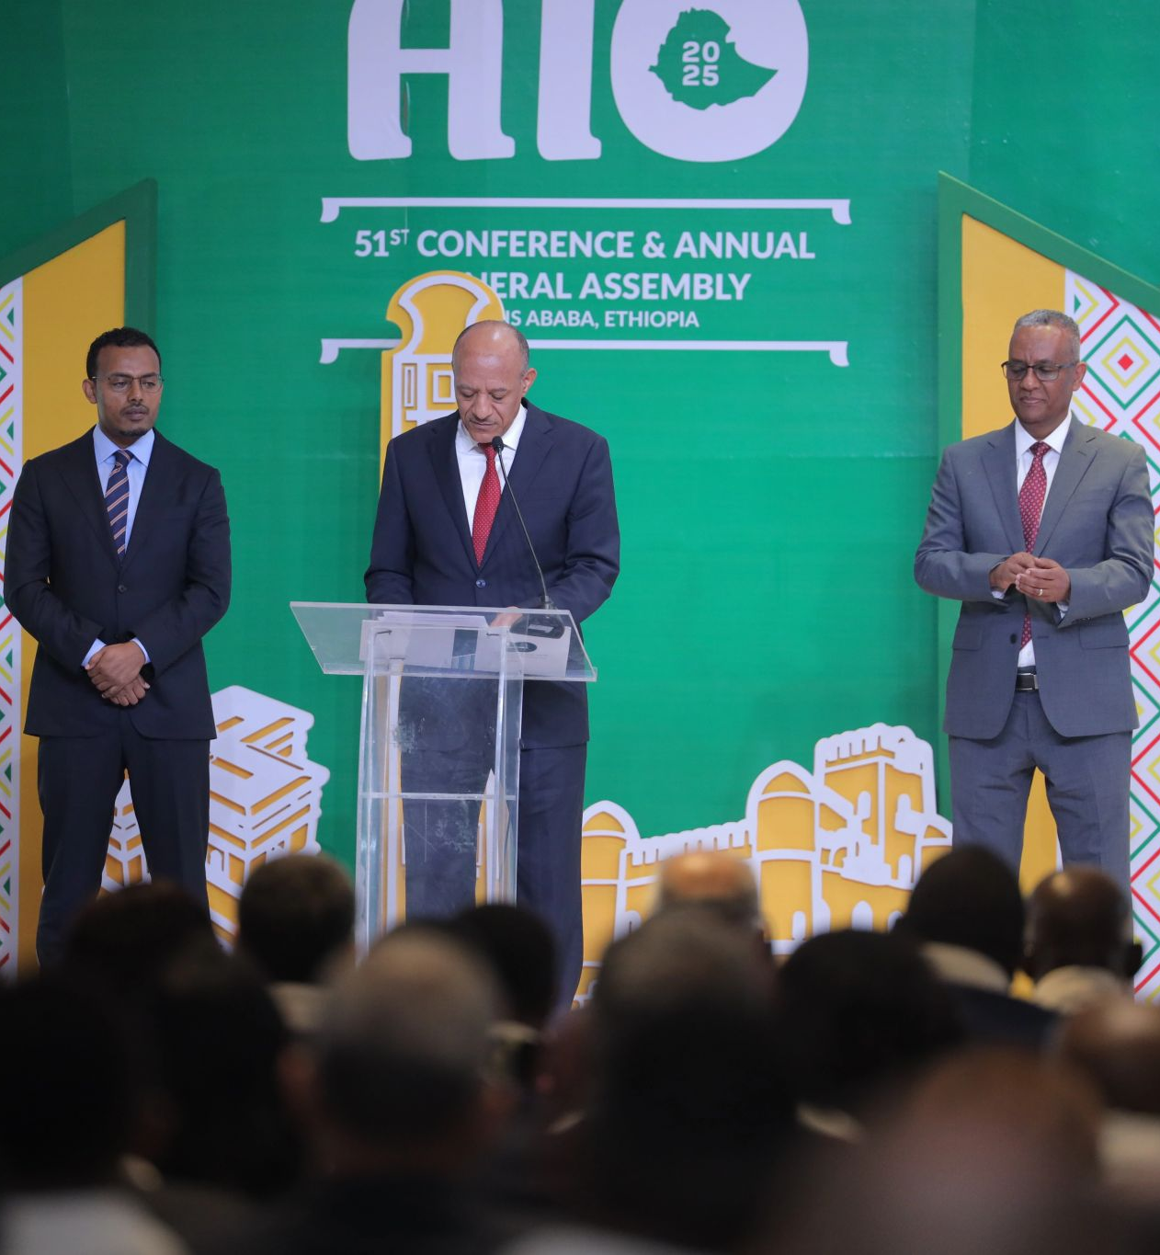
Strategic Initiatives
1
PIDA PAP 1 & 2
Programme for Infrastructure Development in Africa (2010)
51 programmes, 400+ projects (2012-2020)
69 projects, $160.8B investment (2021-2030)
2
THE AFRICA FINANCE CORPORATION (AFC)
FOR INFRASTRUCTURE AND TRADE FINANCING IN AFRICA
3
Infrastructure Consortium for Africa
4. Infrastructure Project Preparation Facility (IPPF)
5. African Infrastructure Investment Managers (AIIM)
6. Africa50 Infrastructure Acceleration Fund

Slide 9
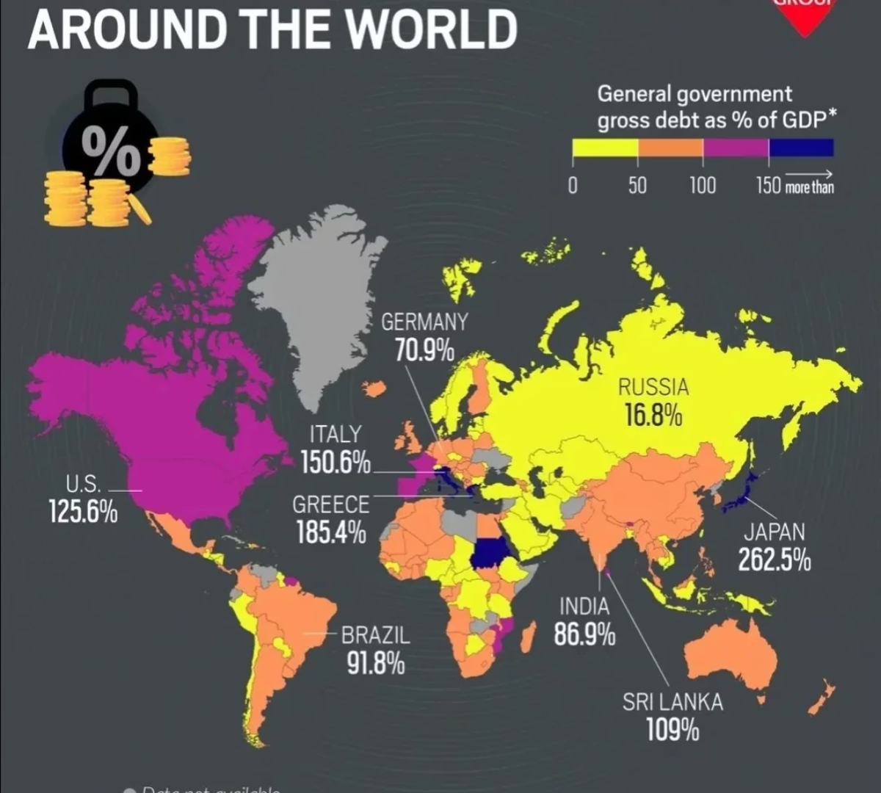
Global Debt-to-GDP Ratio

Slide 10

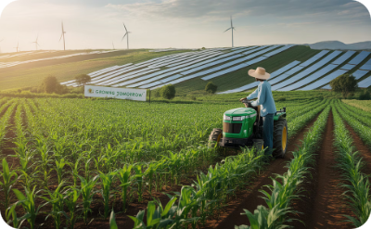

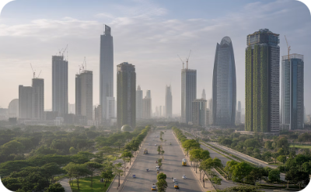
Africa's Growth Potential
Young Population
Natural Resources
AfCFTA Impact
Economic Growth
Median age 19, growing to 2.5B by 2100
65% of world's arable land, 10% of freshwater
Potential GWP growth to $3.4T by 2072
11 of 20 fastest-growing economies globally

Slide 11
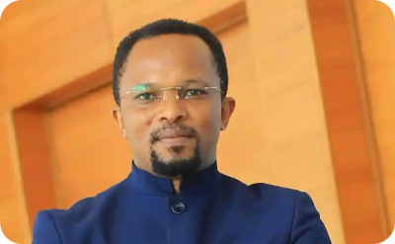
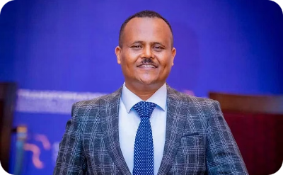
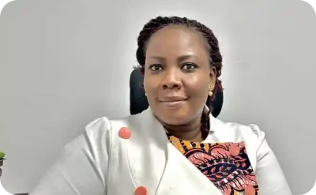
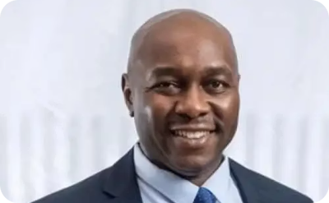
Meet Our Distinguished Panel
Leading experts in African insurance development
Dr. Anselmi Anselmi
Fikru Wordofa
Emma Ocansey
Clement Chamboko
Moderator
Panelist
Panelist
Panelist
Academician
Executive Officer B’ness
Strategy & Dvt Ethio Re
Chief Distribution Officer Old Mutual, West Africa
MD Africa GCR Rating
Business Consultant
Former banker
Insurance Broker
Board Member OESAI
Financial inclusion devout Former banker
Pan Africanist
Award winning Author
Award winning Author

Slide 12
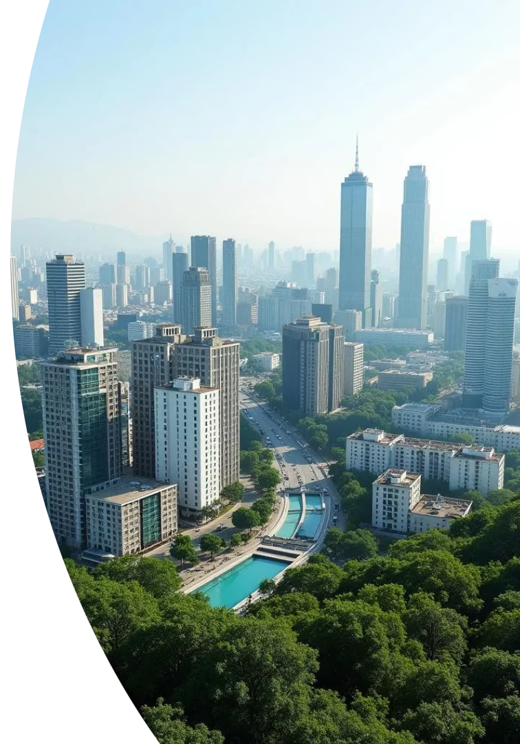
Africa Fit for Future
Africa's insurance industry is not just a protector of assets, but a potential architect of prosperity.
The journey of a thousand miles begins with a single investment... perhaps even in a really long bridge!

Slide 13
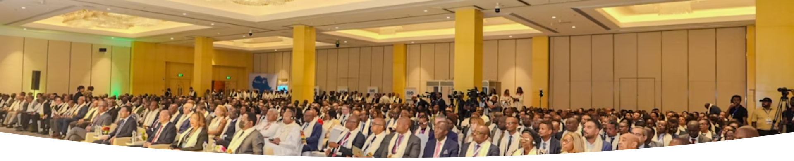
Africa's Untapped Potential
2.5B
65%
$3.4T
Population by 2050
World's Arable Land
Potential GWP by 2072
Africa has the world's youngest population with median age 19.
Africa holds significant agricultural potential.
With optimized AfCFTA, growing from current $115B.

Slide 14
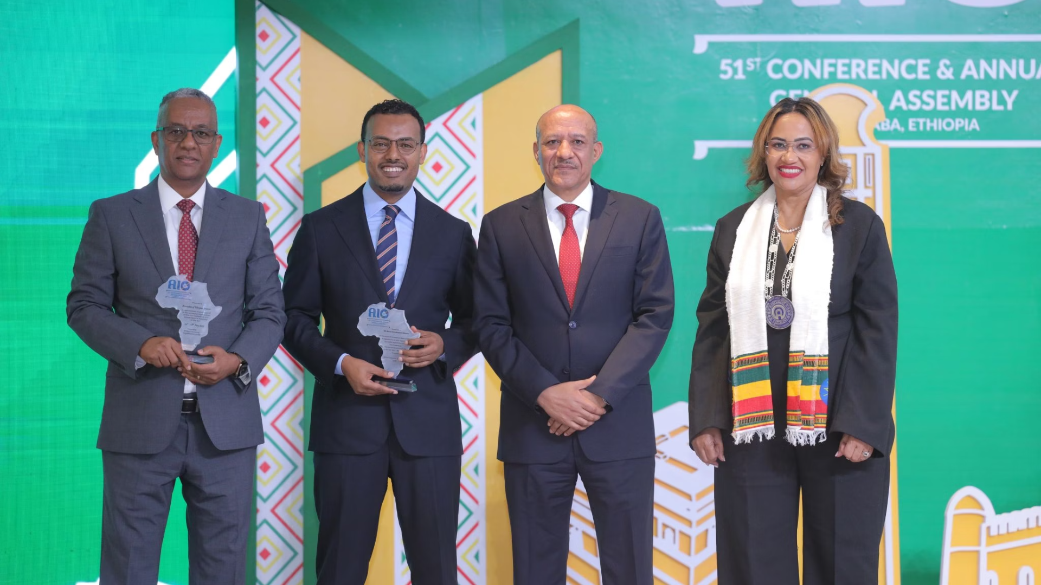




Call to Action
Innovative Financing
Develop insurance-led investment vehicles
Strategic Partnerships
Form coalitions between insurers and developers
Governance Reforms
Combat illicit financial flows ($50-115B annually)
Agenda 2063
Align with "The Africa We Want" vision

Slide 15




Moving Forward Together
Reject Status Quo
Strategic Investment
Continued Dialogue
"We do not want to be a status quo Continent neither a status quo people."
Ensure Africa's books are overflowing with dividends of impactful investments.
Continue this vital conversation beyond this room.

Slide 16
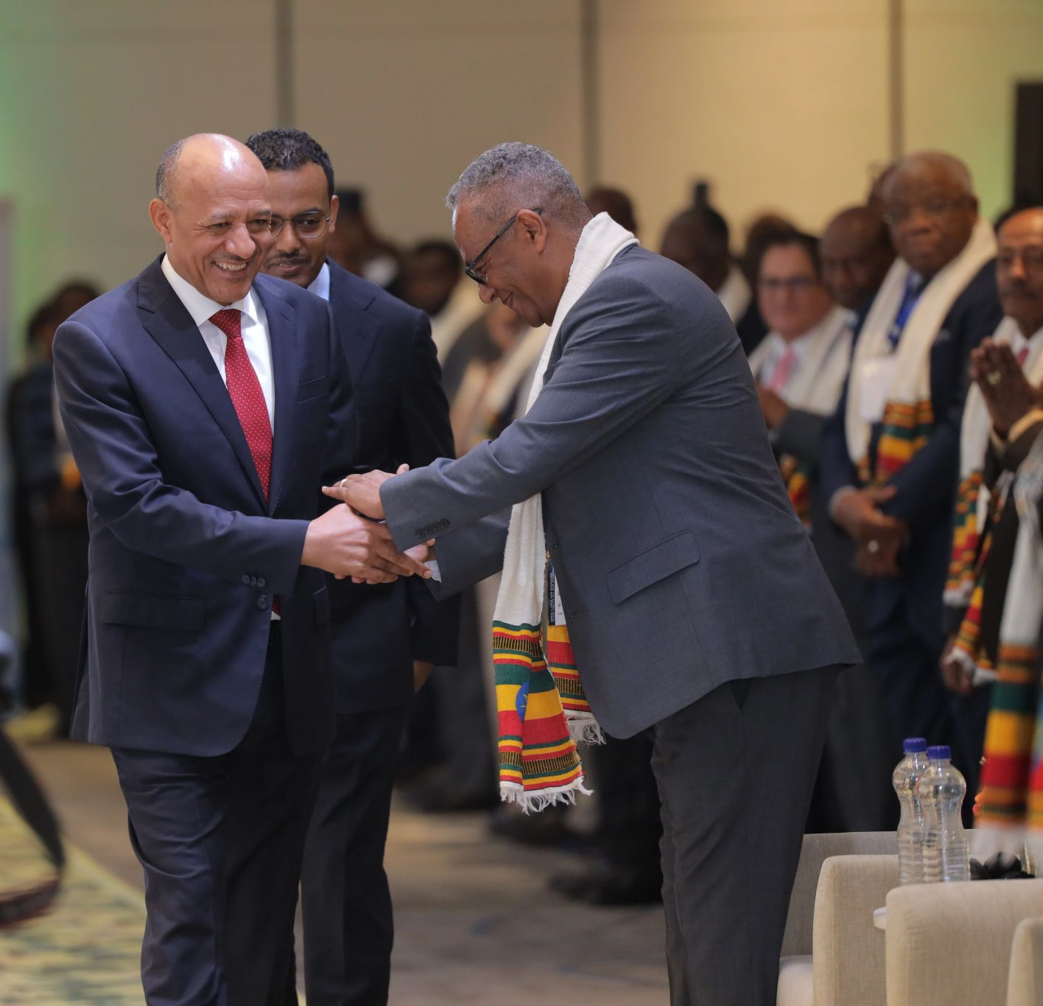
Thank you!!
1
Merci
2
Ahsante Sana
3
Asamegnalehu

