Slide 1
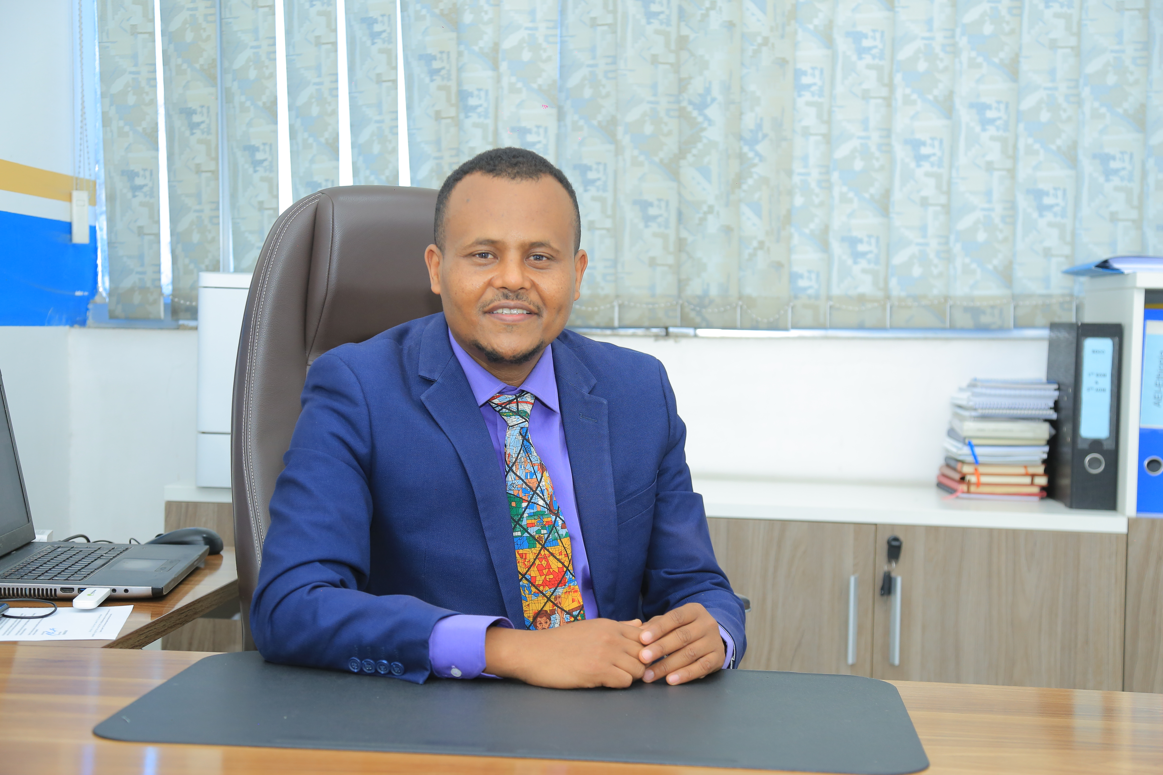
Session 6: Panel: Building an Africa fit for the future
FIKRU TSEGAYE W.

Slide 2
Brief Profile : Fikru Tsegaye wordofa
Fikru Tsegaye Wordofa (Author)
(CTP, ARA, ACS, FLMI, ALMI, Exec-IB&F, Cert- CII, MBA, MA (J&C), MA (HROD), MBA (IB&F), BA, BSC)
20+years of experience: Executive Officer (EO) Strategy &BD, -Ethio-Re
Winner of AIO Book Award-2023 (Algeirs)

Slide 3
Outline
Drivers and gaps
The Road Ahead
The role of African In(Re) insurers in funding infrastcutre projects.

Slide 4
the role of re/insurers in investing in infrastructure

Slide 5
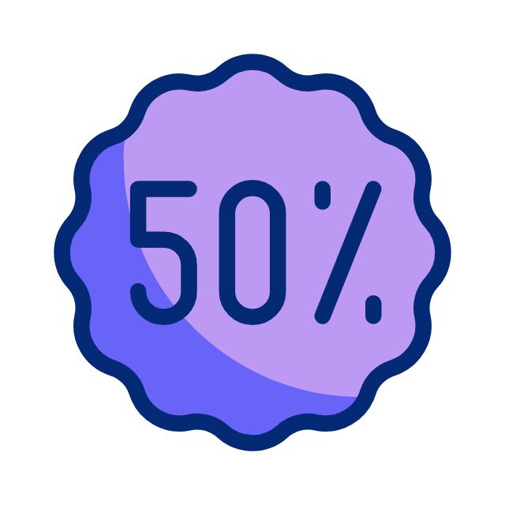
If insurers allocate only 5% of their gross written premiums to infrastructure investments, it could cover nearly half of the annual investment gap.
Nevertheless, insurers’ asset allocation to infrastructure appears insignificant compared to their total asset size in many countries.
Their allocation to infrastructure stands at 1.5 percent of their assets on average in 2019, which is well behind other institutional investors such as sovereign wealth funds.
Source: World bank Group, Insurance companies and infrastructure investments study, accessed on 2025
Notes:
The management of the recruiting process will directly affect:
The quality and diversity of the applicant pool.
The effectiveness of the interviews.
How quickly the open position gets filed.
The ability to choose the best qualified person for the job.

Slide 6
The global infrastructure financing gap is well acknowledged
Additional USD13 trillion will need to be invested globally in infrastructure projects between 2020 and 2040,
This translates into average USD630 billion per annum, to meet the infrastructure investment need.
There’s a need to advocate about ways to mobilize private capital from institutional investors - including insurers, pension funds, asset managers - to reduce the gap.
Source: Estimates by the Global Infrastructure Hub (GIH)

Slide 7
Driving forces
Although there is a huge infrastructure investment gap around the world, its size varies widely by country.
The infrastructure investment gap flows directly with the growth and development of insurance
First, risk-based supervision (RBS) -to match their assets with their liabilities.
Second, investment in infrastructure provides more lucrative returns than the standard investment vehicles
Alternative investment portfolio- diversification of investment portfolio

Slide 8
Table: Infrastructure investment gap and insurance penetration Selected African Counties
Country | Region | Income class | Infrastructure investment gap (%) | Insurance penetration (%)
Tanzania | SSA | LIC | 5.74 | 0.53
Ethiopia | SSA | LIC | 5.70 | 0.40
Guinea | SSA | LIC | 5.22 | 0.08
Benin | SSA | LIC | 3.98 | 0.70
Senegal | SSA | LMIC | 3.08 | 1.32
Ghana | SSA | LMIC | 2.87 | 0.87
Rwanda | SSA | LIC | 2.66 | 1.64
Angola | SSA | LMIC | 2.50 | 0.55
Egypt | MENA | LMIC | 1.82 | 0.75
Kenya | SSA | LMIC | 1.36 | 2.43
Tunisia | MENA | LMIC | 1.34 | 2.30
South Africa | SSA | UMIC | 1.28 | 15.80
Source: World bank Group, Insurance companies and infrastructure investments study, accessed on 2025
Notes:
The management of the recruiting process will directly affect:
The quality and diversity of the applicant pool.
The effectiveness of the interviews.
How quickly the open position gets filed.
The ability to choose the best qualified person for the job.

Slide 10
Table: Infrastructure investment gap and insurance penetration Selected Higher Income Countries
 | Region | Income class | Infrastructure investment gap (%) | Insurance penetration (%)
Singapore | EAP | HIC | 0.00 | 7.76
Germany | ECA | HIC | 0.01 | 6.05
France | ECA | HIC | 0.01 | 10.22
Canada | NA | HIC | 0.03 | 7.21
Japan | EAP | HIC | 0.06 | 7.94
South Korea | EAP | HIC | 0.07 | 10.75
Spain | ECA | HIC | 0.12 | 5.20
United Kingdom | ECA | HIC | 0.14 | 13.17
New Zealand | EAP | HIC | 0.25 | 3.57
Australia | EAP | HIC | 0.33 | 5.53
Saudi Arabia | MENA | HIC | 0.47 | 1.19
Uruguay | LAC | HIC | 0.47 | 2.50
Poland | ECA | HIC | 0.48 | 2.83
Croatia | ECA | HIC | 0.55 | 2.57
Italy | ECA | HIC | 0.55 | 7.65
United States | NA | HIC | 0.56 | 11.41
Chile | LAC | HIC | 0.57 | 4.65
Source: World bank Group, Insurance companies and infrastructure investments study, accessed on 2025
Notes:
The management of the recruiting process will directly affect:
The quality and diversity of the applicant pool.
The effectiveness of the interviews.
How quickly the open position gets filed.
The ability to choose the best qualified person for the job.

Slide 11
Investing in infrastructure brings huge benefits for the African economy at large.
Investment in infrastructure also drives economic growth and development an turn could lead to African prosperity and
directly contribute for the growth and development of insurance and change the dismal figures in growth of insurance-exploit the untapped potential
According to the Solvency II - the harmonized EU insurance regulation -
Notes:
The management of the recruiting process will directly affect:
The quality and diversity of the applicant pool.
The effectiveness of the interviews.
How quickly the open position gets filed.
The ability to choose the best qualified person for the job.

Slide 12
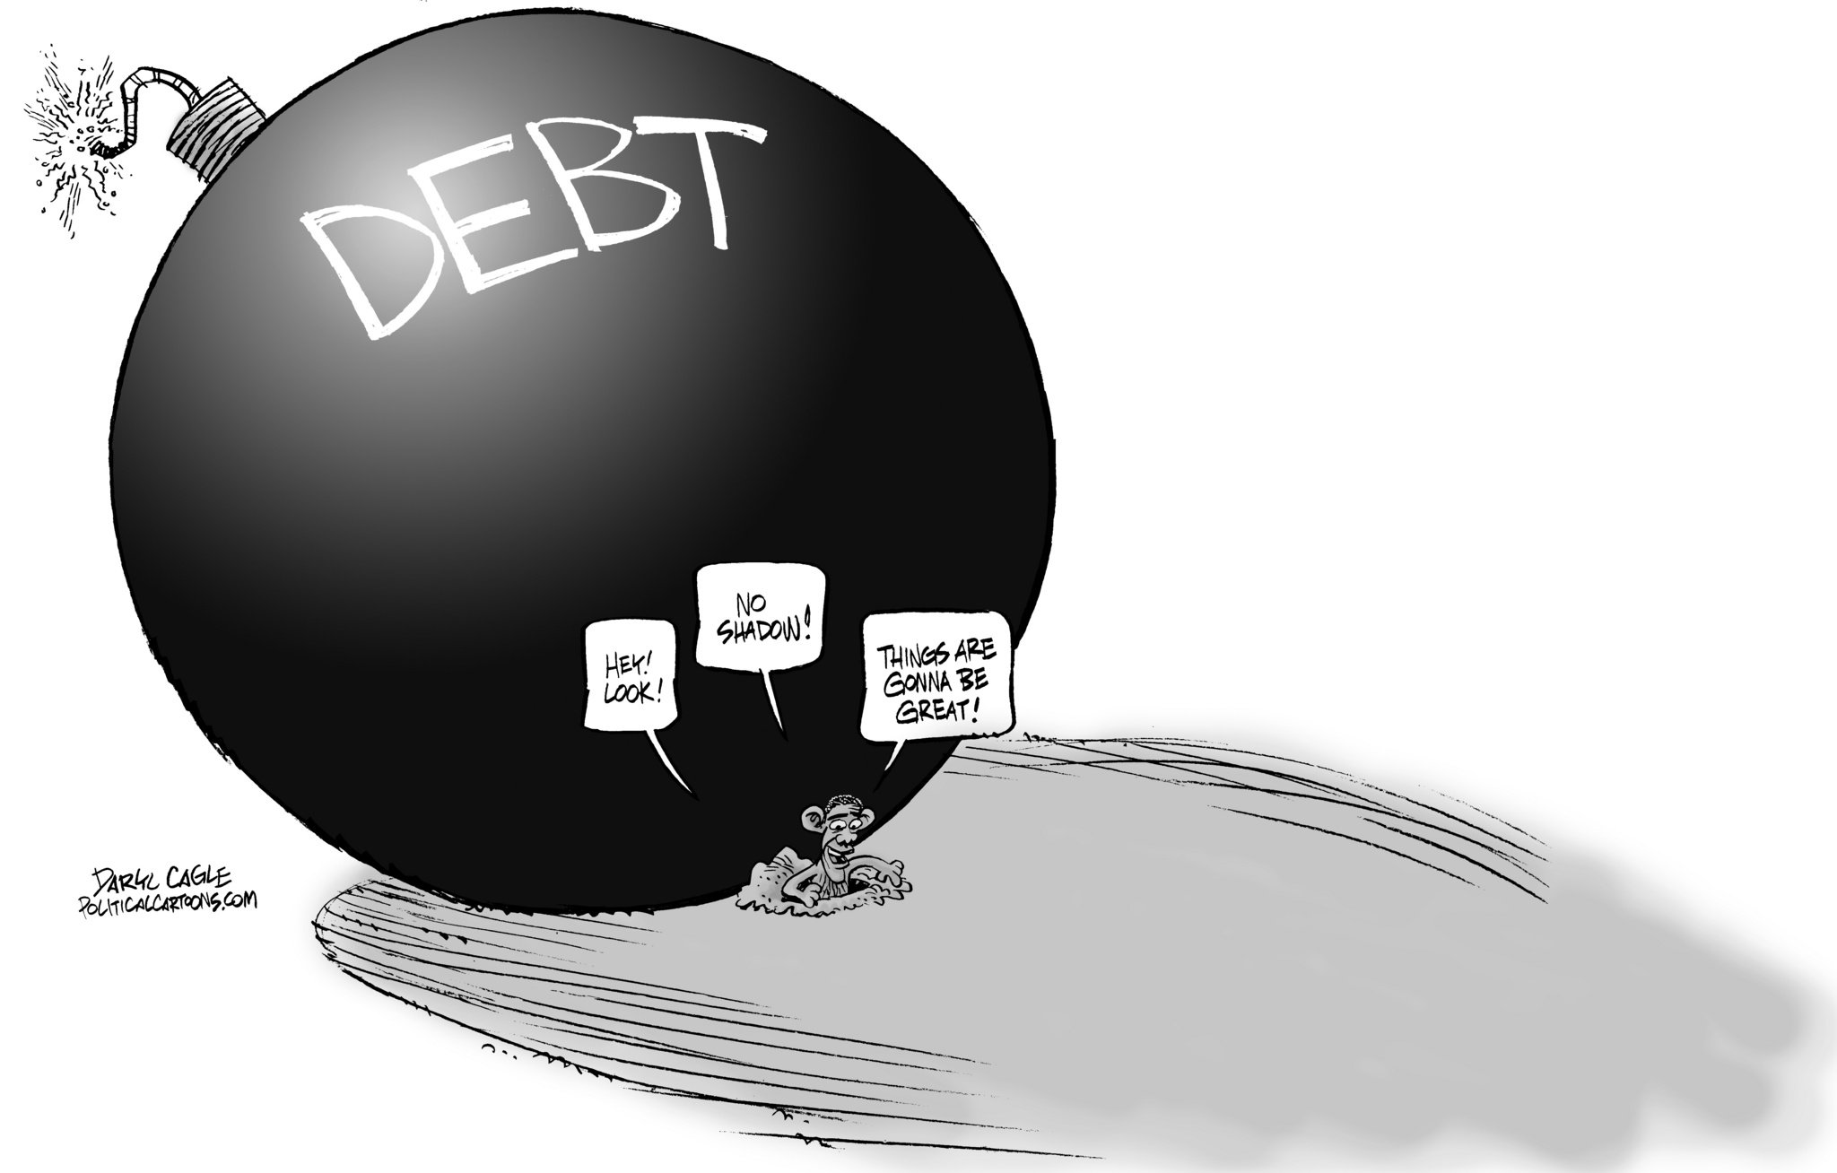
Will help to reduce the government’s and countries debt burden by creating a revenue stream for countries/governments
Infrastructure investments are composed of different financial instruments and better to investors’ preference in terms of risk and return characteristics.

Slide 13
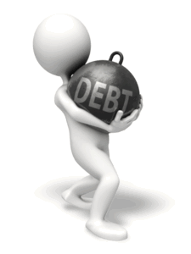
Sovereign debt ratings can indirectly influence an insurer's financial strength rating, primarily by affecting the country's creditworthiness and overall operating environment.
While a sovereign downgrade on its own may not directly trigger an insurer's downgrade, it signals potential issues that can be incorporated into the rating process on a company-by-company basis.
Sovereign Ceilings:
Sovereign ceilings, which would limit an insurer's rating to the sovereign's rating, are not universally applied by rating agencies.
Insurers can be more financially secure than their government, and their ability to manage country risk is a key factor in the rating process.

Slide 14
Insurers have been promoting infrastructure investments as both asset owners and asset managers because this asset class makes sense from an ALM viewpoint and they can leverage their asset management function..
The major drivers and barriers for insurers to engage in infrastructure?
Insurance is an important part of the financial sector, supporting broad economic and general well-being in developed economies in a way that is so entrenched and accepted that it is not always widely recognized.

Slide 15
Africa Faces Infrastructure Investment Gap
Though there is capital, there still remains a significant infrastructure investment gap in Africa and success rate
African Development Bank,2023

Slide 16
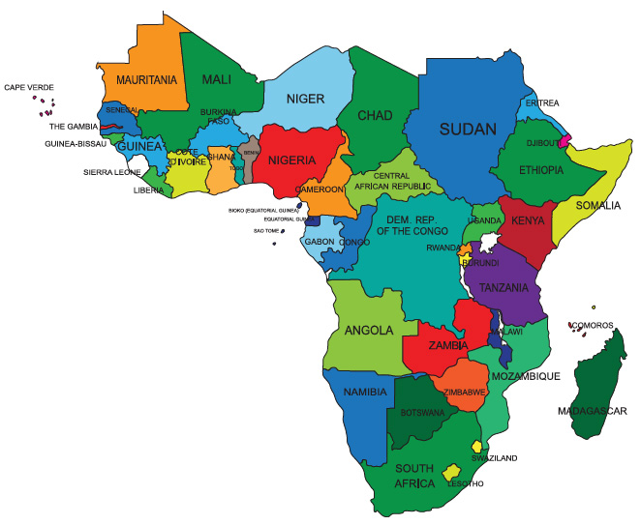
Estimate, up to 80% of infrastructure projects identified never reach financial close due to low technical capabilities and limited financial resources being dedicated to developing feasibility studies and business plans

Slide 17
Challenges
The lack of statistics and data has not allowed to carry out enough research that demonstrate the role played by insurers in infrastructure investments.

Slide 18
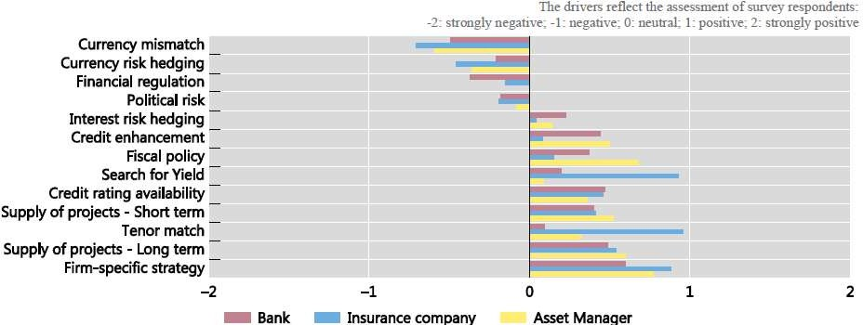

Slide 19
Challenges
Currency mismatch and currency risk hedging are major challenges for insurers to increase their infrastructure exposure, followed by political risk and gaps in regulation.

Slide 20
They are well behind other institutional investors such as sovereign wealth funds (SWFs), public or private pension funds, etc. Research also reveals, insurers target 3 percent of their assets to be allocated to infrastructure, with the 1.5 percent unfilled target translating into around USD490 billion globally.
Insurers’ allocation to infrastructure amounted to 1.5 percent of their total assets in 2021, increasing by
0.5 percentage point from 1.0 percent in 2015.
Although insurers have been increasing their exposure to infrastructure, their asset allocation to the sector appears insignificant compared to their total asset size.

Slide 21
Less utilization of Co-Investment : nearly half of insurers utilize co-investment opportunities offered by infrastructure fund managers. Through co-investments, investors invest on their own account alongside other investors, funds etc., allowing them to collectively bid on larger projects. Preqin’s research demonstrates that 47% of insurers co-invest in infrastructure alongside infrastructure funds, which indicates that they have a certain level of in-house capacity such as credit assessment teams etc. as co-investments require them to assess individual investment opportunities with input provided by fund managers (Figure 7).

Slide 22
Capital market development
There is a need for greater mobilization of developmental capital to the African continent. To fill the gap for infrastructure financing .
We need to tap into resources that are outside the continent and pension funds that have the resources but don’t have the appetite to channel the resources to the continent.

Slide 23
Call to action
Considering African infrastructure investments, many investors expressed concerns about
-weak legal environments,
-political uncertainties, and
-difficulties accessing financial markets.
Source: Mercer, MiDA Advisors, and Standard Bank,(2021)

Slide 24
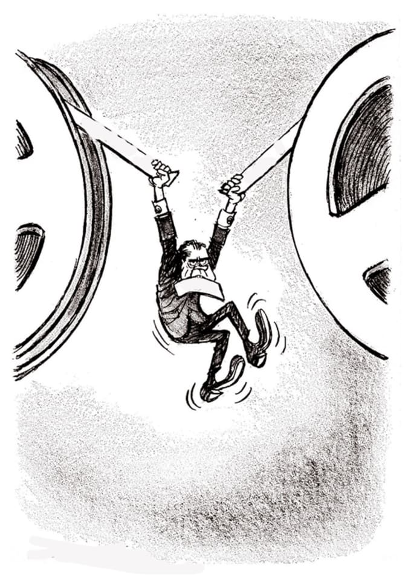
Insurance regulation on infrastructure investments

Slide 25
A limited number of insurance regulators treat infrastructure investments more favorably from other asset classes by applying lower capital charges, while many others still do not.

Slide 26
Restrictions- Insurance regulation in some developing countries does not allow for direct investments in infrastructure, although these restrictions could be lifted under appropriate risk-based supervision in place unless it does harm to the interests of policyholders.
Insurers’ allocation to infrastructure amounted to 1.5 percent of their total assets in 2021, increasing by
0.5 percentage point from 1.0 percent in 2015.
Although insurers have been increasing their exposure to infrastructure, their asset allocation to the sector appears insignificant compared to their total asset size.

Slide 27
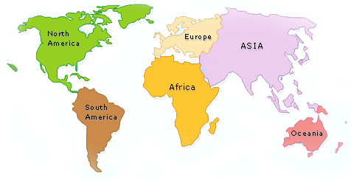
Insurers in Africa can Play a role in bridging the infrastructure shortfall
Insurers also can support economic growth meaningfully
Can also help governments reduce their debt burden

Slide 28
The Road Ahead-Building an Africa fit for the future

Slide 29
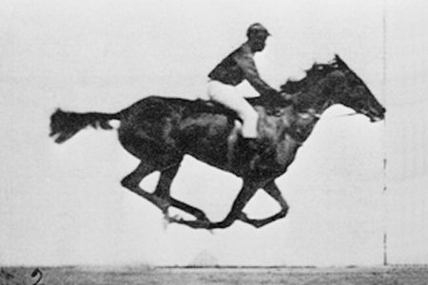
To right the wrong
The African Insurance and reinsurance landscape requires an overhaul and transformation- Closing the infrastructure investment gap
Insurers should be recognized for their role in facilitating the flow of capital and investments into Africa
Creating an ecosystem around infrastructure finance and different types of market players is of high importance- enable the in/reinsurers invest more in to infrastructure

Slide 30
By improving ratings and expanding reinsurance capacity, African insurers can play an even more significant role in mobilizing capital and supporting sustainable development on the continent..
The continent seeks to bridge its infrastructure gap and achieve its development goals, insurers are poised to play an increasingly vital role.
Blended finance —should be a Theme in Africa-by structuring and combining public and private capital in order to facilitate investment

Slide 31
Compiling data
lowering capital charges on infrastructure investments
facilitating credit enhancement for investible infrastructure projects
Lift Restrictions on direct investments to infrastructure
Place appropriate risk-based supervision-Robust legal and regulatory framework
Government and regulators support for infrastructure investments

Slide 32
Creating conducive and enabling legal and regulatory environment -Overhauling the African Regulatory Apparatus and integration across Africa spearheaded by the (AIO) to enable in(re) surers invest in infrastructure

Slide 33
“ድር ቢያብር ኣንበሳ ያስር.”
“When spider webs unite, they can tie up a lion.” – Ethiopian Proverb

Slide 34
FIKRU TSEGAYE W.
(CTP, FLMI,ARA,ACS)
fikru.tsegayee@gmail.com

