Slide 1
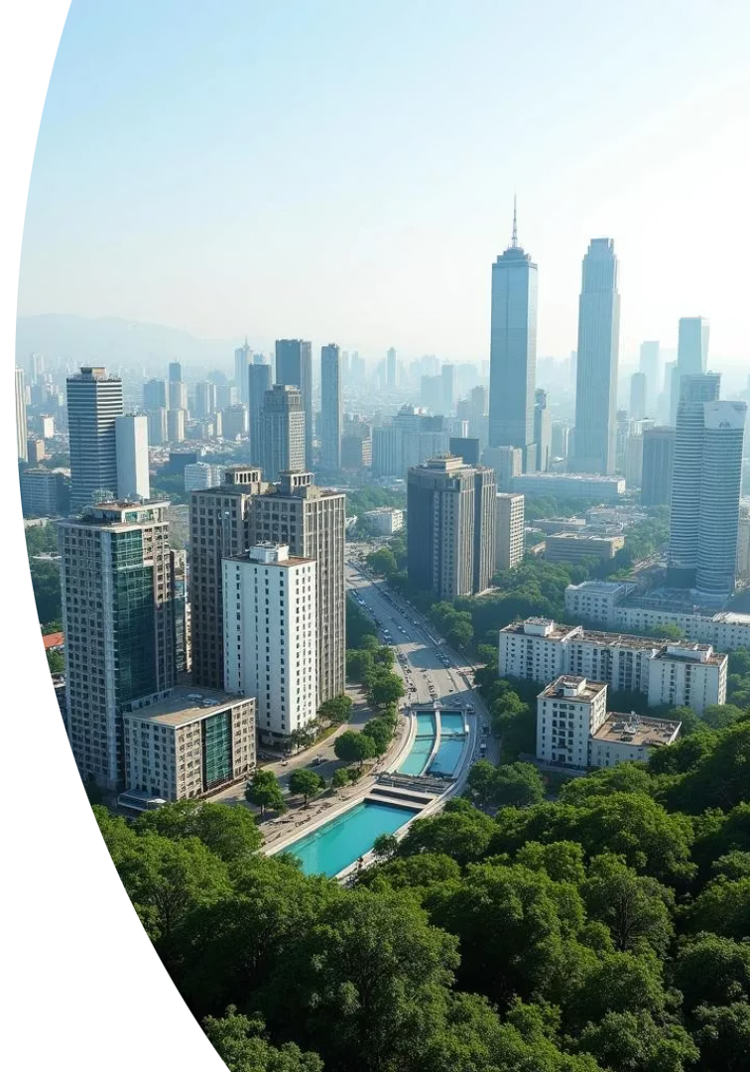
Africa Fit for Future
Africa's insurance industry is not just a protector of assets, but a potential architect of prosperity.
The journey of a thousand miles begins with a single investment... perhaps even in a really long bridge!

Slide 2
Africa's Untapped Potential
2.5B
65%
$3.4T
Population by 2050
World's Arable Land
Potential GWP by 2072
Africa has the world's youngest population with median age 19.
Africa holds significant agricultural potential.
With optimized AfCFTA, growing from current $115B.

Slide 3
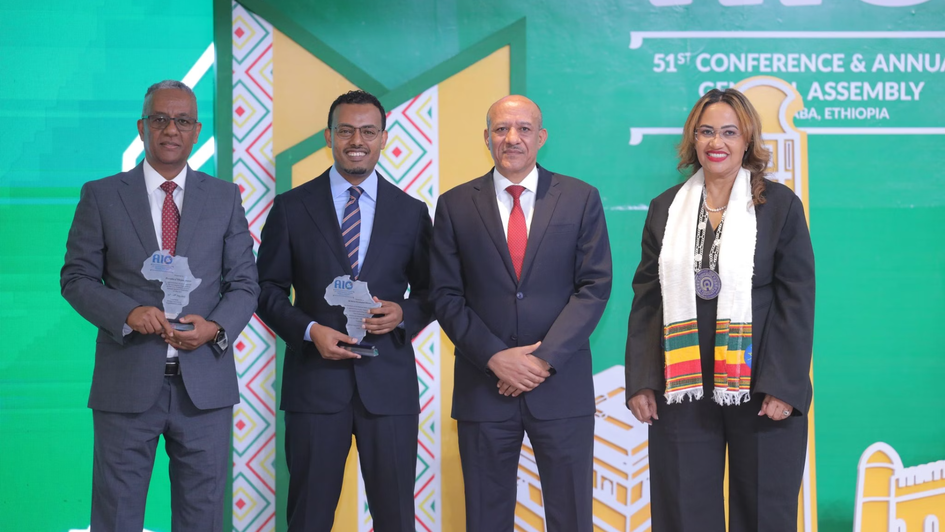
Call to Action
Innovative Financing
Develop insurance-led investment vehicles
Strategic Partnerships
Form coalitions between insurers and developers
Governance Reforms
Combat illicit financial flows ($50-115B annually)
Agenda 2063
Align with "The Africa We Want" vision

Slide 4
Moving Forward Together
Reject Status Quo
Strategic Investment
Continued Dialogue
"We do not want to be a status quo Continent neither a status quo people."
Ensure Africa's books are overflowing with dividends of impactful investments.
Continue this vital conversation beyond this room.

Slide 5
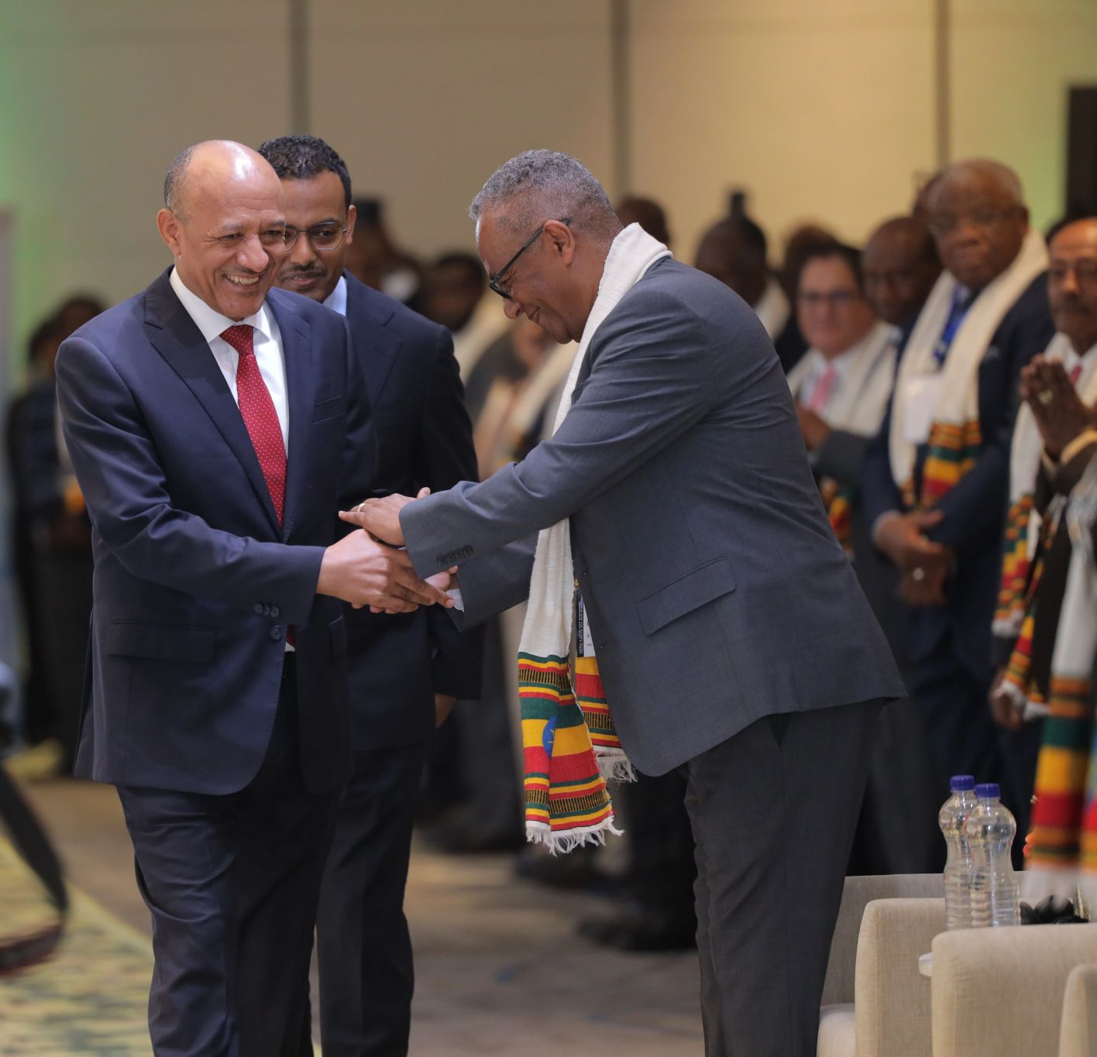
Thank you!!
1
Merci
2
Ahsante Sana
3
Asamegnalehu

