Slide 1
Presentation of the
PAPSS African
Currency Marketplace

Slide 2




1. About PAPSS

Slide 3



PAPSS, the Payment System endorsed by the African Union to support the implementation of the AfCFTA

Slide 4
About PAPSS
PAPSS is a financial market infrastructure for the economic and financial integration of Africa. It is a centralized payment and settlement infrastructure for intra-African trade and commerce.
It is designed to effect payments in local currencies.

Slide 5




Value Proposition
❍ Ownership: from conception to operationalization, PAPSS is a pure African product. For Us By Us, Africans.
❍ Governance: controlled and governed by the African Central Banks.
❍ International Standards: international security standards and technology.
❍ Collaboration: not intended to compete with or cannibalize existing payment systems.
Ownership
Governance
International
Standards
Collaboration

Slide 6
2. Introducing the African Currency Marketplace

Slide 7
The Challenges: Pan African Reinsurance Companies
High Forex Costs
Reinsurance companies incur substantial forex costs to convert local currencies into major reserve currencies (e.g., USD or EUR) to make cross-border payments, especially for claim settlements in different African countries.
Complex Treasury and Liquidity Management
Reinsurance companies need to manage reserves in multiple African currencies creates challenges in ensuring sufficient liquidity for claim payments and operational costs, resulting in inefficient treasury management.
Exposure to Currency Fluctuations
The frequent exchange rate volatility between local currencies and major reserve currencies complicates Reinsurance companies’ budgeting, impacting both pricing strategies for premiums and cash flow planning.
Delayed Claim Settlement:
Forex-related delays in converting funds impact the timeliness of cross-border claims payments, which can affect customer satisfaction and lead to reputational risk.

Slide 8



Problem Statement
Restricted Market Access
Businesses need help to expand trade and operations across African borders due to complex currency exchange hurdles, which discourages trade and investments between markets
Stagnated Market Expansion
Trapped revenues in one market restrict the ability for companies to redirect resources that can be used for investment and expansion in other African markets.
Heightened Risks and Operational costs
Exposure to currency fluctuations and dependencies on hard currency availability results in increased cross-border transaction costs and operational uncertainty.

Slide 9

PAPSS African Currency Marketplace
Introducing
PAPSS African Currency Marketplace
Demand-driven matching and exchange of African currencies

Slide 10

PAPSS Wholesale Currency Exchange
1
1. A dedicated platform
Built specifically for participants to offer and exchange local currencies, eliminating any reliance on hard currencies.
2. Order Book driven
Exchange rates are market-driven while adhering to local regulatory rules, ensuring transparency, efficiency, and competitive pricing.
3. Trusted Counterparties
Transactions are matched between fully-funded and verified buyers and sellers, in adherence to best compliance practices, maximizing efficiency and reducing counterparty risk.
3
2

Slide 11





How it Work: Simple 4 Steps
1
Deposit
2
Offer Creation
3
Offer Matching
4
Withdrawal
A Liquidity Provider (ie: Corporate Treasurer) transfers local currency to the PAPSS marketplace. Liquidity Provider’s marketplace position is updated to reflect funds available for offer creation
Liquidity Provider creates an exchange offer within the marketplace.
Exchange offers between Marketplace participants are matched where proposed rates align.
Liquidity Provider’s marketplace position is updated to reflect the exchange
Liquidity Provider instructs Marketplace to remit exchanged funds to designated beneficiary account.

Slide 12



Use Case
NIGERIA
KENYA
Banks
(Naira)
Banks
(Kenya Shillings)
Collects Naira (NGN)
Bank accounts in Naira in Nigeria
Needs revenue in Kenya (Headquarters)
Deposit
NGN
KES
Deposit
Sells cement in Kenya
Collects Kenya Shillings (KES)
Bank accounts in KES in Kenya
Needs revenue in Nigeria (Headquarters)
Offer
Creation
(exchange rate)
Offer
Creation
(exchange rate)
Offer
Matching
Offer
Matching
Headquarters in Nigeria
Consolidation in Naira (NGN)
Bank accounts in Naira in Nigeria
Headquarters in Kenya
Consolidation in Kenya Shillings (KES)
Bank accounts in KES in Kenya
Withdrawal
NGN
KES
Withdrawal
Banks
(Naira)
Banks
(Kenya Shillings)

Slide 13

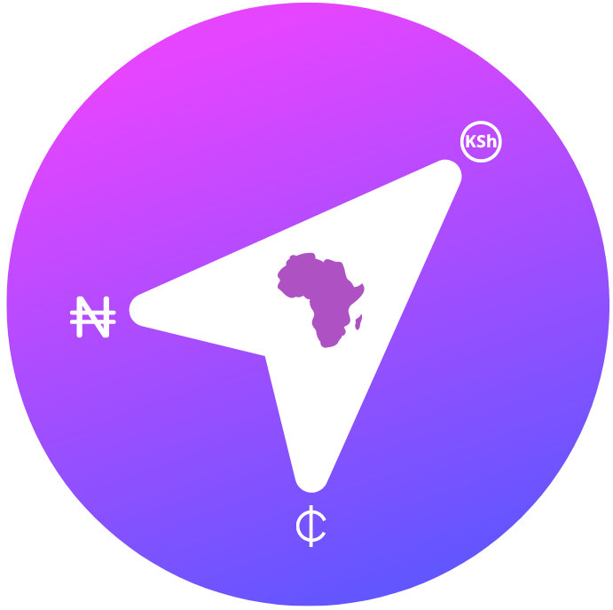



Benefits for Participants
1
2
3
4
5
100% in African currencies
No need for Hard currency
Repatriate blocked funds
Fully transparent & compliant
Automatically select the best offer
More affordable transaction fees

Slide 14



Early adopters of the PAPSS African Currency Marketplace

Slide 15








Recent joiners……

Slide 16




Participation in the Marketplace
Participants
Countries
Liquidity Providers (Corporates)
Commercial Banks
PAPSS
Nigeria, Ghana, Kenya
Egypt, Ethiopia, Uganda, Tanzania, Malawi, Mozambique, Zambia, Zimbabwe, Burundi, Rwanda, South Africa, WAEMU (XOF) and CEMAC (XAF)
Maximum transaction Value
Schedule
No transaction limit
Present

Slide 17
Eligibility Criteria for Participating in Marketplace
Corporate Users
Transacting
Partner Agents
Referral Partner Agents
Corporates with footprints across different African countries
Corporate/Treasury Experience
Identifying, recruiting, and referring both Corporate Users and Transacting Partner Agents to the PAPSS African Currency Marketplace.
Corporates with footprints across different African countries
Corporates with need to repatriate money to their Headquarters
Financial Institutions Experience
Corporates with need to expansion to another African markets
Must be able to provide local currency on demand in every country they want to participate in
Corporates like airlines, manufacturing companies, Insurance companies, International Aid organizations, etc.
Must have an established and registered business in at least 1 market across Africa

Slide 18
How to Participate in the Marketplace?
Membership
Complete KYC requirements
Sign membership agreement
Access
Fill and sign the application form
Creation of profiles/users
Training
Virtual and hand-son training
Setting up local currency accounts on the marketplace
Granting access to users

Slide 19
Interested in participating in the Marketplace?
Contact Us! marketplace@papss.com papss.com

