Slide 1
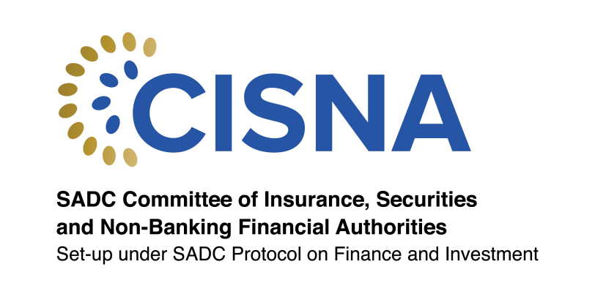
28th African Reinsurance Forum- Regulatory Developments to date
12 OCTOBER 2024
KENNETH S. MATOMOLA, CISNA CHAIRPERSON

Slide 2
OUTLINE
About CISNA
CISNA Strategic Plan 2022-2026
Harmonization
Insurance Model Law
Re-Insurance – Survey
Conclusion

Slide 3
ABOUT CISNA

Slide 4
ABOUT CISNA
A substructure of the Southern African Development Community (SADC)
Established in 1998 in terms of Article 2 of Annex 10 of the SADC Protocol on Finance and Investment (FIP).
A committee of Authorities responsible for the regulation and supervision of NBFIs in SADC Member States. The current Membership is 27 Member Authorities from 14 Member States.

Slide 5
VISION AND MISSION
VISION
A financially stable region with a harmonised regulatory and supervisory framework for NBFIs.
MISSION
To promote financial stability by effectively and efficiently championing a process of collaboration, engagement and coordination between the NBFI regulators and stakeholders through policy research, capacity building and market development initiatives.

Slide 6
OBJECTS
To promote harmonisation of regulatory and supervisory regimes
To promote development of financial products and services
To promote access to financial products & services by majority of population of MS
To encourage cross-border cooperation, exchange of info & experience sharing among regulatory authorities
To promote sound corporate governance of NBFIs
To promote relationship with international bodies and compliance with international standards
To enhance capacity building, through training and education of regulatory authorities staff
To promote AML/CFT/CFP supervision of financial institutions in compliance with international standards
To promote consumer financial education and protection

Slide 7
STRATEGIC PLAN 2022-2026

Slide 8
STRATEGIC PLAN 2022-2026
The CISNA Strategic Plan 2022-26 was adopted during the 45th CISNA Meeting in May 2022 and approved by the SADC Committee of Ministers of Finance and Investment in July 2022.
Strategic Themes and Objectives
Harmonization of the Legal and Regulatory Framework
Capacity Building
Market Development
Internal
Institutional
Professional
Domestication
Expansion
Adherence to International Standards
Response to International Trends

Slide 9
HARMONISATION

Slide 10
HARMONIZATION MANDATE
In SADC, there exists diversity between regulatory frameworks for NBFIs which are at different stages and levels of development. Based on the variations in the regulatory frameworks of the Authorities, Article 6 of Annex 10 of the FIP provides for the Authorities to comply with international standards including IAIS, IOPS and IOSCO.
Article 9 of Annex 10 to the FIP provides for the Authorities to work towards the harmonisation of their respective laws and regulatory policy frameworks with the aim of preventing or reducing regulatory arbitrage.
CISNA may determine principles, standards and guidance for the regulation and supervision of NBFIs in order to promote a harmonised financial regulatory and supervisory regime that are aligned to the principles, standards and guidance of the international bodies referred above.

Slide 11
HARMONISATION INSTRUMENTS / TOOLS
Model Laws
Minimum requirements
3 approved -2019
8 approved -2024
Regional Guidelines
NBFI Risk Based (AML/CFT)
Assessment of Compliance with International Standards
Assessment of compliance for IAIS ICP 9 and 10
Agricultural Derivatives Exchange
Green Finance & Carbon Trading
Cooperatives Guidelines
Feasibility for regional certification
Fintech Development
IOSCO Questionnaire Theme 1 Assessment
Assessment with IOPS Principles

Slide 12
APPROVED CISNA MODEL LAWS
Capital Markets
Collective Investment Schemes
Insurance & Pensions
Insurance
Pensions Regulatory Requirements
Microfinance and Financial Co-operatives
Minimum Regulatory Requirements for the Establishment and Operation of A Central Securities Depository
Small and Medium Enterprises Listing Requirements
Debt Listing Requirements
All
Financial Intermediaries
Microfinance Institutions
Microlending Institutions
Co-operative Financial Institutions
Medical Aid Societies

Slide 13
INSURANCE MODEL LAW

Slide 14
INSURANCE MODEL LAW
A Model Law to provide for the harmonisation of licensing, regulation and supervision of persons carrying on insurance business in Southern Africa Development Community Member States; and to provide for matters connected with or incidental to the foregoing.
Application of the Model Law
Southern African Development Community Member States are required to benchmark their domestic laws governing the regulation and supervision of persons carrying on insurance business to meet the minimum requirements as set out in this Model Law.

Slide 15
INSURANCE MODEL LAW - APPROVAL
The Insurance Model Laws were opened for consultation in September 2022.
Consultation included input from Member Authorities on a prescribed template and discussions during an online consultation session.
A validation workshop was done for CISNA Member Authorities in August 2023.
Further consultation was done with other national stakeholders as of June 2024 through the SADC National Focal Points.
The Insurance Model Law was approved in August 2024 by the SADC Committee of Ministers of Finance and Investment.

Slide 16
RE-INSURANCE

Slide 17
RE-INSURANCE
CISNA has launched a survey on “Ceding Reinsurance Funds” to explore and enhance reinsurance ceding practices within the SADC region
The main objectives of the initiative include the following:
Review current reinsurance ceding practices by compiling and analysing the current list of commitments on reinsurance across SADC Member States, assessing the impact on regional savings and economic development.
Benchmark against global best practices lessons from other parts of the world, identifying strategies that have successfully contributed to the retention and growth of insurance funds.
Propose a strategic framework by developing actionable recommendations for enhancing the ceding of reinsurance funds to local and regional reinsurance companies, aiming to support the expansion of the regional savings pool.
The target date for completion is January 2025

Slide 18
CONCLUSION

Slide 19
CONCLUSION
SADC Protocol on Finance and Investment
Requirement to be a member of Standard-setting bodies (IAIS, IOPS, IOSCO) and adhere to the Core Principles
Tools (August 2024)
Model Laws (including Insurance model law) approved by SADC for implementation by Member States
Implementation (as from 2025)
Monitoring through an Implementation Matrix, that is being developed currently

Slide 20
THANK YOU

