Slide 1
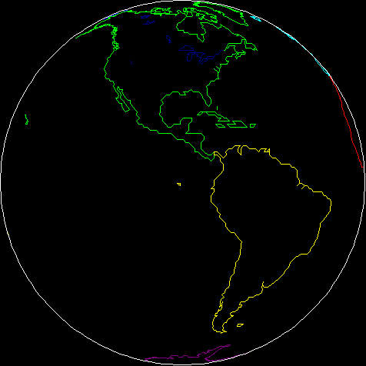
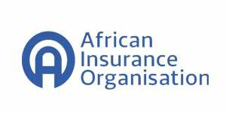
REGULATORY DEVELOPMENTS TODATE
FIKRU TSEGAYE W.

Slide 2
Brief Profile : Fikru Tsegaye wordofa
Fikru Tsegaye Wordofa (Author)
(CTP, ARA, ACS, FLMI, ALMI, Exec-IB&F, Cert- CII, MBA, MA (J&C), MA (HROD), MBA (IB&F), BA, BSC)
20+years of experience: Executive Officer (EO) Strategy &BD, Company secretary-Ethio-Re
Winner of AIO Book Award-2023 (Algeirs)

Slide 3
Outline
Regulatory Prospects and challenges
The road ahead
Characterizing the African Market

Slide 4
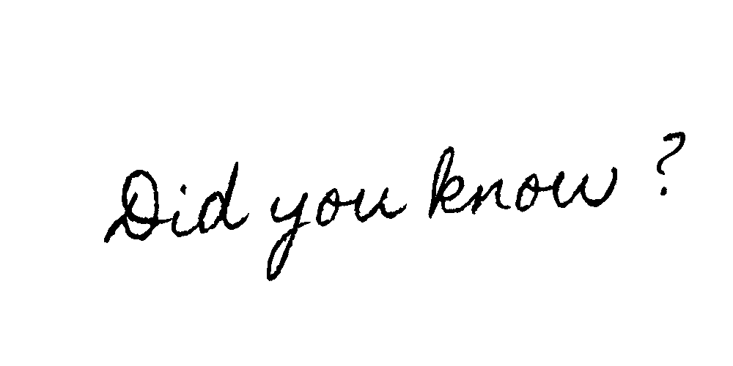
Insurance accounts 1.4% of the USD 7.1 trillion GWP and 2% of Reinsurance GWP in 2023.
Despite having close to 16% of the global population, (1.5 billion Pop) the current insurance penetration in Africa is between 2.8%- 3.5%.“
Swiss Re: Sigma: 2023

Slide 5
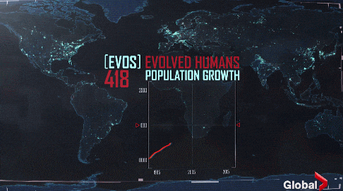
1.55 Billion: 2024
1.7 Billion: 2030
2.5 Billion: 2050
Africa is the world’s second largest and second most populous continent , ranked next to Asia
$3.1 trillion GDP. n recent years, Africa’s average annual GDP growth has consistently outpaced the global average. average growth projected to stabilize at 4.0 percent in 2024–25, (AfdB,IMF,2024)

Slide 6
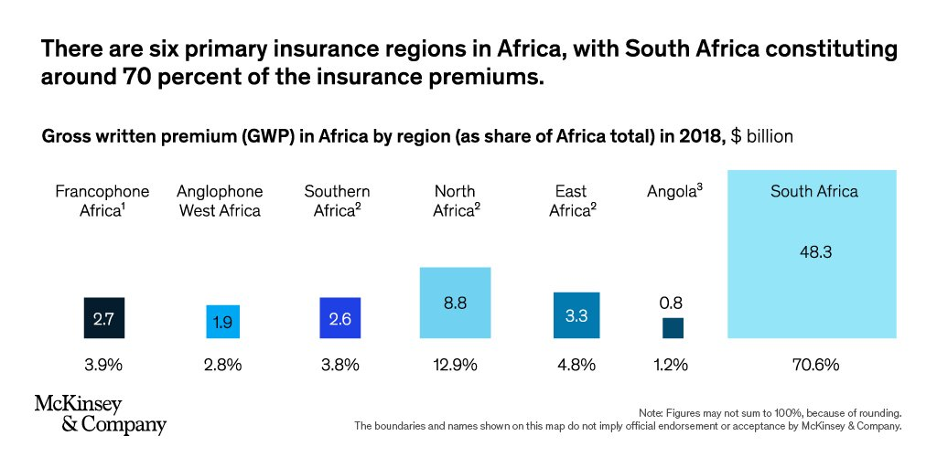
91% of insurance premiums are housed in just 10 countries, the largest of which, South Africa, holds 70 percent of the market’s premiums

Slide 7
Impact of market concentration
□High market concentration indicates a lack of competition In Africa's I n(RE)surance industry.
□The industry has various protectionist measures /
Individual countries have domestication policies not to permit free competition and as a result Regional or domestic parastatals maintain strong control.

Slide 8
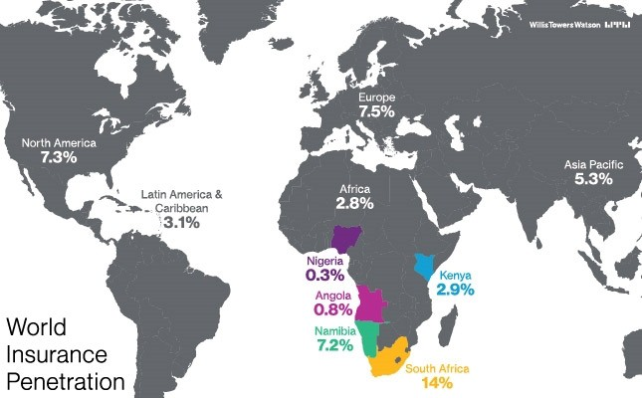
Insurance penetration (premium as percentage of GDP)
Accessed from Willis towers Watson, 2022

Slide 9
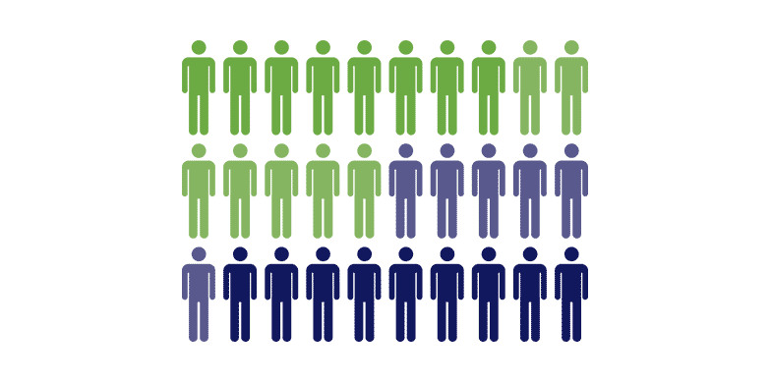
African insurance density:
Country | Density 2021 |  |  | Density 2020 |  |  | 2020-2021 evolution
 | Life | Non life | Total | Life | Non life | Total | Life | Non life | Total
South Africa | 698 | 154 | 852 | 560 | 124 | 684 | 24.64% | 24.19% | 24.56%
Namibia | 241 | 94 | 335 | - | - | - | - | - | -
Morocco | 66 | 77 | 143 | 61 | 77 | 138 | 8.20% | 0.00% | 3.62%
Tunisia | 20 | 63 | 83 | 18 | 58 | 76 | 11.11% | 8.62% | 9.21%
Kenya | 20 | 24 | 44 | 18 | 23 | 41 | 11.11% | 4.35% | 7.32%
Côte d'Ivoire | 13 | 18 | 31 | 11 | 15 | 26 | 18.18% | 20.00% | 19.23%
Egypt | 12 | 15 | 27 | 11 | 13 | 24 | 9.09% | 15.38% | 12.50%
Ghana | 13 | 13 | 26 | 12 | 13 | 25 | 8.33% | 0.00% | 4.00%
Algeria | 2 | 22 | 24 | 2 | 22 | 24 | 0.00% | 0.00% | 0.00%
Nigeria | 4 | 3 | 7 | 3 | 3 | 6 | 33.33% | 0.00% | 16.67%
Africa average | 38 | 17 | 55 | 31 | 14 | 45 | 22.58% | 21.43% | 22.22%
Insurance density (the ratio of premiums to population (per capita premium).

Slide 10
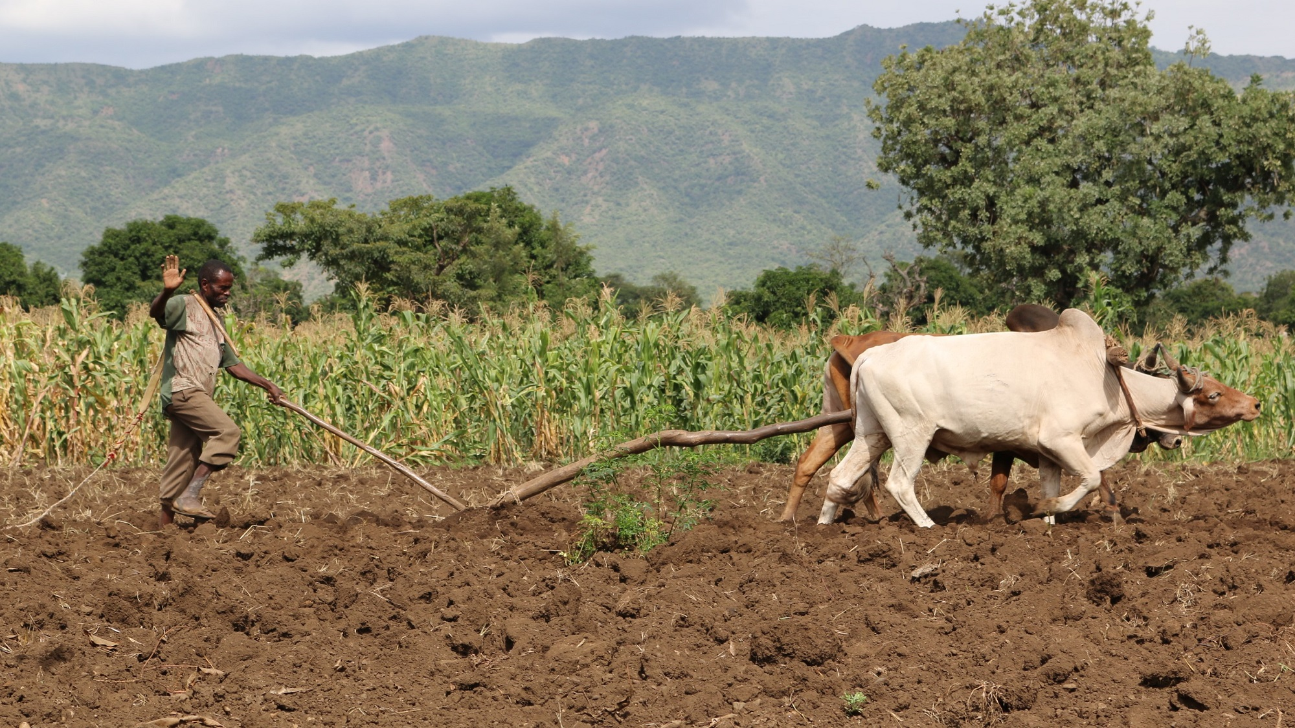
Absence of Insurance products/channels
Agriculture employs more than half of Africa’s workforce, and smallholder farmers constitute 60% of the population in low-income African countries
Agricultural insurance
Micro insurance
Insuretchs are still nascent
AFDB, 2024

Slide 11
TAKAFUL IN SURANCE
The long journey towards Islamic financial services
Islam is the second most widely professed faith and with an estimated total population of around 437 million. The Muslim population in sub-Saharan Africa is forecast to more than double by 2050

Slide 12
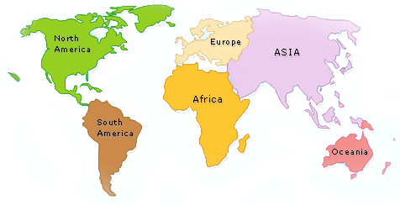
Low penetration rates persist
The market is dominated by non-life insurance and life insurance is growing off a low base
Compulsory insurance remains a key driver of uptake
Insurtech sectors are still nascent and have a B2B focus
Fragmented regulation and domestication
Africa
Northernmost point —Tunisia
Southernmost point —South Africa
Westernmost point —Senegal
Easternmost point —Somalia

Slide 13
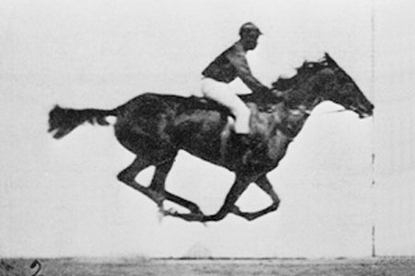
Insurance Regulators as Market Developers
The long-standing debate within the insurance regulatory world has been “to what extent should regulators be responsible for market development, closing protection gaps and increasing insurance penetrations rates.”
The other question “Why there is uneven distribution of insurance services across Africa?”
To what extent the African regulatory regimes are harmonized?

Slide 14
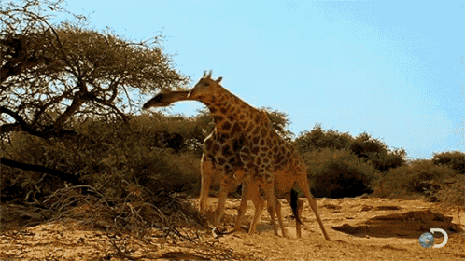
The regulatory framework of the insurance sector in Africa is comprised of the laws, regulations, prudential guidelines, case laws, principles of insurance, and market norms accepted by insurers.

Slide 15
So we need a new wave of insurance reforms that can solve these problems and bring structural transformation.
One key aspect, among others, is Harmonization of the African (re)Insurance Regulation for a Sustainable Future
Although the theory of regulation ranges from strict to liberal approaches.-Insurance is a highly Regulated venture

Slide 16
1. The regulatory frameworks across the continent are evolving to ensure governance, compliance and supervision in the sector with varying levels of maturity;
2. When we seethe regulatory supervisory mechanisms in place across Africa, some have an independent insurance regularly and development authority while others incorporate it under state banks, ministry of trade or industry or sometimes under ministry of tourism..

Slide 17
Regulation's are essential to protect consumers and investor’s rights (Investor Confidence) (UNCTAD 2019)
Creating robust competitive environment (among the private and public sectors)
Innovation and R&D,
Entry of market Players and ensure market stability(OECD 2020)
Ensuring property rights, Ensure contracts, and bring sustainable growth (World Bank 2020)
the African Continental Free Trade Area Agreement (AFCFTA) to boost intra-African Trade and bring radical economic development among member states through creating a liberalized single continental market facilitated by the movement of natural persons and capital mainly for the free flow of trade in Goods and trade in Services by dismantling tariff and non-tariff barriers of trade
For the African insurance industry to proper, We need to create enabling regulatory environment and work towards regional and continental integration.

Slide 18
The Approach used so far to create harmonized insurance regulation:
Continental Harmonization and integration
Regional
Country
There is a need to Harness regional integration before The vision at the continental level is to achieve an African Economic Community by the end of six successive stages. The rationale behind the six-phased approach is that the integration vision should first consolidate at the regional level, through creating and strengthening the regional economic communities, which would eventually merge into the African Economic Community.

Slide 19
Phases | Duration | Key milestones
First stage | 1994–1999 | Strengthening of existing regional economic communities; establishing new regional economic communities in regions where they did not exist previously
Second stage | 1999–2007 | Stabilization of tariff and non-tariff barriers, customs duties and internal taxes in each regional economic community/Schedules for the removal of such barriers/Harmonization of customs duties/Strengthening of sector integration/Coordination and harmonization of the activities of regional economic communities
Third stage | 2007–2017 | Establishment of a free trade area and customs union in each regional economic community
Fourth stage | 2017–2019 | Coordination and harmonization of tariffs and non-tariff systems among regional economic communities, leading to a continental customs union
Fifth stage | 2019–2023 | Common sector policies/Harmonization of monetary, financial and fiscal policies/Free movement of persons and rights of residence and establishment
Sixth stage | 2023–2028 | African Common Market/Pan-African Economic and Monetary Union/African Central Bank/Pan-African Parliament/Development of African multinational enterprises
Key Pillars of Africa’s Regional Integration: Six key milestones

Slide 20
8 regional economic communities recognized as the building blocks of the African Union.
Arab Maghreb Union
Community of Sahel-Saharan States
Common Market for Eastern and Southern Africa
East African Community
Economic Community of Central African States
Economic Community of West African States
Intergovernmental Authority on Development
Southern African Development Community
Source: ECA adaption of the Treaty Establishing the African Economic Community

Slide 21
Observatory on Regional Integration in Africa has identified five key pillars derived from treaties and protocols of the African Union and the regional economic communities:
1. Trade and market integration
2. Macroeconomic policy convergence
3. Free movement of persons
4. Peace, security, stability and governance
5. Harmonization of sectoral policies
Source: ECA adaption of the Treaty Establishing the African Economic Community

Slide 22
What we’re witnessing:
Licensing requirements
Solvency standards
Liquidation/rehabilitiation provisions
Rating (pricing) restrictions
Trade practice requirements
Subsidy programs
Taxation
Resource challenges: Financial and technical support for the AfCFTA is from external partners.

Slide 23
The Insurance regulatory environment in Africa is complex due to complex economic, social and political reality
How can we achieve the desired Regulatory harmonization (Integration) in the African In(Re) surance Industry?

Slide 24
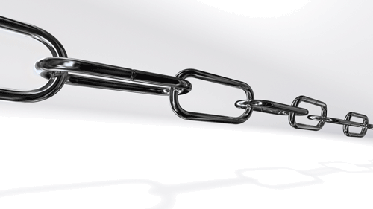
Key Regulatory challenges: Breaking the regulatory burden before it breaks the industry

Slide 25
Frequent Changes
Increase compliance costs for doing business
Creates uncertainty /unpredictable business environment
Mainly- Driven by Political will
Fragmented across countries and regions
An uneven distribution of costs and benefits.
-Each country having its own set of regulations .Is Insurance that much different?
Source: World bank and Deloitte: (2020)
1. Varying Regulatory Framework
Source: (UNECA: 20219/20)

Slide 26
Clashes between continental aspirations and national priorities.
Differences in standards, Rating requirements, , Regional disparities, Barriers to trade and investment, and enforcement mechanisms can complicating- cross-border business
Difficulties in forming and sustaining viable strategic partnerships(are several examples of alternative distribution partnerships across the continent)
Limited/no Regional integration
Efforts to promote regional integration African Continental Free Trade Area (AfcFTA) are hampered by disparities
East Africa –20 counties make up EA (UN)
Over 18 countries and two dependencies – Each having its own insurance Regulation
2. Absence of Regulatory Harmonization
Source: (UNECA: 20219/20)

Slide 27
Stringent and outdated policies and regulations –hampering innovation and growth
Regulation should adopt to the changing business environment (VUCA) world
Absence of stable and inclusive business environment
R&D and innovation has not been a priority and innovative ideas struggle to attract sufficient investment
Absence of Regulatory sandboxes and the existing ones do not yet gaining traction.
3.Inhibitied Growth and Innovation
Source: (GSMA and IMF: (2020)

Slide 28
Challenges in competition polices
Varied licensing and enforcement standards
Weak compliance to International standards
Insurance Core Principles (referred to as ICPs) that were issued by the International Association of Insurance Supervisors (referred to as IAIS).
Weak infrastructure such as technology, digital services, and manpower
Risks of non- compliance
Source: World bank and Deloitte (2020)
4. Absence of standards and infrastructure

Slide 29
Lengthy and complex approval process
Unpredictable political and economic environment
High risks to commit resources by investors
Protectionist policies (high tariffs, restrictive licensing/entry requirements, etc)
Domestication ( such as compulsory cessions)
Resulting: Risks of attracting and retaining investors
Source: (IMF , OECD and Transparency International (2020)
5. Barriers to entry and reduced investor confidence

Slide 30
Inadequate enforcement
Regulatory bodies lack of capacity, willingness and resources such as skilled manpower and technology to work properly
Leading to wide non-compliance , favoritism and regulatory evasion
In most cases countries yet have a comprehensive and outcomes-based innovation monitoring plan
Judicial inefficiencies( Lengthy court proceedings, limited access to justice, and high cost of justice to solve disputes)
companies face challenges to enforce contracts
6. Weak Enforcement Mechanisms
Source: World bank (2020) and UNCTAD (2019)

Slide 31
STRUCTURAL PROBLEMS
Structural Solutions
Overhauling the African Regulatory Apparatus
Much work remains to reach this goal and with this work comes much opportunity to create a safe and robust insurance sector for the people of Africa.

Slide 32
The road ahead strategies to navigate through regulatory challenges and stay ahead of the curve

Slide 33
The challenges require strategic ,proactive, fast responses and innovative solutions from all stakeholders to mitigate risks and capitalize on missed opportunities
Establish a dedicated organ- with clear policy, strategy and capacity: entrenching effective coordination and ensure accountability – harmonization at regional and continental level
Leverage broader government coordination structures to address structural constraints affecting the insurance market.
the set-up of a cross-regulatory forum, or inserting the issue of Regulatory harmonization as agenda point in existing forums.
Invest in technology (Reg-Tech) Solutions , Regulatory sandboxes, and Building the capacity of regulators: Knowledge transfer/experience sharing across regions and countries

Slide 34
Forming public private partnerships and dialogues among them to overcome the challenges, and promote regulatory transformation- engage in policy advocacy programs to create harmonization
How many of the countries truly understand the benefits of continental and regional integration?
Adopting international standards –improves consistency and predictability
Building the institutional capacities of African regulatory authorities

Slide 35
Integration of the Africa’s Insurance regulatory framework is no longer a matter of choice
The small African Insurance market with fragmented, regulatory set up across Africa make a compelling case for the regulations to integrate regionally to, reap efficiency gains, exploit economies of scale, and reduce the thickness of borders;

Slide 36
Governments and African insurance regulators need to properly understand the Importance of regional and continental integration for Africa’s development and roll up their sleeves to implement the same

Slide 37
“ድር ቢያብር ኣንበሳ ያስር.”
“When spider webs unite, they can tie up a lion.” – Ethiopian Proverb

Slide 38
FIKRU TSEGAYE W.
(CTP, FLMI,ARA,ACS)
fikru.tsegayee@gmail.com

