Slide 1

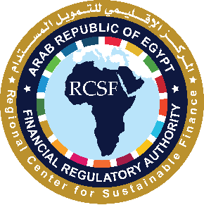
Voluntary Carbon Market:
FRA Strategic Approach

Slide 2

Introduction
Impact of Climate Change
What is Voluntary Carbon Market?
Why Voluntary Carbon Market?
How Voluntary Carbon Markets Work?
FRA Strategic Approach
Insurance and VCM
2

Slide 3

Introduction
Africa represents only 3.8% Global Emissions
The climate finance gap in developing countries is significant and growing, especially as these nations face increased vulnerability to climate change impacts. According to estimates, developing countries will require approximately $2 trillion per year in additional climate finance by 2030 to meet decarbonization and adaptation goals aligned with the Paris Agreement.
Africa, one of the most vulnerable regions, requires $2.4 trillion by 2030 to meet its climate needs, but only 12% of this funding has been met so far.
12%
5 %
Moroco
Algeria
16%
Egypt
Nigeria
9 %
34%
South Africa
Source: Greenhouse gas emissions data, World Bank Group
3

Slide 4
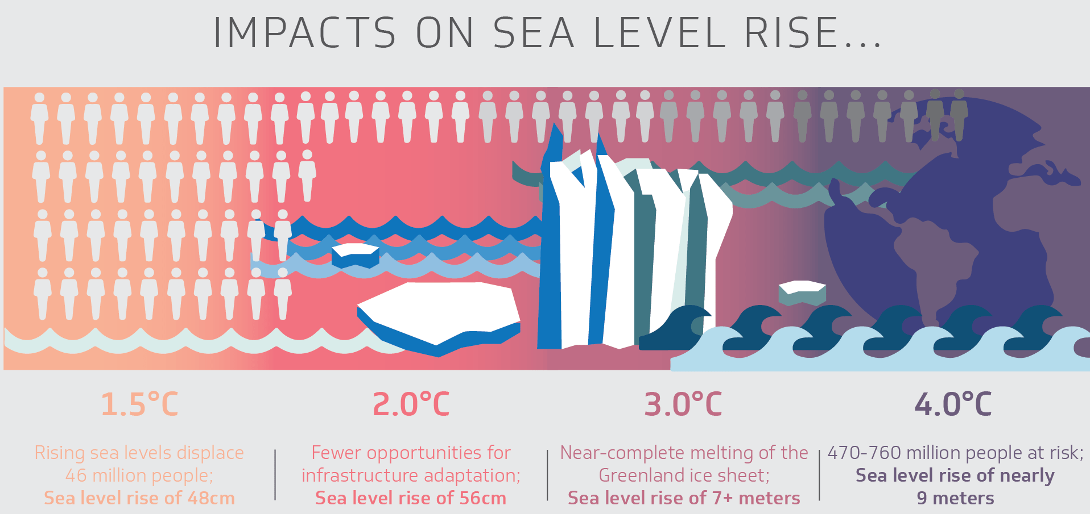
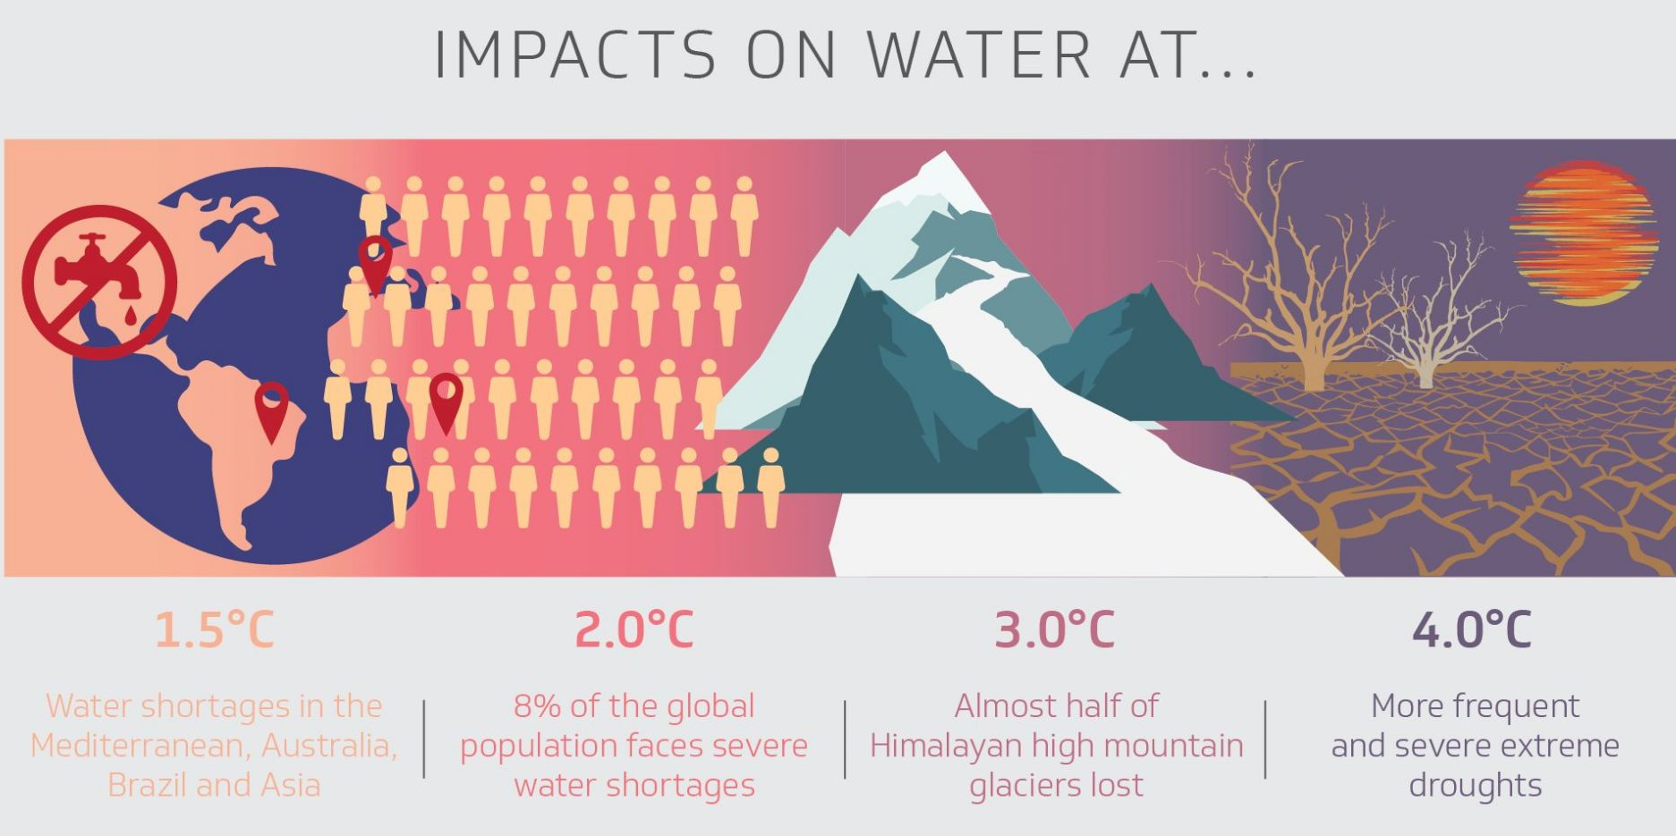
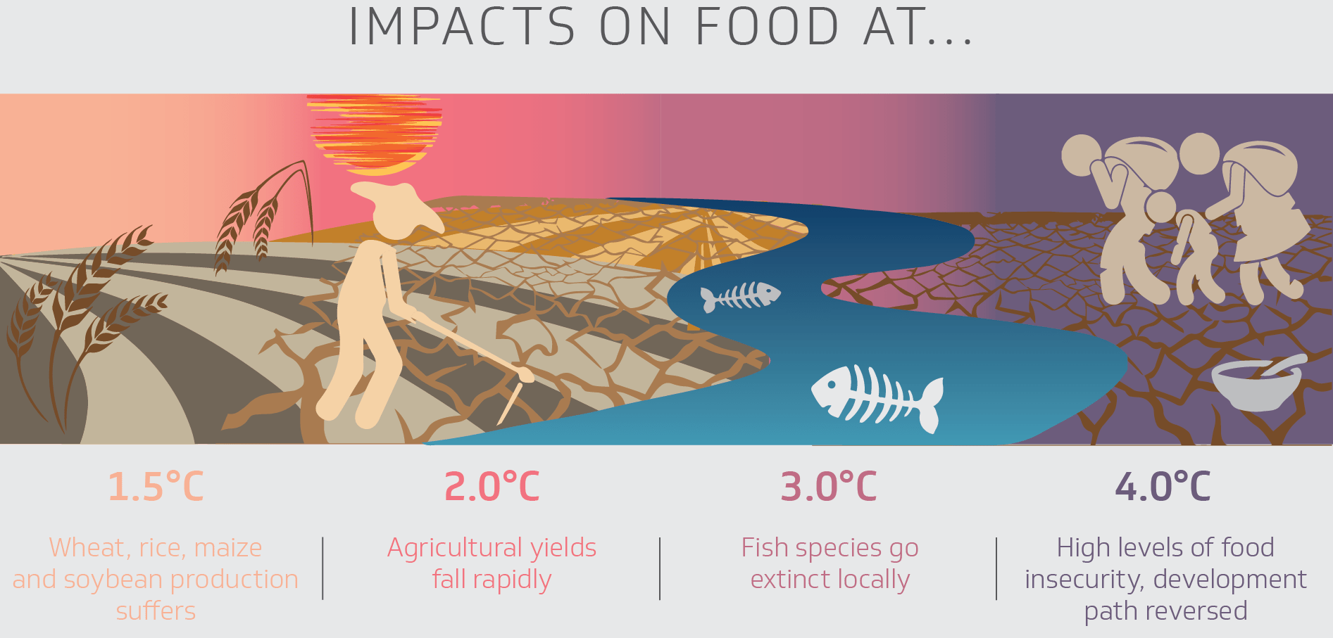
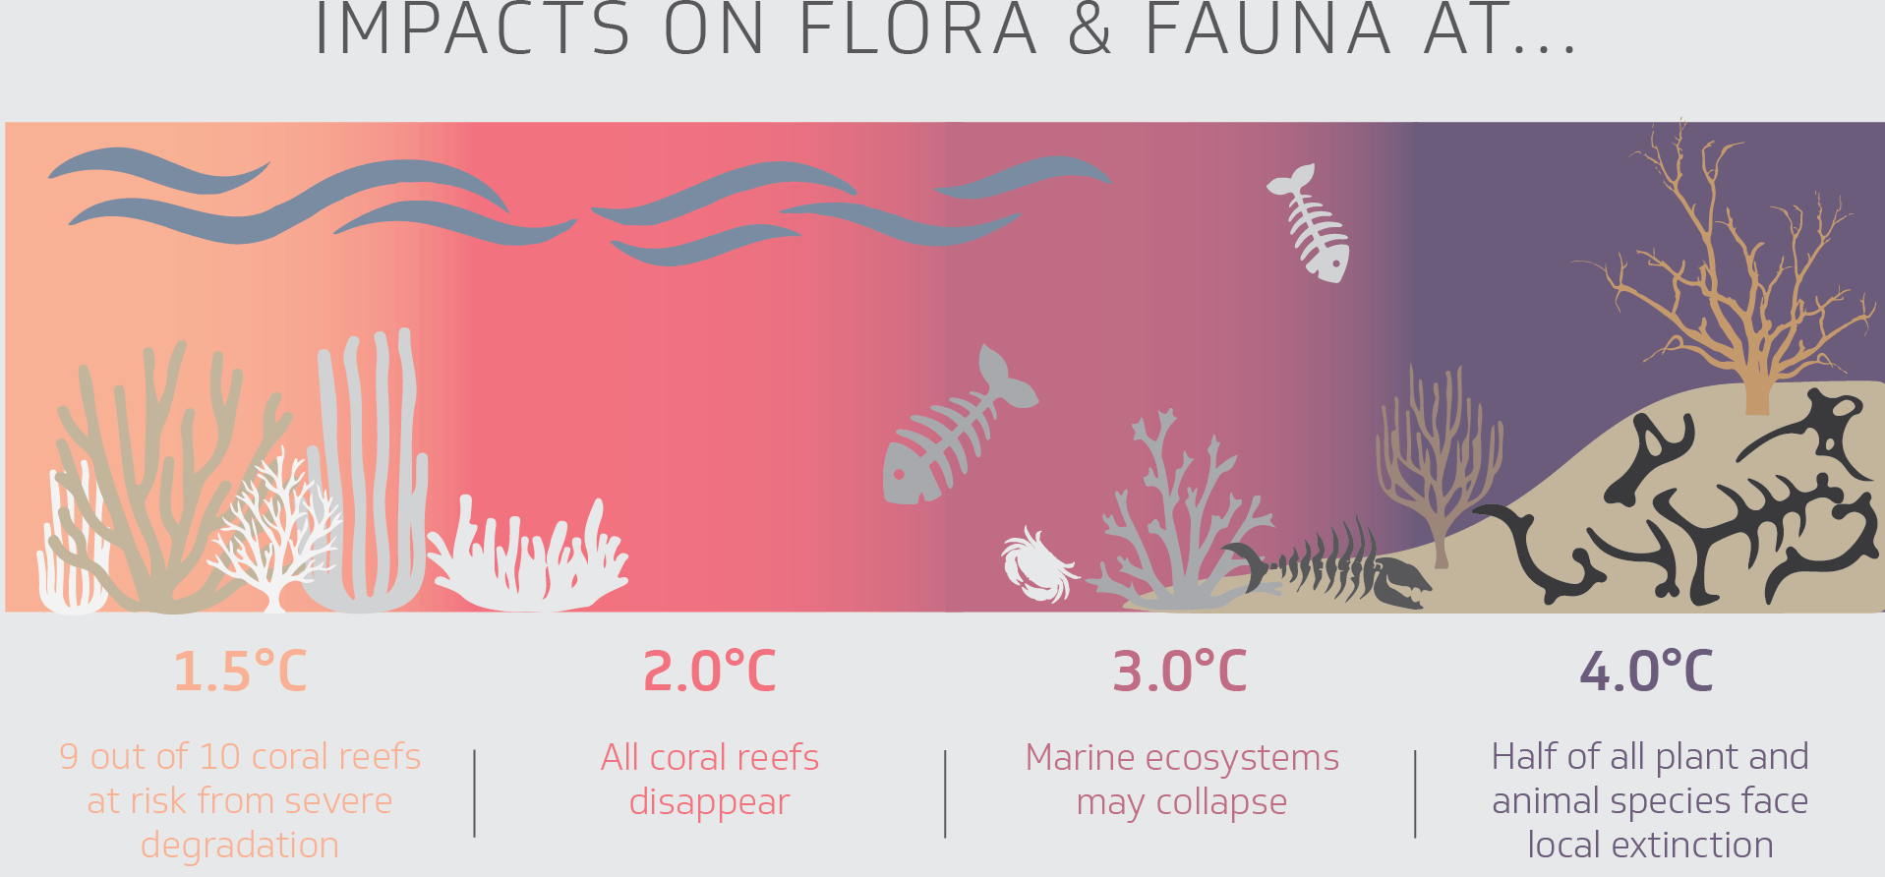
Impact of the Climate Change
4
Notes:
"This slide starkly illustrates why we need to act urgently on climate change. As global temperatures rise, the consequences become increasingly severe across all aspects of our planet."
Breakdown by Sector:
Sea Level Rise: "Even with a 1.5°C increase, we'll see significant sea-level rise, displacing millions. At 4°C, the impact is catastrophic, with coastal cities and entire island nations at risk."
Water: "Water scarcity will become a major global crisis. Droughts will intensify, glaciers will disappear, and conflicts over water resources could become more frequent."
Food: "Food security is threatened by declining crop yields and the collapse of local food systems. At higher temperature increases, widespread food insecurity and famine become a real possibility."
Flora & Fauna: "Biodiversity loss is already a major concern, but with rising temperatures, we face mass extinctions and the collapse of entire ecosystems."
Connecting to Carbon Markets:
"These dire predictions underscore the urgent need to reduce greenhouse gas emissions. Carbon markets are a key tool in this fight. By putting a price on carbon, we can incentivize businesses and industries to reduce their emissions and invest in cleaner technologies."
Transition to Next Slide:
"Now, let's explore how carbon markets function and their potential to drive the transition to a low-carbon economy..."

Slide 5
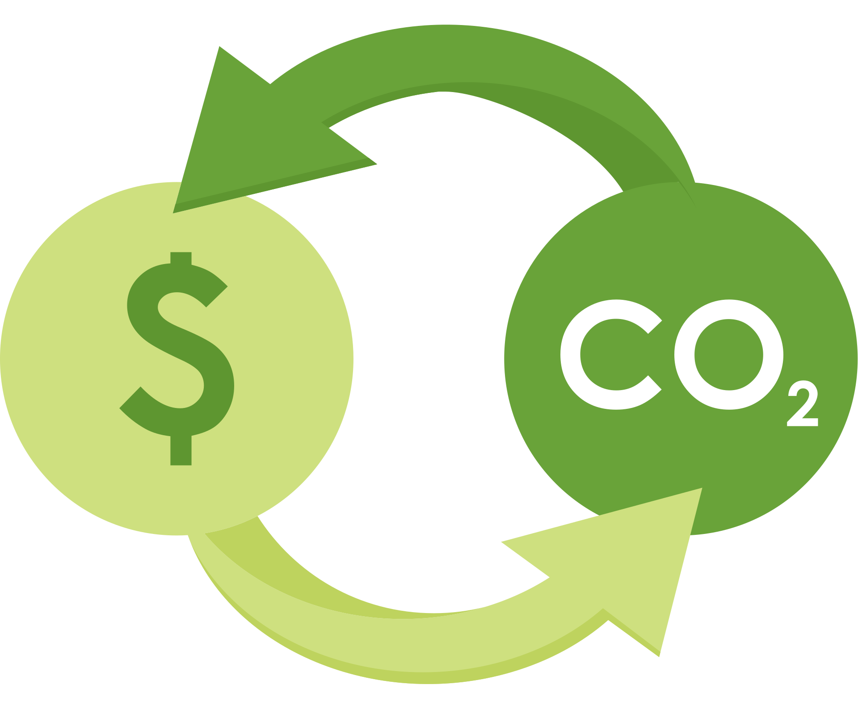
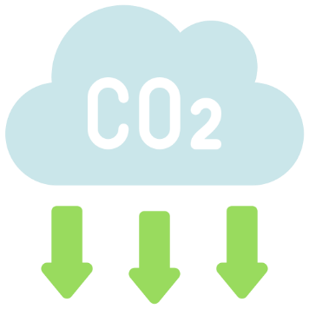
What is Voluntary Carbon Market (VCM)?
The VCM is a platform where private entities, corporations, and other actors voluntarily buy and sell carbon credits to offset their carbon emissions.
  What is a Carbon Credit?
According to the UNFCCC, a carbon credit, also termed as an “offset,”
One carbon credit equals one metric ton of carbon dioxide equivalent (CO2e), reduced, avoided, removed, or captured from the atmosphere, and can be used to offset the carbon footprint of a business, organization, or individual.
5

Slide 6




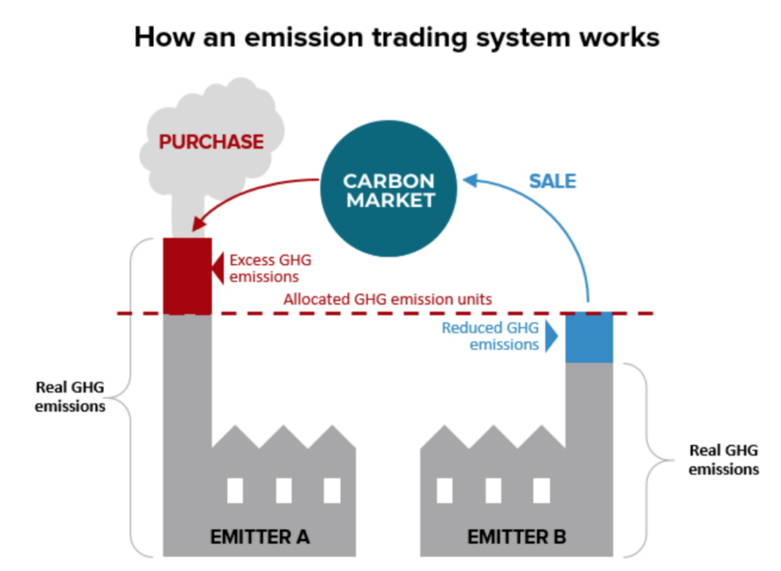



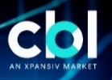



Voluntary Markets Vs Compliance Markets
Compliance Carbon Market
Voluntary Carbon Markets
Driven by binding emission reduction targets (e.g. ETS) or other types of regulation
Corporates or individuals who wish to offset their emissions
(“voluntary offsetting”)
Definition
Definition
Kyoto Protocol,
Emissions trading systems
Carbon Markets Segments
Ex. Corporates, Individuals
Examples
Examples
EU ETS (EU Emission Trading System)
Existing
Existing
The California Global Warming Solutions Act (USA)
6

Slide 7










Why Voluntary Carbon Markets?
Regulated
A regulated market increases the transparency
and integrity with ensuring a real impact.
6. Access to Regions More Vulnerable to Climate Change
A gate to the African and local projects.
2. Price Discovery
Ability to view current supply of cost-effective
emission reductions.
7. Increased Transparency
Ability to view the transactions and prices,
projects and trading reports.
3. Build Local Capacity
Raise awareness of local sustainability teams
to offset using projects with local context.
8. Low Trading Fees
The market encourages participation by reducing
the trading fees.
4. Encourage Local Innovation
Incentivizes local companies to innovate more sustainable technologies to reduce emissions.
9. Promoting Decarbonization
Projects in Egypt and Africa
The market helps allocating finance into Africa.
5. CBAM Readiness
Once CBAM is operationalized, African exporters
will need offsetting mechanism to compensate for
over-emissions or else risk penalties.
10. Reduced Counterparty & Delivery Risk
through settlement and clearing systems.
7

Slide 8
FRA Strategic Approach
Regulatory Gaps and Market Fragmentation in the VCM
Environmental Challenges
Market Based Challenges
Lack of Transparency
High Fixed Costs
No Additionality
Limited Liquidity
Double-Counting
High Transaction Costs
Leakage and Lack of Permanence
8

Slide 9

FRA Strategic Approach
Decree No.4664 of 2022
Amending Capital Market
Executive Regulations
Commodity vs. Financial Instrument
VCM High-level committee
Decree No.163 of 2023
Requirements for VVBs
(Domestic and International)
ISO 14064-3, 14065, and ISO/IEC17029
Decree No.30 of 2024
Requirements for approving voluntary carbon registries
International: ICROA
Domestic: Governance, VVBs, and IT Risk Management
1
2
3
4
5
Planning of the GHG Project
Project Design Document (PDD)
Validation
Registration of the Carbon Project
Implementation Phase
VVBs
Voluntary Carbon Registry
Project Developer
Project Developer
Demand Side (Buyer)
(AfricarboneX, Climate Impact X)
Voluntary Carbon Registry
VVBs
Carbon Offsetting
Trading and Settlement of the Carbon Credits
Issuance of the VCCs
Verification
MRV
(Monitoring Reporting and Verification)
10
9
8
7
6
3 Transactions
(Domestic and International)
Currently: 12 Agricultural Projects registeried on FRA database, and listed in EGX.
Trading Rules. (OTC, Auction, Countious Trading)
Settlement Rules (Global Custodian Account)
Decree No.31 of 2024
Listing and delisting rules
(Decree no. 636 of 2024)
Accounting treatment for carbon credits in the accounting books.
9
Notes:
FRA issued the official accounting treatment for carbon credits that include four main cases:
In case carbon credits are issued to the project developer (and being the owner of the reduction project too) and shall be used for offsetting, they are to be considered as: Intangible Assets Or In case carbon credits are to be sold, they are to be considered as: Financial Instruments
In case carbon credits are issued to the project developer who does not own the physical carbon emissions reduction project, they are considered as: Financial Instruments
In case carbon credits are bought from the market for offsetting purposes, they are considered as Intangible Assets
In case carbon credits are bought from the market to be traded, they are considered as: Financial Instrument

Slide 10
Insurance and VCM
Insurance plays a growing and multifaceted role in the VCM, helping to increase trust, reduce risk, and ultimately drive greater investment in climate action:
Risk Mitigation
Enhanced Trust and Transparency
Natural disasters: Fires, floods, or droughts can damage projects and impact their ability to generate carbon credits.
Project failure: Unexpected technical issues or changes in land use can hinder a project's success.
Liability: Claims of environmental or social harm arising from a project.
Due Diligence: Insurance providers conduct thorough due diligence on projects before offering coverage. This adds a layer of independent verification and helps to weed out low-quality or fraudulent projects.
Standardized Contracts: Insurance policies can help standardize contracts and processes, increasing transparency and reducing transaction costs.
10

Slide 11
Insurance and VCM
Emerging Insurance Products
Financial Security
Carbon Credit Invalidation Insurance: Protects buyers against the risk that carbon credits are invalidated due to fraud, negligence, or changes in methodology.
Project Performance Insurance: Covers the risk that a project fails to deliver the expected carbon reductions.
Liability Insurance: Protects project developers from legal claims arising from their projects
Increased Investment: By mitigating risks, insurance can encourage greater investment in carbon offset projects. This is crucial for scaling up the VCM and driving significant emissions reductions.
Unlocking Capital: Insurance can help unlock capital for projects that might otherwise be considered too risky by investor
Challenges and Opportunities
Developing robust methodologies
Scaling up insurance solutions
11
Awareness and Communications
Collaboration between stakeholders

Slide 12

Thank you

