Slide 1
Building Financial Resilience to Safeguard and Incentivize Development

Slide 2
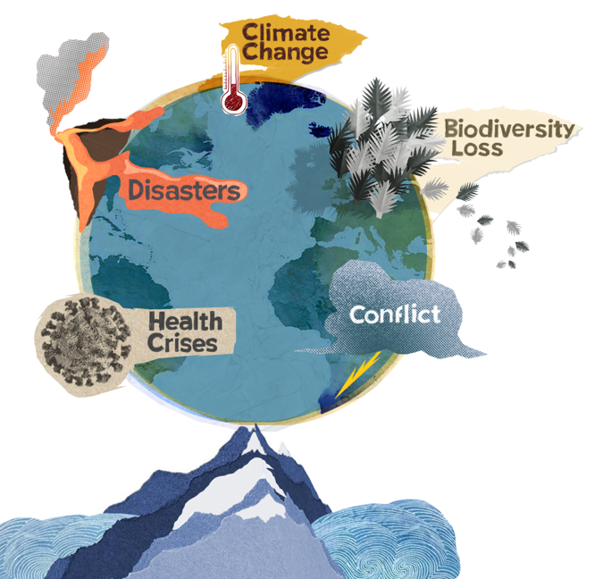
Rising risks...
and weak financial protection
Record $1.8 trillion
global insurance protection gap in 2022
$380 billion
in global economic losses to disasters in 2023
Record $97 Trillion
public debt reached in 2023
‘Triple Billion’
WHO targets for health emergencies preparedness
Record 12 months
of highest global air and sea surface temperatures continue in June 2024
69% uninsured
Insured losses from disasters exceeded $100B for four consecutive years
3.6 billion people
live in areas highly susceptible to climate change
$46.4 billion
UN 2024 Humanitarian appeal
Notes:
$100+ billion Insured losses from natural hazards for 4 consecutive years. Doubling in past 30 years, projected to double again in 10 (Swiss Re)
Pacific ring is centre for earth quakes, geological
A single event – example tsunami 2004 can be ¼ of total, humanitarian appeal
https://iris.who.int/bitstream/handle/10665/376869/9789240094703-eng.pdf?sequence=1

Slide 3
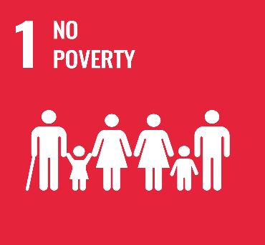
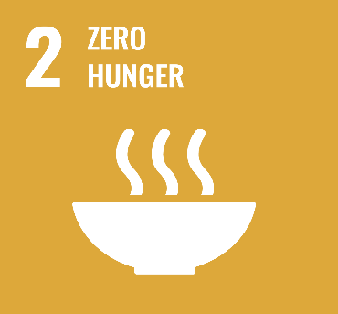
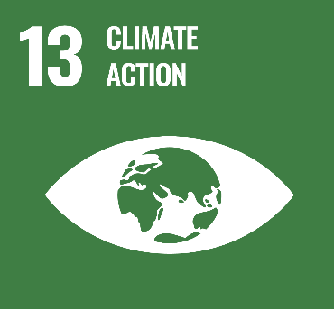
13
UNDP Insurance & Risk Finance Facility
Insurance and the Sustainable Development Goals
We innovate scalable insurance & risk finance to help countries achieve the SDGs
Insurance is agnostic to sectors. It can apply to infrastructure and education, livelihoods and natural capital, oceans, and agriculture – if you there something of value that is under threat from a hazard, and you can measure the severity and frequency of that threat, then a risk transfer tool of some kind can be developed.
Therefore, insurance and risk finance apply to all and any of the SDGs, but is critical to support 6 SDGs:
Insurance helps to end poverty in all its forms everywhere
Insurance helps to end hunger, achieve food security, improved nutrition and promote sustainable agriculture
Insurance helps to ensure healthy lives and promote well-being for all at all ages
Insurance helps to achieve gender equality and empower all women and girls
Insurance helps to promote sustained, inclusive and sustainable economic growth, full and productive employment and decent work for all
Insurance helps to take urgent action to combat climate change and its impacts

Slide 4
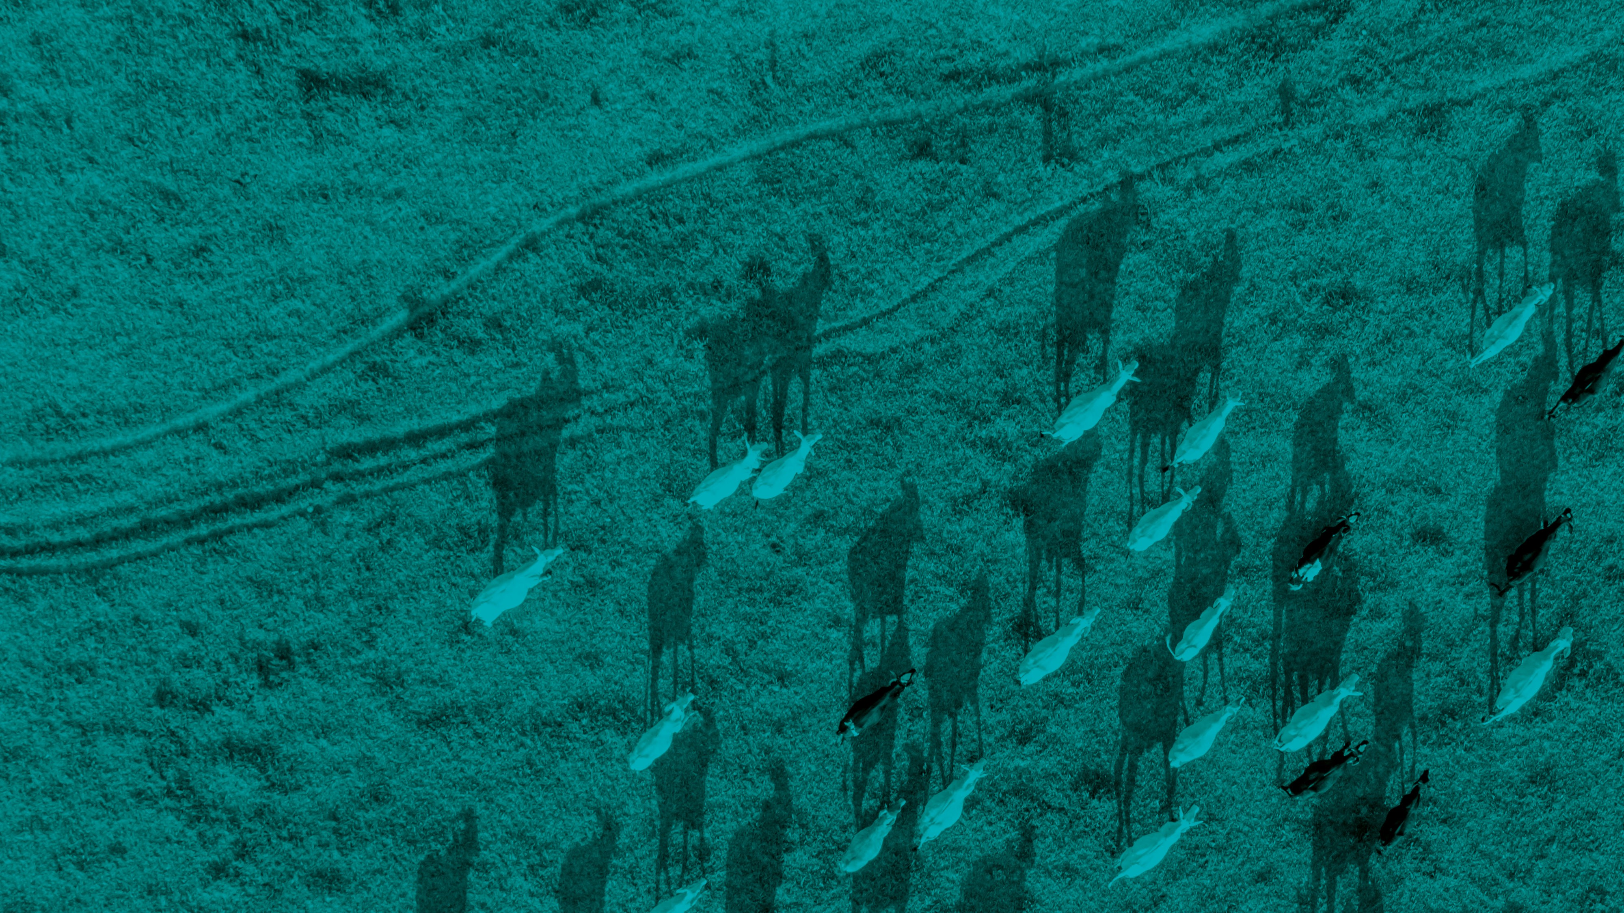
Working with the insurance industry and government to deliver the financial protection needed right now, and the long-term financial management of risks.
What we do

Slide 5
Reinsurance Availability
Skills
for Inclusive Market
Actuarial Capacity
Distribution Mechanisms
MARKET TRANSFORMATION
Data Collection
Market Innovation
Building long-term financial resilience in countries
Country Financial Risk Management Systems
Research and Evidence
Strong Insurance associations
Government risk finance capacity
Development frameworks (NAPs, NDCs,
INFFs, etc)
Regulatory frameworks
Supportive public policies
ADVOCACY & POLITICAL ENGAGEMENT

Slide 6
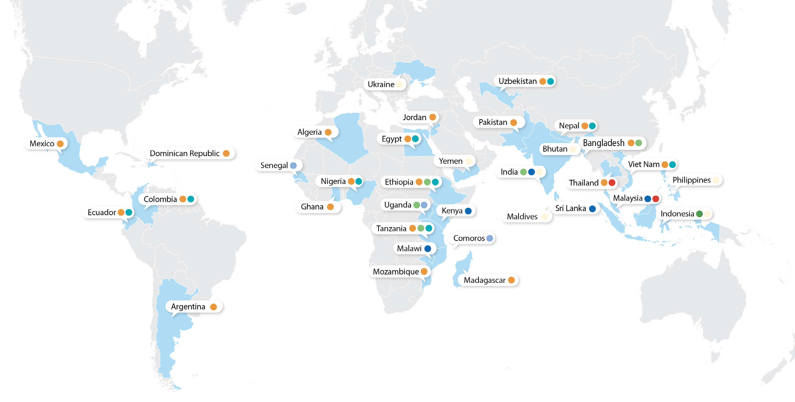
34
Programme Countries
Where we work
20 | 5 | 3 | 2 | 7 | 10 | 1 | 5
Tripartite | Finance | Engagement | SME Resilience | Tailored | Global | Nature & Local | Insurance
Agreement | Resilience in Agriculture | Initiative |  | Programmes | Actuarial Initiative | Community Resilience | Innovation Challenges

Slide 7
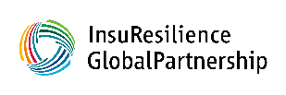
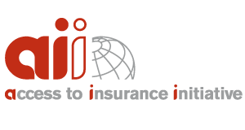
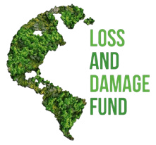
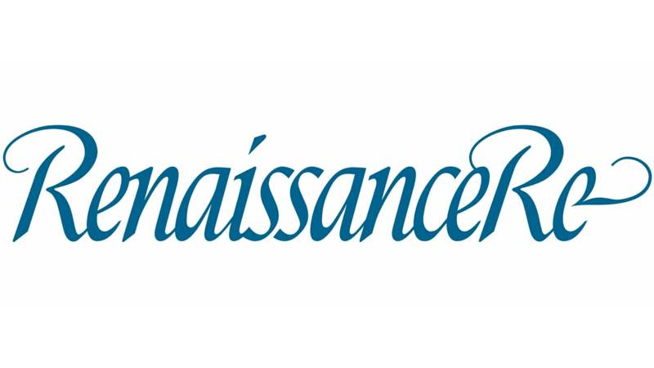
IRFF’s Partners & Ecosystem
Donors Technical & Institutional
Partnerships with Industry

Slide 8
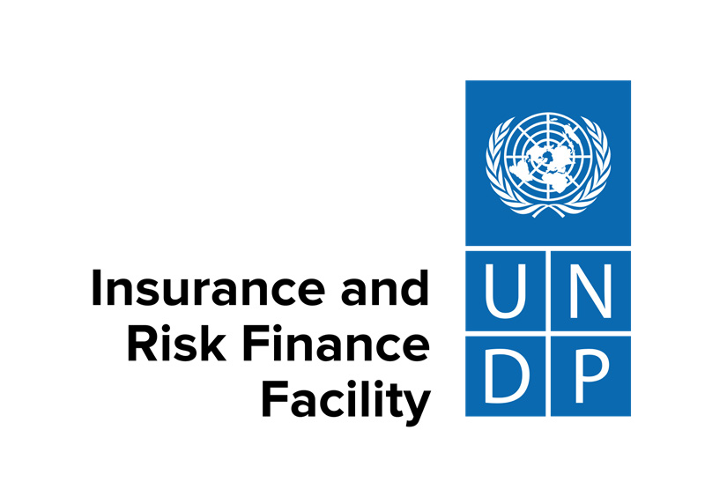
Building financial resilience to incentivise and safeguard development irff.undp.org

