Slide 1
Harmonisation
Uniting the African Insurance and Reinsurance Market for a Sustainable Future
Dr. Corneille Karekezi
Group MD/CEO
Africa Re
28th AIO African Reinsurance Forum – 14 October 2024 (Cairo, Egypt)

Slide 2
Outline
01
04
INTRODUCTION
AFCFTA AGENDA
How harmonization works and its key success factors.
What is the AfCFTA and its current operating framework for the trade in services and how the industry can engage the stakeholders.
02
05
REINSURANCE INDUSTRY PULSE
RECOMMENDATIONS
Insights into the reinsurance industry as well as the African macroeconomic environment.
Recommendations that can be considered by the industry to start unlocking the potential value of harmonisation.
03
HARMONIZATION INITIATIVES
06
CLOSING
Regional harmonisation initiatives and how the operate for possible insights into how the industry can harmonise.
Conclusion of the presentation including the key takeaways.
2

Slide 3
Introduction

Slide 4
Harmonization, Liberalization and Integration
Dimension | Liberalization | Harmonization | Integration
Definition | Liberalization refers to reducing government restrictions and barriers to entry in the insurance market to encourage competition and innovation | Aligning regulatory standards, practices, and policies for cross-boarder operations to create consistency in the insurance sector | Integration refers to the process of creating a more cohesive insurance market across countries, often through collaboration and policy alignment.
Goals | More insurance providers, more choices for consumers. More foreign direct investment in local markets. Better product offerings | Coherence to facilitate cross-border operations. Consumer protection and best practices. Standardized products and services | Unified regional market, seamless operations across borders. Risk pooling and sharing to manage large-scale risks effectively. Regional stability and resilience against economic shocks.
Examples | Most African insurance markets. Ethiopia next? | Common solvency standards and regulatory frameworks (CIMA, ECOWAS). | African Continental Free Trade Area (AfCFTA)
Considerations | Is this Achievable | Is this attainable? | Is this possible?
AfCFTA = Promotion of Trade and Investment across African countries, including insurance services.
4

Slide 5
Modes of Services Supply
Dimension | Mode 1 Cross-Border Supply | Mode 2 Consumption Abroad | Mode 3 Commercial Presence | Mode 4 Presence of Natural Persons
Definition | Insurance services are provided from one country to consumers in another country without any physical presence? | How consumers travel to another country to consume insurance services? | How an insurance company establishes a physical presence in another country | How an individual from one country provide insurance services in another country, usually on a temporary basis.
Examples | Online insurance company through digital platforms. | Tourists and Travel Insurance, High-net-worth Individuals | Multinational insurance firm sets up an office (subsidiary or branch) in foreign countries | Insurance consultants, Claim Assessors & Adjustors, Risk Managers, Insurance Broker
Significance | Highly flexible and cost-effective. But, it faces regulatory challenges and lacks local context. | Benefits from direct consumption experiences But, relies heavily on travel. | Allows for deeper market penetration and customer engagement. But, requires significant investment and navigation of local regulations. | Offers personal service and expertise. But, can be complicated by legal and logistical barriers for individuals.
NB: The Commercial Presence is the dominant mode in the insurance industry. When local capacity is exhausted, there are regulatory provisions for cessions abroad through reinsurance. The AfCFTA may be pushing for more cross-border supply, but this may be challenging in a regulated and protected market like insurance. The industry needs to find its own way!
5

Slide 6
Mode of Operations (1/2)
Dimension | National Players | Regional Players | Continental Players | International Players
Definition | They are focused on a single country, addressing local needs and regulations. | They operate in multiple neighboring countries, promoting regional cooperation and access. | They function across an entire continent, adapting to diverse market conditions and regulations. | They are operating across countries and continents, offering a broad range of products and managing complex risks.
Characteristics | Domestic market and regulations. National laws and regulatory frameworks. Individual consumers and businesses within the country. | Defined region with similar regulatory environments. Offer products that may be standardized across several countries. Engage in regional collaboration and partnerships. | Diverse insurance needs of multiple countries within the continent. Adapt to varying regulations and market conditions. Participate in continental initiatives to promote cross-border insurance services. | Offer products often tailored to global clients. Governed by international standards and regulations while also complying with local laws. Engage in complex risk management strategies that encompass diverse markets.
Significance | Understand better local markets, specific risks and requirements of the local population. | Enhance insurance access and options for consumers in neighboring countries, promoting regional economic integration. | Contribute to broader economic cooperation and can pool resources to manage larger risks, such as natural disasters affecting multiple nations. | Facilitate global trade and investment by providing coverage that mitigates risks associated with international business operations.
Each African market allows all these players, since capacity, expertise, and diversification are relevant to insurance markets to be efficient
6

Slide 7
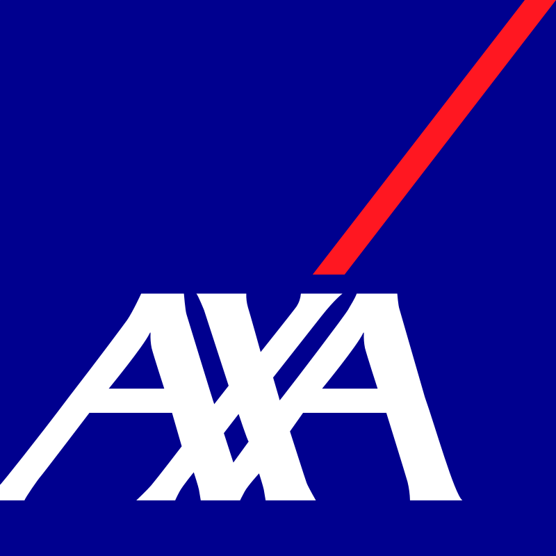
Mode of Operations (2/2)
Based on the scope of operations of some insurance entities, how does harmonisation work on the continent? What does it offer to the sector?
7

Slide 8
Macroeconomic and Industry Pulse

Slide 9
Africa Macroeconomic Highlights
Debt Sustainability
Structural Inflation
2024 Election Cycles
Anti-Government Protests
As public debt ratios are stabilizing with rising funding squeeze, governments are still grappling with financing shortages, high borrowing costs and rollover risks amid persistent domestic resource mobilization challenges.
While the effect of inflation is gradually reducing in advanced economies and some emerging markets, some economies such as Nigeria are still experiencing high pressures driven by food inflation although inflation is cooling in Nigeria, South Africa and Egypt.
Elections pose significant risks of political unrest. In Africa, there are over 20 scheduled elections leveraging on disgruntled populace including the 2024 US elections. The elections in Senegal and South Africa have been largely peaceful.
Kenya, Nigeria and other countries recorded several incidence of violent protests. This has been linked to, demand for change in government, cost of living crisis, rejection of antimasses bills and human right abuses concerns.
Heterogenous Growth
Currency Volatility
Extreme Weather
Economic Integration
IMF retained its initial growth forecast of 3.5% for the region in 2024, up from 3.2% in 2023 and 4.0% for 2025. This is predicated on a rebound in regional activity, as the supply side improves and the negative effects of past weather shocks decline.
There is significant depreciation of African currencies. In 2024, the Egyptian Pound, Ethiopian Birr and Nigerian Naira have depreciated by 36.1%, 50.9% and 46.2%, respectively. This has worsened the situation for import dependent economies. Kenya experienced a strengthening.
There is an increasing threat from extreme weather especially the secondary perils of floods. The recent experience in the United Arab Emirates and Kenya is a litmus test of possibilities if climate change agenda is not sustained.
The ongoing discussion of the African Continental Free Trade Area (AfCFTA) and other economic blocs is also a recent trend that is expected to continue as China, Russia and their allies plan to disrupt the dominance of the western countries.
Key Issues: Debt Sustainability, Weather Risks, Inflation, Currency Depreciation.
For How Long ?
9

Slide 10
Global Reinsurance Market Outlook
Moody’s (September 2024)
Fitch (September 2024)
AM Best (September 2024)
S&P (September 2024)
(Revised from Stable to Positive)
Headwinds
High Exposure to Natural Catstrophe; High Social and Economic Inflationary Pressure;
Tailwinds
Positive Pricing Environment; Strong Industry Capitalisation; Higher Demand for Reinsurance; Better Enterprise Risk Management;
(Revised from Improving to Neutral)
Headwinds
High Claims Inflation; Elevated Natural Catastrohe Losses; Volatile Financial Markets;
Tailwinds
High Price Discipline; Rising Reinvestment Yields; Return on Capital to Exceed Cost of Capital; Strong Reinsurance Demand; Strong Capital Adequacy;
(Remains Positive)
Headwinds
Heightened Natural Catastrophes; Geopolitical and Economic Uncertainty: Inflation Interest Rates and Recession Risks; Volatile Financial Markets; More Complex Risk Environment; Widening Protection Gap;
Tailwinds
Sustained Upward Pricing Trend and Improving Terms and Conditions; Shift in Business Mix and Positive Reserve Development; Strong Reinsurance Demand; Continued Underwriting Discipline; Strong Capitalisation;
(Remains Stable)
Headwinds
Persistent Inflation Risks; Elevated Natural Catastrophe Disasters; Volatile Financial Markets; Increasing Cost of Capital;
Tailwinds
Favourable Reinsurance Pricing; Strong Investment Income due to Higher Bond Yields; Robust Industry Capitalisation; Tighter Terms and Conditions; Earning Cost of Capital;
2022 = Historical Worst Year
It is Good to be a Reinsurer in 2023 – 2025 !
10

Slide 11
Global Reinsurance Market Outlook
Outlook POSITIVE … FOR LONG ??? !!!
11

Slide 12
Harmonization Initiatives

Slide 13
Cross Border Motor Insurance Schemes
Arab League Orange Card (6 Countries in Africa and 7 Countries in Middle East): The foundation of the unified insurance card on motor vehicles crossing the Arab countries through an international convention which signed in Tunis (Tunisia) on 26th April1975 and aims to encourage the tourism, facilitate the trade exchange and the circulation of Arab citizens vehicles between Arab members countries.
ECOWAS Brown Card (14 Countries): This was created on 29th May 1982 in Cotonou (Benin Republic). The main objective of the Brown Card Scheme is to ensure prompt and fair compensation to the victims of road accidents for the damages caused them by non residing motorists travelling from member states.
Are we Happy with these Schemes / Mechanisms?
Do they really work?
CEMAC Zone Pink Card (6 Countries): This is a regional initiative designed to facilitate and streamline vehicle insurance in the member states and was created in 1996 as part of efforts to promote regional integration and facilitate cross-border vehicle insurance among member states. The system aims to facilitate cross-border travel by providing a standardized insurance document that ensures compliance with local insurance laws
COMESA Yellow Card (13 Countries): The Yellow Card Scheme was established by a Protocol on the Establishment of the Third-Party Motor Vehicle Insurance Scheme, signed by the Heads of States and Governments on 4th December 1986, in Addis Ababa, Ethiopia.
13

Slide 14
CIMA Zone
CIMA Zone Highlights
The CIMA (Inter-African Conference on Insurance Markets) zone refers to a regional framework for insurance regulation and cooperation in several West and Central African countries. The CIMA zone aims to enhance regional integration in the insurance sector through standardized regulations and practices. It established a harmonized regulatory framework for insurance companies operating in member states. This includes guidelines on licensing, solvency, consumer protection, and market conduct. The framework enables insurers to offer services across borders without needing to adapt to vastly different regulatory environments, facilitating regional trade in insurance services.
The Regional Integration of the Insurance Industry started on 27th July 1962.
CIMA as we know it today was established 10th July 1992.
Governance
Council of Ministers - Adopts Insurance Legislation.
Regional Insurance Supervisory Commission – Enforces Insurance Legislation, Protects Policyholders and Manages (Grants / Revokes) Licenses;
General Secretary – Supervises Insurance Companies.
National Insurance Supervision Agencies – Supervises Contracts, Premiums and Claims; Collects Statistics; Supervises Intermediaries.
Stands a Great Chance to Reach Integration … If Disintegration Stops
14

Slide 15
Insights from Harmonization Initiatives
Digitization Agenda
Consumer Awareness
Regulatory Enforcement
National Peculiarities
01
There is a limited access to technology and data infrastructure that hinders the collection of necessary information for regulatory compliance and market analysis. This is an important consideration for development.
02
The low levels of awareness and understanding among consumers about their rights and the insurance products available can hinder the effectiveness of the scheme. There is a need to promote insurance awareness.
03
There are several challenges to promoting regulatory enforcement in collaboration to law enforcement agents leading to fake covers issued to the public. There is a need to have an authentication mechanism and national bureaux.
04
The different member states have varying capacities to implement the harmonised insurance code effectively, leading to inconsistencies in application and enforcement. It is necessary to strengthen the common purpose.
Remittance Challenges
Moral Hazards
Technical Expertise
Scope of Coverage
05
There has been late remittances of premium returns and reimbursement to statutory bodies impacting the trust among stakeholders. There is a need to explore a payment gateway that simplifies cross-border remittances.
06
The prevalence of fraud and unethical practices in some markets can undermine consumer trust and the overall effectiveness of the insurance framework. There is a need to ensure transparency in the process through governance.
07
There is a probable lack of trained personnel and resources within regulatory bodies and insurance companies to fully understand and implement the harmonized regulations. There should be an intention capacity building on the continent.
08
There is also a need to review the scope of coverage and requirements across countries. This is due to the due to differences in local market conditions, financial capabilities, and operational practices. This needs to be evaluated.
There Are Other Pressing Issues …. To Start With.
15

Slide 16
Reality Check: Insurance Industry is Regulated and Protected!
Legal Cessions | Coinsurance | Local Content Laws | Other Options
National and Regional Cooperation and Premium Retention. Some examples are: Faso Réassurance, Ethio Re, Uganda Re, Zambia Re, National Re, Tan Re, Société Centrale de Réassurance, Compagnie Centrale de Réassurance, Namib Re, Ghana Re, Sen Re, Kenya Re, Cica Re, Zep Re, Waica Re Africa Re | The objectives of coinsurance is to: Optimize capital usage by allowing insurers to underwrite large policies without overextending capital. Increase market participation by allowing insurers to underwrite larger risks together. Build relationships among insurers and enhances market presence through collaboration. | It must be supported by the following documentations: Letter of Attestation Approval in Principle Request for “No Objection” Certificate of Offshore Reinsurance | These covers other forms of regulations and protection to the local markets. Some of them include: Taxation: To keep a market protected, raising taxes on foreign participants is a way to restrict supply of non-admitted services. Regulation: Equivalent Jurisdiction policy keeps Africa Re operating at a high level of capital expenses and charges to cedants
Despite More Than 50 Decades of Independent Market, Africa Needs Capacity, Expertise and Diversification
What About Minimum Financial Rating Conditions?
What About Obligatory Reinsurance Deposits Conditions?
16

Slide 17
AfCFTA Agenda

Slide 18
African Continental Free Trade Area
According to Agenda 2063, the African Union‘s (AU) flagship project is the African Continental Free Trade Area (AfCFTA). It provides a member-driven road map for achieving sustainable and inclusive development on the continent. Its objective is to create an integrated market for the trade in goods and services, as well as the free movement of people and capital. The ambition is to bring together all 55 member states of the African Union creating a market of more than 1.2 billion people, with a combined gross domestic product (GDP) of more than US$ 2.5 trillion.
Status of Signatories (August 2024)
2018: Ghana, Kenya, Rwanda, Niger, Chad, Eswatini, Guinea and Côte d’Ivoire
2019: Mali, Namibia, South Africa, Congo Republic, Djibouti, Mauritania, Uganda, Senegal, Togo, Egypt, Ethiopia, Gambia, Sahrawi Arab Democratic Republic, Sierra Leone, Zimbabwe, Burkina Faso, São Tomé & Príncipe, Equatorial Guinea, Gabon and Mauritius.
2020: Central African Republic, Angola, Lesotho, Tunisia, Cameroon and Nigeria.
2021: Malawi, Zambia, Algeria, Burundi and Seychelles
2022: Tanzania, Cabo Verde, Democratic Republic of Congo, Morocco and Guinea-Bissau
2023: Botswana, Comoros and Mozambique
2024: Liberia
Libya
Sudan
Eritrea
South Sudan
Somalia
Benin
Madagascar
87.27% Countries have Signed and Deposited the Instrument of Ratification with Africa Union Chairperson. 54 out of 55 (98.18%) Countries have signed with the exception of Eritrea.
Reference: https://www.tralac.org/resources/infographic/13795-status-of-afcfta-ratification.html
18

Slide 19
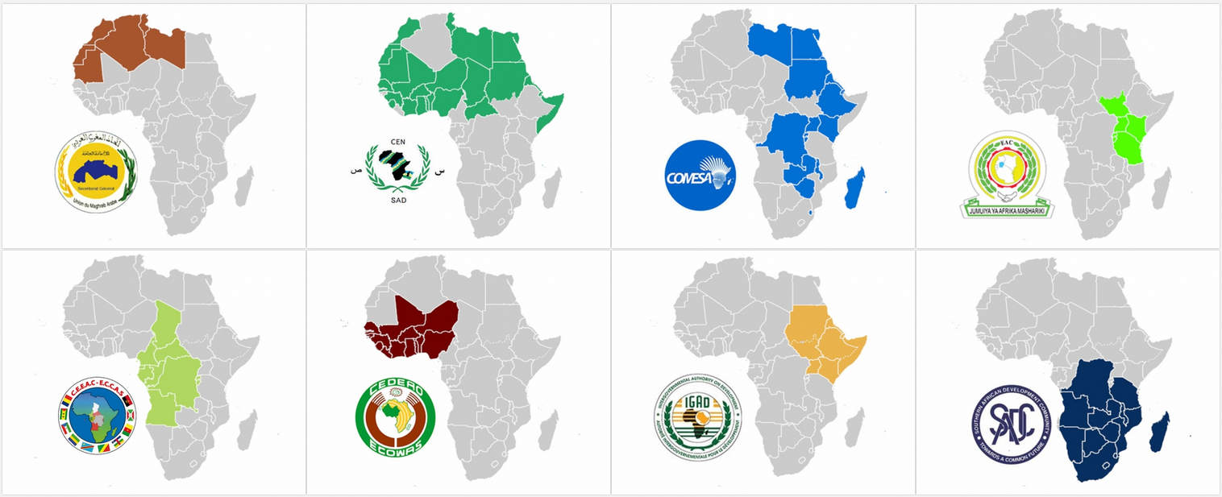
Regional Economic Communities
AMU: Arab Maghreb Union
COMESA: Common Market for Eastern and Southern Africa
CEN-SAD: Community of Sahel-Saharan States
EAC: East African Community
ECOWAS: Economic Community of West African States
IGAD: Intergovernmental Authority on Development
SADC: Southern African Development Community
ECCAS: Economic Community of Central African States
The AfCFTA leverages on the existing Regional Economic Communities! Some countries belong to more than one REC and some of them are largely inactive due to tensions.
19

Slide 20
Status of African Continental Free Trade Area
Agreement Establishing the African Continental Free Trade Area
Phase I
Phase II
Phase III
Protocol on
Trade in Goods
Protocol on
Trade in Services
Protocol on Rules and Procedures in Settlement of Disputes
Protocol on
Competition Policy
Protocol on
Youth and Women in Trade
48 Submitted Tariff Offers
7 Outstanding Tariff Offers
45 Approved Tariff Offers
3 Pending Tariff Offers
14 Gazetted Tariff Offers
Rules of Origin
Guided Trade Initiative
5 Priority Sector
48 Submitted Service Offers
22 Approved Offers
26 Pending Offers
7 Pending Offers
5 Gazetted Offers
Pending Annexes
None
Pending Annexes
None
Pending Annexes
None
Protocol on
Investment
Protocol on
Digital Trade
Pending Annexes
Dispute Resolution
Governance Model
Trade & Investment Agency
Pending Annexes
Rules of Origin
Digital Identities
Cross-Border Digital Payment
Online Safety and Security
Financial Technology
Pending Annexes
Rules of Origin
Transit
Guided Trade Initiative: Cameroon, Egypt, Ghana, Kenya, Mauritius, Rwanda, Tanzania and Tunisia.
Guided Trade Initiative is an interim solution launched on 07 October 2022 with 8 countries and 92 commodities to kick-start meaningful trade among interested State Parties that have met the minimum requirements for commencing trade under the Agreement, to test the readiness of the private sector, and to test the operational, institutional, legal and trade policy environment under the AfCFTA. It is Operational now!
Protocol on Intellectual Property Rights
Pending Annexes
None
20

Slide 21
History of European Single Market
In 1957 the Treaty of Rome established the European Economic Community which aimed to create a large European 'free trade area’.
28 years after, between 1985 and 1992 (7 years), 282 laws were adopted to remove technical, legal and bureaucratic barriers that hindered free trade and movement.
The single market was established on 1 January 1993 for 12 EU countries.
2023: The single market celebrated its 30th anniversary on 1 January 2023.
Over the past 30 years the single market has brought unity and opportunities to Europeans.
A lot is demanded from the African Union (AU) and a lot expectations have been placed into the AfCFTA. (Re)Insurers Should Play Their Role.
21

Slide 22
Proposed Governance Highlights
This is our proposed enhancement
Subgroups
National Ministry of Finance
National Ministry of Trade Services
Other Ministries, Departments & Agencies
Service Providers
Trade Negotiators
NB: All Trade Decisions are made through the Trade Negotiators in consultation with Industry Regulators and other stakeholders by the government.
Industry Regulators
Working Group: This is an additional layer to ensure the industry is heard.
Steering Committee
Industry Taskforce
AfCFTA Secretariat
Committee on Trade in Services
Council of Ministers
Risk
Carriers
Advisory Organ to serve as Coalition Body Representative
Coordinated by the AfCFTA Secretariat
AU General Assembly
Similar Structure serves the Banking and Capital Markets Stream
African Insurance Organisation
There is a consideration of 04 Subgroups in the Working Group. Each Subgroup will be represented on the Project Steering Committee. Risk Carriers refer to the Insurers and Reinsurers including their Industry Associations. The Service Providers covers Insurance and Reinsurance Brokers, Loss Adjusters and other Intermediaries. The final approving authority is the African Union General Assembly!
22

Slide 23
Recommendations

Slide 24
Next Steps
Market Study | Industry Strategy | Resource Requirements | Implementation Plans
Based on a study of the entire industry to identify the pain points of market participants and find ways to be resolve them under the AfCFTA Agreement. One of such finding could be related to premium retention on the continent through limited capacity, intra-group arrangements and so on. | Based on the robust strategy and an understanding of the pain points of the industry, we may need to consider developing a wholesome strategy that consolidates strengths, addresses weaknesses, mitigate threats and explore opportunities for relevant stakeholders in the value chain. | Based on the defined strategic orientation, it is important to determine the resources needed to actualize the strategy for the desired goals to be achieved. There is a need to be intentional about resource requirements within the existing industry frameworks. | Based on the commitment to provision the relevant resources, there needs to be a formal implementation plan. These actions should be implemented via stakeholder work groups that have the relevant influence in this domain.
Considerations This covers understanding the key Strengths Weaknesses Opportunities Threats | Considerations This covers elements of a strategy Key Objectives Critical Stakeholders Strategic Orientation Strategic Priorities | Considerations This covers the following needs Technology Enablement People Development Product Innovation Stakeholder Conduct Partnership Framework | Considerations This covers how we should proceed Legislate Regulate Collaborate Innovate Educate
Our efforts complement that of Government, but the real negotiators are the State Parties represented by the Ministries of Trade that consults others. We Have To Be At The High Table, as Important Stakeholders in the Financial Inclusion & Economic Development
24

Slide 25
Opportunities and Areas of Considerations
Products Consideration | Distribution Vehicles | Technology Adoption
The opportunities for the industry for consideration without the disruption of the status quo are as follows: Cessions Abroad: There is a need for the industry to conduct a study on the cessions that go abroad in collaboration with industry regulators as the custodian of such data to explore ways in which some of them can be retained on the continent. Climate Risks: An evolving opportunity is the need to consider how climate resilience solutions can be deployed on the continent to leverage on the combined capacity on the continent for a truly diverse sovereign solution. Specialty Lines: There is a need to leverage risk sharing potentials on the continent to provide more cover on specialty lines of business. Multinational Insurance Programmes: There may be a need to engage regulators to encourage multinational programmes on the continent when local capacity is exhausted. | This covers the vehicles through which the opportunities from products can be exploited to strengthen the market: Insurance Pools: This can be achieved through the adoption of insurance pools for different lines of business that are ceded abroad or are emerging risks to support the continent. Regulatory Review: This is the consideration of a review to encourage the practice of admitted and non-admitted players to provide cover on risks after local capacity has been exhausted. This is the fastest way to promote cross-border insurance and reinsurance. International Agreements: This is the enforcement of cessions within the local market rather the procurement of insurance covers abroad. | This highlights some of the technology considerations that can enable this process for industry players. Technology Infrastructure: The adoption of a digital infrastructure is a key driver of risk sharing on the continent after local capacity has been exhausted. This ensures that all players with the right appetite and regulatory approvals can share risks before cessions abroad. Payment Gateway: This covers the adoption of a payment gateway like the Pan-African Payment and Settlement System (PAPSS) championed by the AfCFTA to reduce the current frictional costs and remittances to international transactions. This reduces the need for settlement in US Dollars that puts a strain of the national economy.
Remember the African Insurance Pools ? Can’t They be Strengthened and Supported?
25

Slide 26
Pan-African Payment Settlement System
Pan-African Payment and Settlement System (PAPSS) is a centralized Financial Market Infrastructure that enables the efficient flow of money securely across African borders, minimizing risk and contributing to financial integration across the regions. Over 80% of intra-African payments go through the Europe or the United States, resulting in high transfer and compliance costs. It provides an alternative to current high-cost and lengthy correspondent banking relationships to facilitate trade and other economic activities among Africa countries through a simple, low-cost risk-controlled payment clearing and settlement system.
Cost Saving
Regulatory Harmonization
Instant Payment
Geographical Coverage
Transaction Transparency
It provides financial institutions and payment providers a direct access to a network of payment institutions in Africa, minimizing liquidity complexities from operating multiple correspondent banking accounts and transaction processing fees for banks and effectively, the last mile.
It rides on a comprehensive legal, regulatory and operational framework comprising of standard rules, format and governance arrangements, harmonized KYC/AML, payment confirmation and settlement finality.
It reduces the current end to end transaction time in 1 – 5 days across regions to guarantee same day clearing and settlement of payment services. There is also settlement in local currency without the need for a third currency. We are also in discussions on currency swaps.
It provides interconnectivity to payment systems across all African regions, increasing the current reach of regional payment systems, thereby facilitating the processing of cross-border payment transaction regardless of payment origination.
It eliminates multiple touchpoints and consequently transaction fee uncertainty. It also provides participants with clearly defined fees for transaction processing.
What About Prompt Payment of Reinsurance Balances? Can’t Change Our Business Culture?
Step 1: Clarify the Values We Need ….. Step 5: Get Rid Of the People Who Do Not Demonstrate Our Values !
26

Slide 27
Closing

Slide 28
Key Takeaways
Trade Negotiations
Market Study
Working Group
Collaborative Engagement
01
The negotiations under the AfCFTA Agreements are handled by the Ministries of Trade and championed through the Regional Economic Communities in which the perspectives of the insurance industry may not have been duly considered as it is managemened by the Ministry of Finance. It is recommended that regulators engage with the trade negotiators as other efforts are complimentary.
02
There is a need for the industry to conduct an indepth study into how it can exploit the provisions of the AfCFTA without disrupting the market dynamics by leveraging on the existing opportunities such as the cessions of abroad which is not recorded or for which the continent’s capacity has not been fully exhausted.
03
There is a need for the industry to create a working group which will harmonise the views of different stakeholders such as risk carriers, prudential authorities and other service providers so that its joint perspective is presented to the AfCFTA Secretariat for engagement with the trade negotiators where necessary.
04
There is a need for the industry to consider implementing solutions that are within it control to gradually expand the market. This includes harnessing capital, technology and expertise within the existing frameworks to take advantage of the opportunities offered by AfCFTA under a collaborative engagement of all stakeholders.
Decision Makers
Actionable Insights
Influence Engagement
Quick Wins
The industry can start from its current position to take advantage of the evolving opportunities of the AfCFTA with ongoing investments.
Irrespective of the considerations we need to have the issues of innovation, digitization, capitalisation, competition and accumulation on the front burner.
28

Slide 29
How good and how pleasant it would be Before God and man, yeah To see the unification of all African(s) (Re)Insurers, yeah
Bob Marley, Africa Unite

Slide 30
Thank You

