Slide 1
Natural catastrophes: Rethinking catastrophe modelling and the insurance protection gap
Picture rights: cuellar / Getty Images
03 June 2024
Nico Conradie

Slide 2
Content
1
Natural Catastrophes: Trends and the impact
2
Catastrophe modelling
3
Updated Modelling and Closing the insurance gap
2

Slide 3
Natural Catastrophes: Trends and the impact
Picture rights: cuellar / Getty Images
01

Slide 4
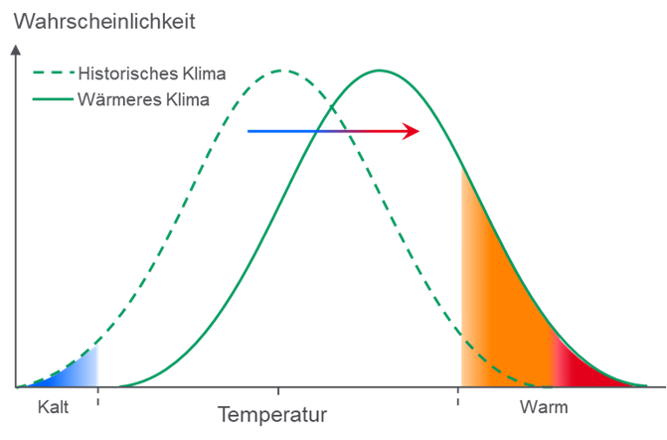
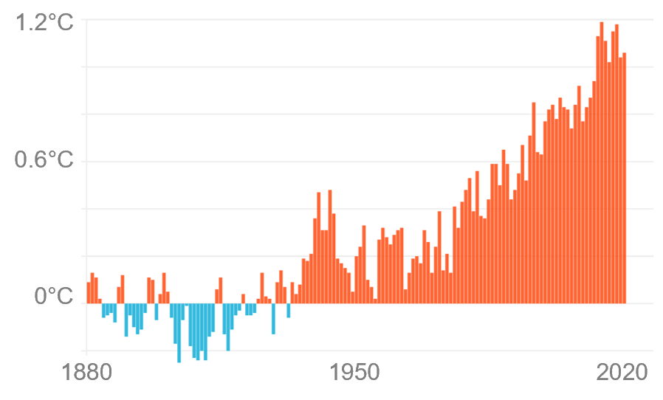
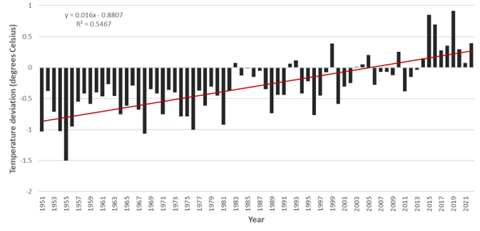
1. Climate Change Natural Catastrophe Risk of Change Small increase in average temperatures large increase in probability of extremes
Global: Primary effect of climate change Linear temperature trend (1880-2022): 1.2°C – man-made share >>50%
Global: secondary effect of climate change
Changing probabilities of extremes → new risks / loss levels
South Africa: Average Surface Temperature Deviation (base period 1991-2020)
Probability
Historical climate
Warmer climate
Increasing hazard
Increasing risk
Cold
Temperature
Hot
Annual temperature anomalies (°C) compared to the 1880-1900 average
Increase of global average temperatures - changing probability distributions
Warming trend of 0.16 ºC per decade indicated for the country, over the period 1951-2022
Source(s): National Centers for Environmental Information (NOAA), Munich Re (based on IPCC data); South African Weather Service, “Annual State of the Climate 2022“
4
Notes:
Left:
The primary effect of climate change, increase in the land & ocean temperature. Graph shows global average temperature compared with average of pre-industrial times (1880-1900).
Global warming is a fact. Globally, the world has warmed by 1.2°C as compared to pre-industrial times. There is no doubt from latest science (IPCC – Intergovernmental Panel on Climate Change), that man made contribution to this temperature increase is higher than >50%
Middle:
The secondary effect of climate change: changing probabilities.
We can see how the "red part" under the curve increases with increasing temperatures. With this, the probability of extreme events also increases.
Just a small increase in average temperature can lead to a large increase in probability of extremes.
With focus on a warmer climate, changes can be in frequency and / or intensity of weather-related perils (depending on peril and region). And this of course can have an impact on the losses as well.
Right:
The annual mean temperature anomaly for 2022 in South Africa, based on the data of 26 climate stations, was on average about 0.4 ºC above the average of the reference period (1991-2020), making it approximately the 4th hottest year on record since 1951 (see Figure 1).
A warming trend of 0.16 ºC per decade is indicated for the country, over the period 1951-2022, statistically significant at the 5% level.
According to NOAA 2022 was the 10th warmest year on record for all of Africa

Slide 5
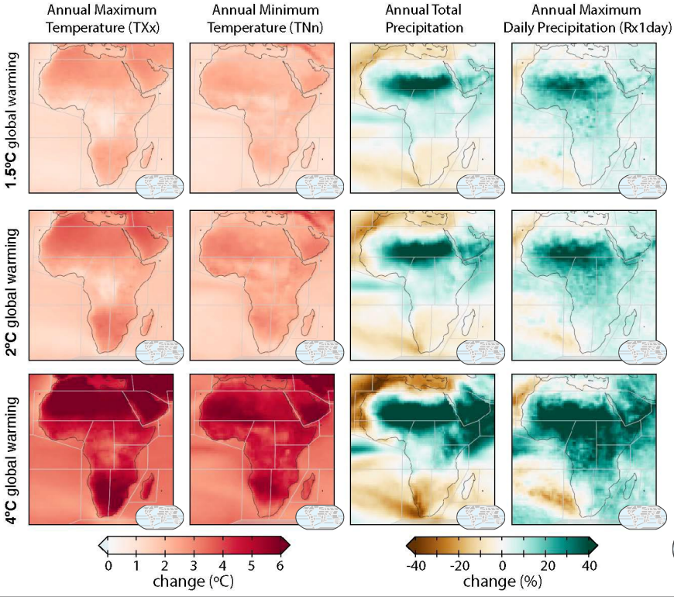
Observed and projected possible climate change impact on Africa Increase in frequency and/or intensity of natural perils – some already observed
Climate change mitigation and adaptation
More frequent temperature extremes
Decrease in mean precipitation & increase in aridity
Increase in fire weather conditions
Increase in frequency & intensity of heavy rainfall events & pluvial flooding
Increase of average TC wind speeds and associated heavy precipitation and proportion of cat 4-5 TCs
Source(s): IPCC, AR6, Climate Impact per Region – Africa
5
Notes:
Areas are not impacted evenly
Hotter temperatures have 2 impacts: drier or wetter
Common regional changes
• Mean temperatures and hot extremes have emerged above natural variability, relative to 1850–1900, in all land regions in Africa (high confidence).
• The rate of surface temperature increase has generally been more rapid in Africa than the global average, with human-induced climate change being the dominant driver (high confidence).
• Observed increases in hot extremes (including heatwaves) and decreases in cold extremes (including cold waves) are projected to continue throughout the 21st century with additional global warming (high confidence).
• Marine heatwaves have become more frequent since the 20th century and are projected to increase around Africa (high confidence).
• Relative sea level has increased at a higher rate than global mean sea level around Africa over the last 3 decades. Relative sea level rise is likely to virtually certain to continue around Africa, contributing to increases in the frequency and severity of coastal flooding in low-lying areas and to coastal erosion and along most sandy coasts (high confidence).
Southern Africa will overall become drier => third column
• The frequency and intensity of heavy precipitation events are projected to increase almost everywhere in Africa with additional global warming (high confidence). => fourth column

Slide 6
Significant natural catastrophes* in Africa 1980 – 2023 12 costliest events by economic loss, 5 of which happened in 2022 and 2023
Period | Event | Country | Economic Losses US$ m (adjusted to inflation) | Fatalities
8.9.2023 | Earthquake | Morocco | 7,200 | 2,960
1.6.-15.10.2022 | Flood, flash flood (season) | Nigeria | 5,800 | 612
10-12.9.2023 | Flash flood, severe storm (Daniel) | Libyan Arab Jamahiriya | 4,100 | 4,255
21-28.05.2003 | Earthquake, tsunami | Algeria | 3,900 | 2,200
9.4.-16.04.2022 | Flash flood, flood | South Africa | 3,000 | 461
10.10.1980 | Earthquake | Algeria | 2,900 | 2,590
9.3-14.03.2019 | Cyclone Idai | Mozambique, Malawi, Zimbabwe, South Africa | 2,900 | 1,014
12.10.1992 | Earthquake | Egypt | 2,400 | 561
9-14.03.2019 | Cyclone Idai, flood | Mozambique | 1,900 | 603
15-17.03.2007 | Tropical Cyclone Indlala | Madagascar | 1,600 | 150
21.2.-15.3.2023 | Cyclone Freddy | Madagascar, Malawi, Mozambique, Zimbabwe | 1,500 | 1,411
17.3.1986 | Tropical Cyclone Honorinina | Madagascar | 1,200 | 32
*Excludes drought, heatwave, famine
Notes:
The table shows the dozen most costliest natural catastrophe losses by economic damage from 1980 onwards. Economic losses are inflated to today’s values. Insured losses from these events are difficult to track, and thus not shown here.
We can observe that 8 out these 12 losses occurred in the past five years, and five in 2022 and 2023 alone.
Four earthquakes (of course no climate change impact)
Three floods and five cyclones, where we know climate change increases the likelihood and severity of such events over time
One can’t derive the impact from climate change from these two handful of events, however they correlate with the impact that scientists forecast to happen from climate change.
The growth in population and urbanization with resulting concentration of values in exposed areas are also a driver for seeing the number of catastrophic events increase over time.
We don’t collect the data on drought, heatwave and famine, but obviously in terms of impact on food security this is at least as critical for Africa than the above natural perils.

Slide 7
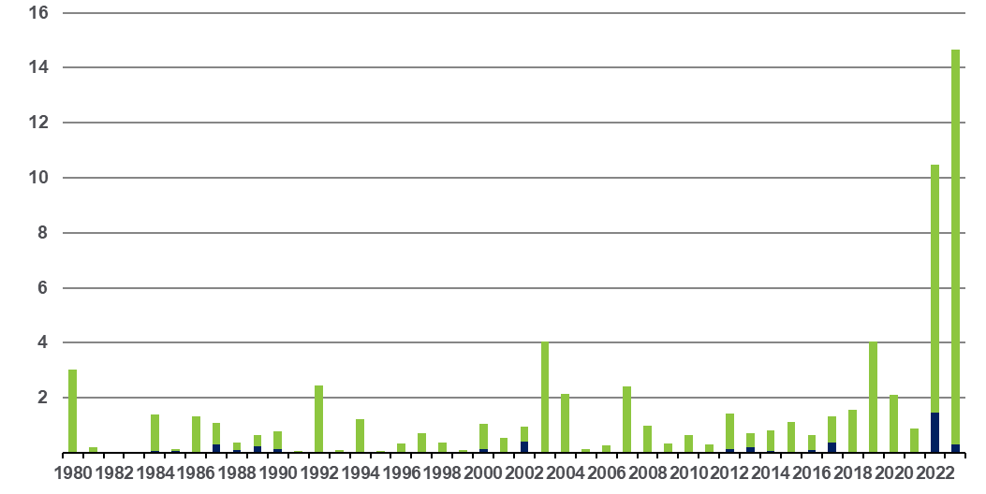
Natural catastrophe losses in Africa 1980 – 2023 Overall and insured losses (US$)
US$ bn
Overall losses
(in 2024 values)
Thereof insured losses
(in 2024 values)
Inflation adjusted via country-specific consumer price index and consideration of exchange rate fluctuations between local currency and US$.
Excludes drought, heatwave, famine.
Notes:
If one maps all natural catastrophes over time, the concentration of extreme events in 2022 and 2023 becomes even more apparent.
This graph also shows our rough estimates of insured loses as well, in the dark blue lines at the bottom of the charts.
The large gaps between economic losses and insured losses that we see in Africa is stark. We estimate that only 6% of economic losses are insured. This compares to X% in Europe or Y% in North America.
The graph illustrates two key needs:
Incorporating natural catastrophe modelling into the underwriting and decision making of insurers across Africa.
Overcoming the insurance protection gap.

Slide 8
Catastrophe modelling
Picture rights: cuellar / Getty Images
02

Slide 9
Incorporate natural catastrophe exposure into underwriting Maps risks against perils, price adequately, understand accumulation, steer portfolio
Risk scoring tools to map risks/portfolios, examples of earthquake and flash flood shown here
Notes:
Steering at the portfolio level that any insurer should incorporate in his portfolio management:
Map every risk underwritten against the natural perils it is exposed to.
Price adequate margin for every single risk for such natural peril (often only fire exposure is really considered)
Understand the accumulation for an event in the portfolio
Steer the portfolio accordingly through risk selection, scenario budgeting and reinsurance buying
The two graphs shown here for earthquake and flash flood are indicative at high level. The tools are available to map risks at granular level for earthquake, volcano, tsunami, tropical cyclone, extratropical storm, hail, tornado, lightning, river flood, flash flood, storm surge and wildfire.

Slide 10
Catastrophe modelling based on insured market losses Example of MRoA’s South Africa natural catastrophe data
Natural catastrophes: insured losses in SA
Return periods per peril modelled
Earthquake
Hail
Wildfire
Illustration only
Windstorm
Notes:
Modelling large natural catastrophes:
Top-down model:
The first requirement is to collect data on insured losses at market level, as complete as possible, as far back in time as possible. Come up with estimates for any missing data.
Together with further information on large natural catastrophes from decades prior to the captured ones, one can then derive return period curves per peril. As the illustration on the right hand side illustrates, for an assumed event of 25, 50 or a 100 years the severity of a market losses is modelled. This market model per peril is then scaled to individual insurers’ portfolios where it can be utilized for risk management as well as reinsurance buying and pricing.
Bottom-up model:
Alternatively, one can model from ground up, whereby to portfolio of individual risks with their sums insureds the territorial scope of affected risks is assumed and damage ratios are applied to the risks to yield the severity of a given scenario.
Both model approaches should be combined, together with actual historic experience of a portfolio, to yield the expected loss of natural catastrophes for a portfolio, or price a reinsurance programme.

Slide 11
The insurance protection gap
Picture rights: cuellar / Getty Images
03

Slide 12
Closing the insurance protection gap Challenges and solutions to overcome these
Challenges | Solutions
Government typically is the backup solution when disaster strikes, who then needs to divert funding from other priorities in response. Ex-post financing (relief by appealing for grants after an event) is typically too late for adequate disaster response. | Pre-arranged finance response, where rapid liquidity can reduce the overall cost of disaster. This should be aligned with risk mitigation measures and disaster recovery plans.
Protection gaps not well enough understood; lack of modelling of natural catastrophe risk and impact. | Modelling capabilities are developing at modelling specialists, brokers, consultants, and (re)insurers; they must be linked to the need.
Indemnity based insurance products are slow to pay out, it’s complex for affected people/entities to quantify losses. | Trigger based pay-outs are faster and efficient to pay out monies, experience has been gathered on their implementation.
Affordability and availability of insurance. | Pooling and spreading of risk plus defining the right level of retention makes it more cost-effective for risk-transfer. Subsidy through local and foreign government. Besides parametric insurance there are also catastrophe bonds, natural disaster risk funds, credit guarantees, contingent credit, forecast-based finance.
Protracted payouts to households, companies, government agencies impedes fast rebuilding. | Efficient and transparent disbursement channels need to be established ahead of disasters, considering all channels: insurers, NGOs, government institutions, private sector, humanitarian agencies.
The various components of the solutions outline here need to be joined up. | Initiatives like the Global Shield against Climate Risks, initiated by the G7 and the V20, intend to achieve alignment of all of the above into comprehensive solutions.
Notes:
Governments typically need to make up for under-insurance when disaster has struck, to mitigate its impact on food security, infrastructure, health, education. However, African government are mostly unlikely to have funds available and are forced to divert of funding from elsewhere, undermining to long-term improvement of the country. Or only inadequately respond to disaster relief.
The slide outlines six challenges leading to the insurance protection gap with corresponding solutions that by now are well established and functional.

Slide 13
Call to action
Picture rights: cuellar / Getty Images
04

Slide 14
4. Call to action
Winning in catastrophe modelling and narrowing the insurance protection gap
Crafting a solution:
Data
Public-Private Partnership
and
14

Slide 15
Thank you for your attention!
Picture rights: cuellar / Getty Images

Slide 16
Disclaimer
© 2024 Münchener Rückversicherungs-Gesellschaft Aktiengesellschaft in München ("Munich Re").
All rights reserved.
The content of this presentation (including, without limitation, text, pictures, graphics, as well as the arrangement thereof) is protected under copyright law and other protective legislation. These materials or any portions thereof may be used solely for personal and non-commercial purposes. Any other use requires Munich Re’s prior written approval.
Munich Re has used its discretion, best judgement and every reasonable effort in compiling the information and components contained in this presentation. It may not be held liable, however, for the completeness, correctness, topicality and technical accuracy of any information contained herein. Munich Re assumes no liability with regard to updating the information or other content provided in this presentation or to adapting this to conform with future events or developments.

