Slide 1
Life insurance in the face of climate change: Adapting to increasing natural catastrophes in Africa
June 2024
Africa Insurance Organisation

Slide 2
Who I am
Roelof Coertze is a deeply experienced actuary who is passionate about actuaries positively impacting the planet and society.
Roelof was previously Prudential’s Group Director of Climate Policy and is currently its Africa Head of Enterprise Risk Management. In his roles, he has helped set, monitor and meet climate targets for carbon reduction and responsible investment, developed and performed financial climate scenario testing, and lead authored public ESG and TCFD disclosures.
Roelof is co-chair of the Actuaries Carbon Collaboration with the past IFOA president. He continues to contribute to IFOA working parties, including climate and risk management.
Very importantly, he is a father and wants to help leave the planet in good shape for his two sons.

Slide 3
Why is climate change relevant to Prudential?
“We are Prudential.
For Every Life, For Every Future.”
As a life and health insurer, we are a long-term business.
The most severe physical climate risks manifest over the long term if not managed today
“Prudential plc provides life and health insurance and asset management to 18 million customers across 24 markets in Asia and Africa”
Climate risk disproportionately affects developing and emerging markets, which are more vulnerable because they are least prepared to cope with changes in global markets and physical climate impacts

Slide 4
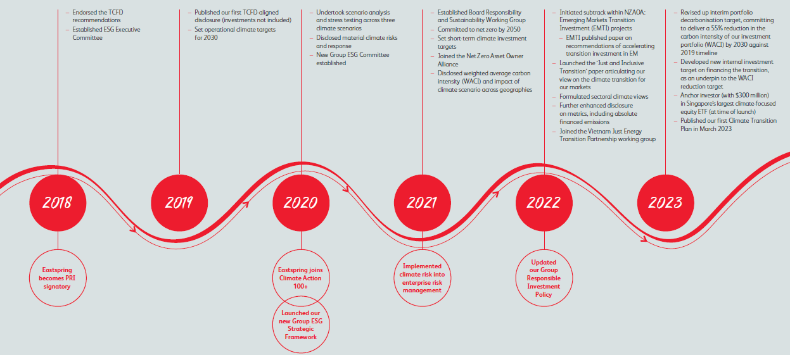
Prudentia’s sustainability journey so far

Slide 5
Climate change impacts are here already

Slide 6
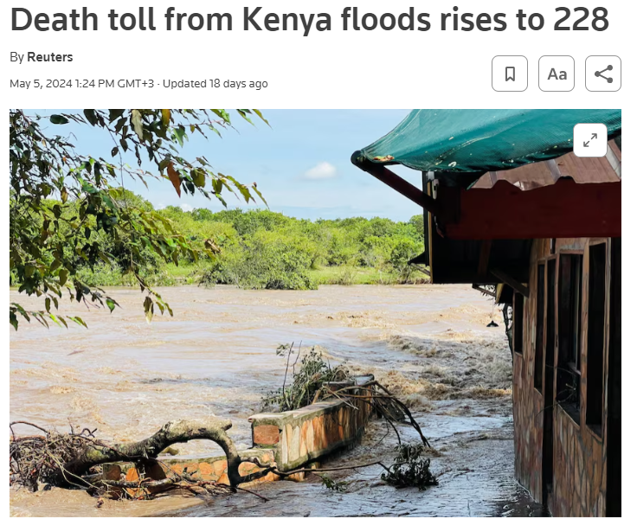
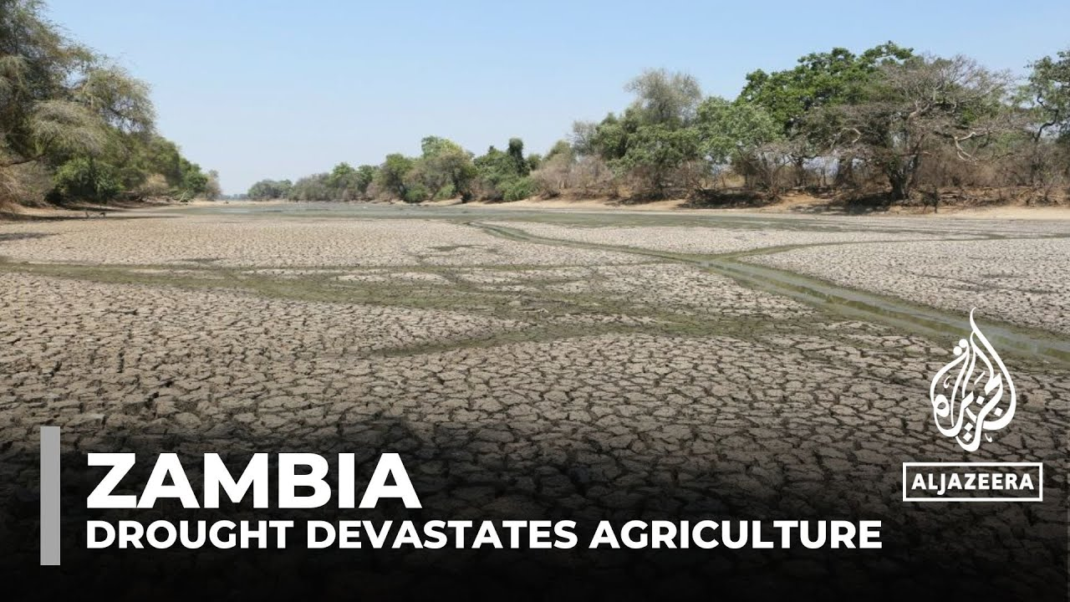
The impact is different to the average

Slide 7
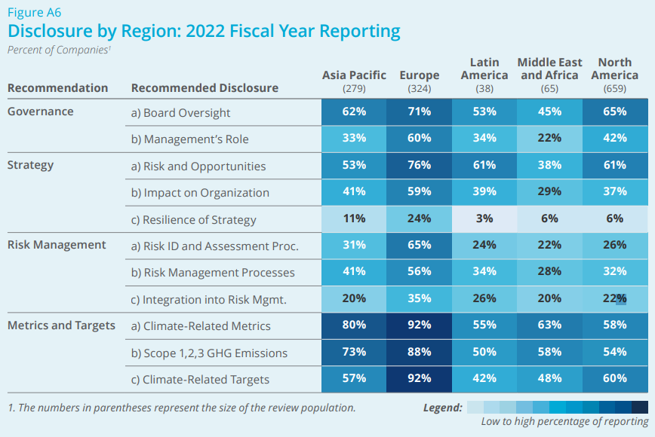
How well does our region understand climate risks?
To manage a risk, you need to understand it thoroughly
This table shows the level of TCFD disclosure against their principles by region
Disclosures are moving from TCFD recommendations to IFRS ISSB requirements
Source: 2023 TCFD status report

Slide 8
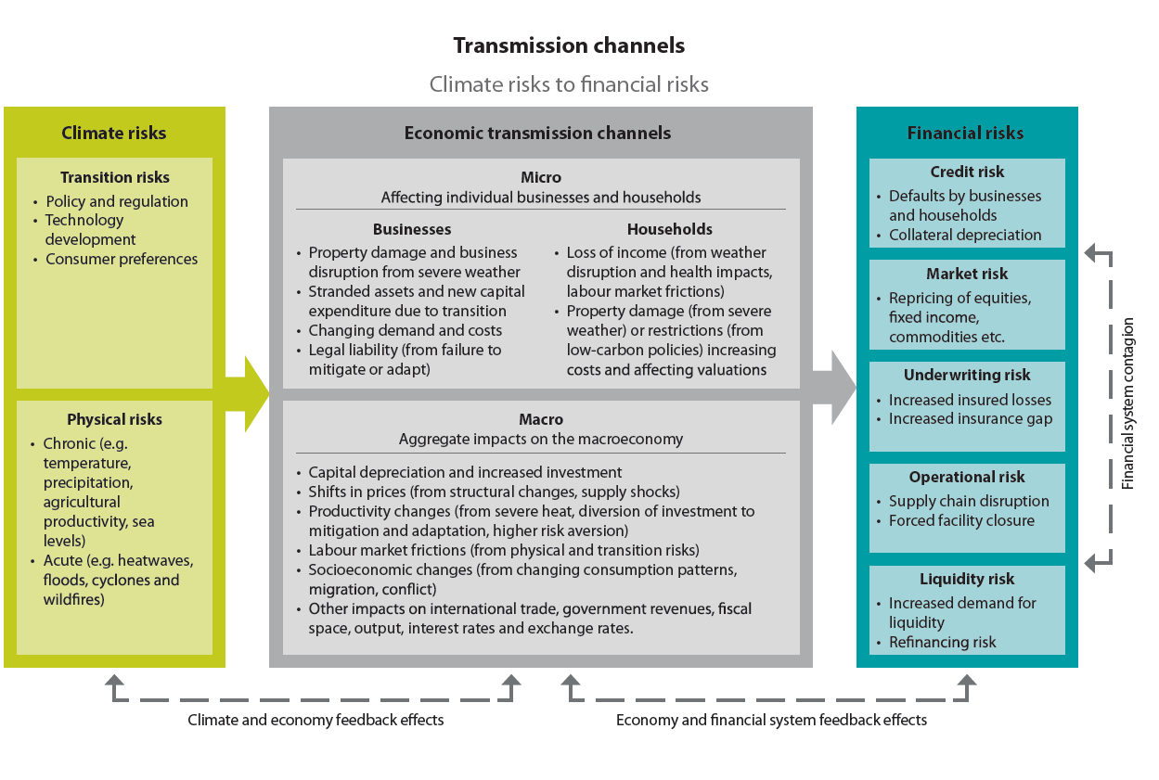
What are the climate risks?
Climate change’s impact can come both from doing something (transition risks) and from doing nothing (physical risks)

Slide 9
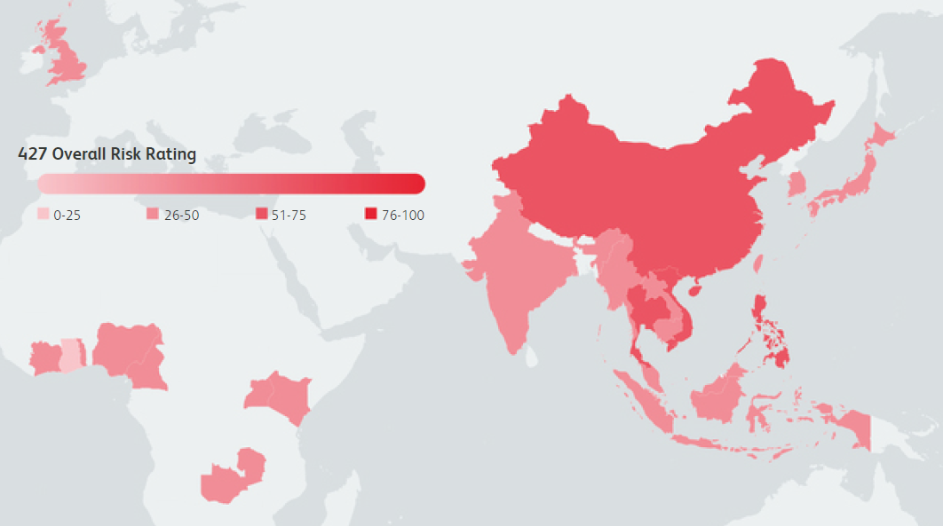
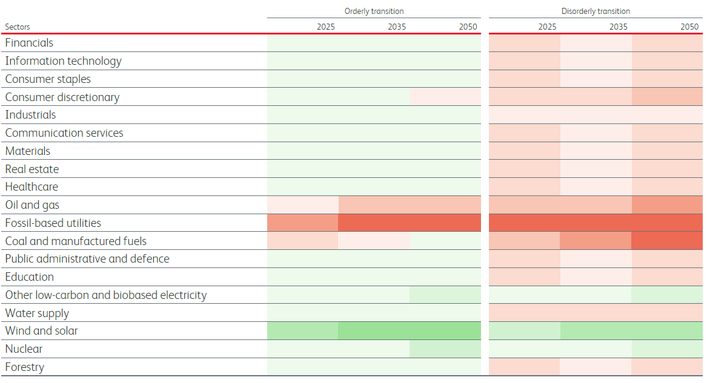
How have we assessed the impacts on us?
Given the uncertainty surrounding how climate change can evolve along with governments’ and societies’ responses, scenario testing has been a key tool
Operational risks
Credit, market and liquidity risks
Underwriting risks
Notes:
Reliant on emerging body of research into impacts of heat, humidity, pollution, diseases, food and water shortages, geopolitical

Slide 10
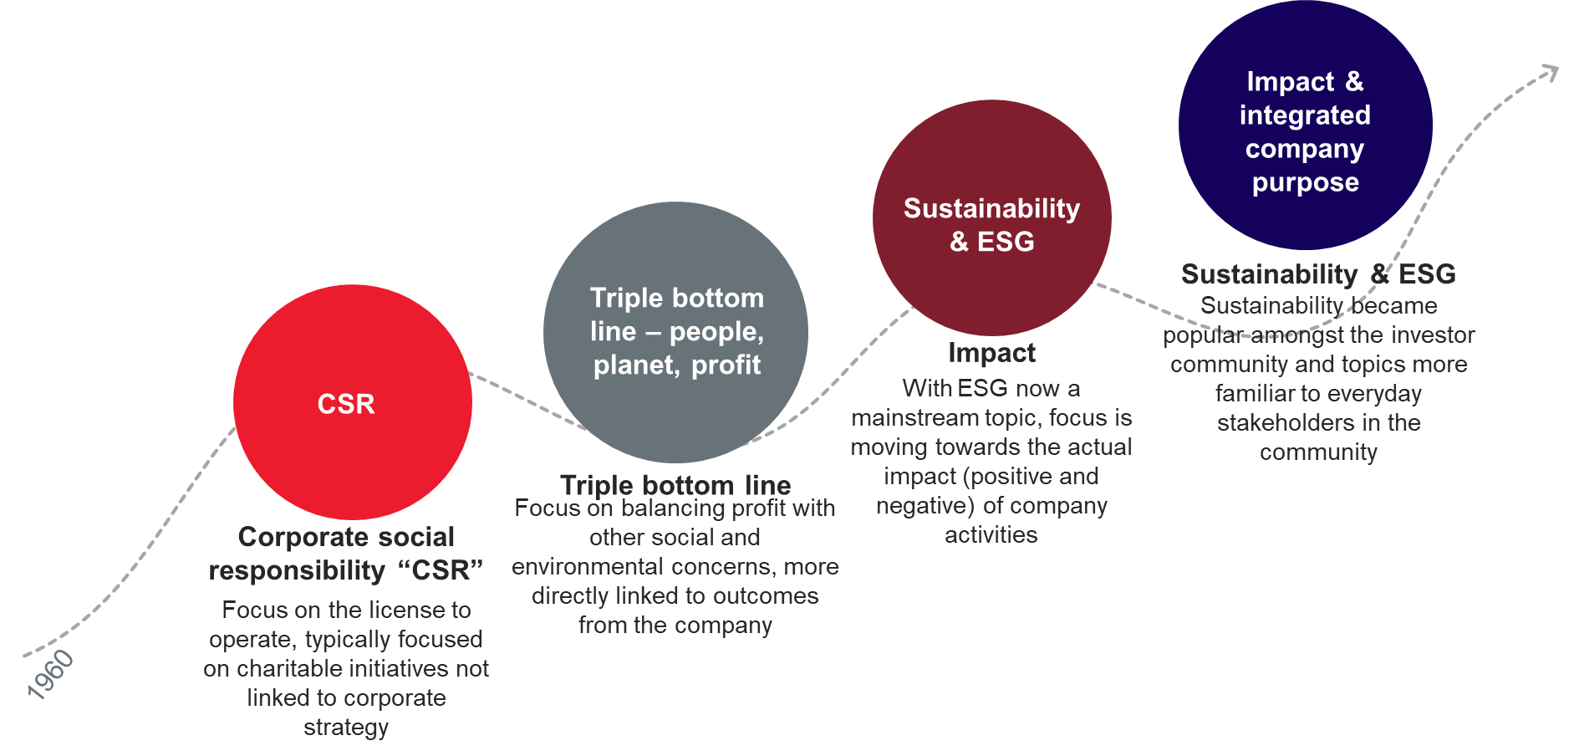
Change is also a source of opportunity
We have seen a global increase in investor focus on sustainability and ESG developments

Slide 11
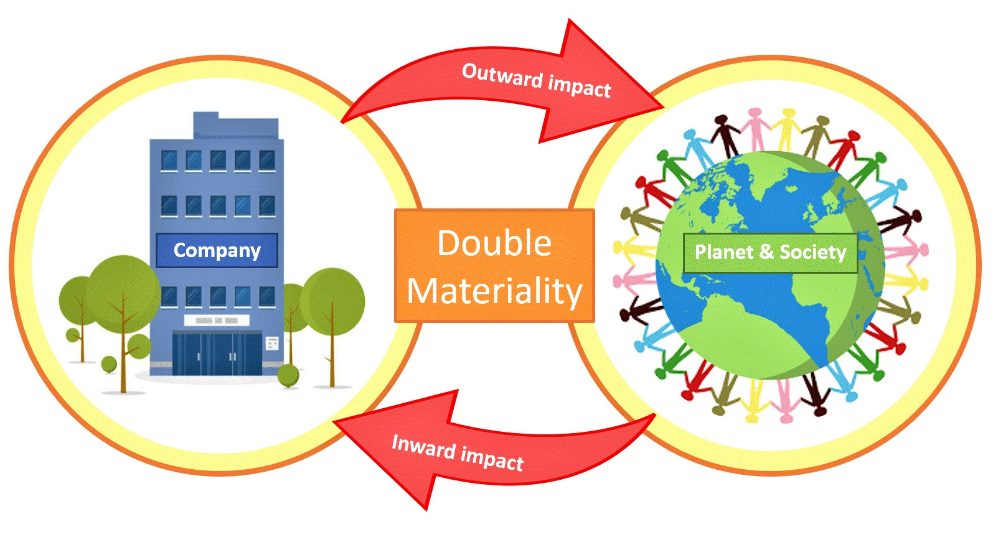
What impact can life insurers have?
“Double materiality” considers not only the impact of climate and societal change on companies, but also the impact of companies on climate and society

Slide 12
How can companies assess double materiality?
Applying double materiality to the company’s stakeholders can highlight the key areas of risk and opportunities
This application should be done over the short, medium and long term horizons as well as using different potential future scenarios
Direction of impact | Climate risk | The company’s stakeholders
 |  | Customers | Employees | Distribution | Share-holders | Society | Regulator and Government | Rating agencies | Third party providers
Impact on the company | Transition risk | ? | ? | ? | ? | ? | ? | ? | ?
 | Physical risk | ? | ? | ? | ? | ? | ? | ? | ?
Impact from the company | Transition risk | ? | ? | ? | ? | ? | ? | ? | ?
 | Physical risk | ? | ? | ? | ? | ? | ? | ? | ?

Slide 13
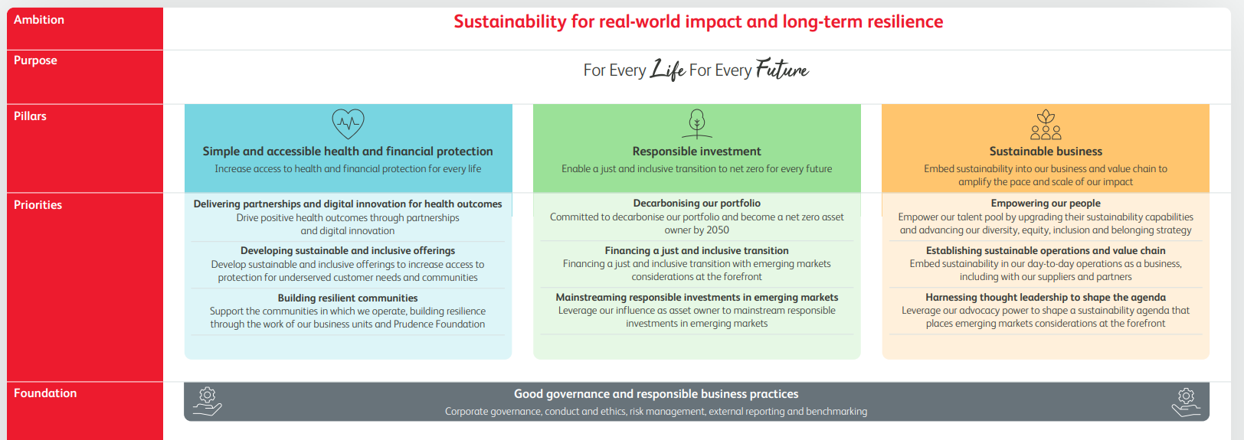
How is Prudential adapting?
Prudential has developed its Sustainability strategy, which is in full alignment with its strategic strategy

Slide 14
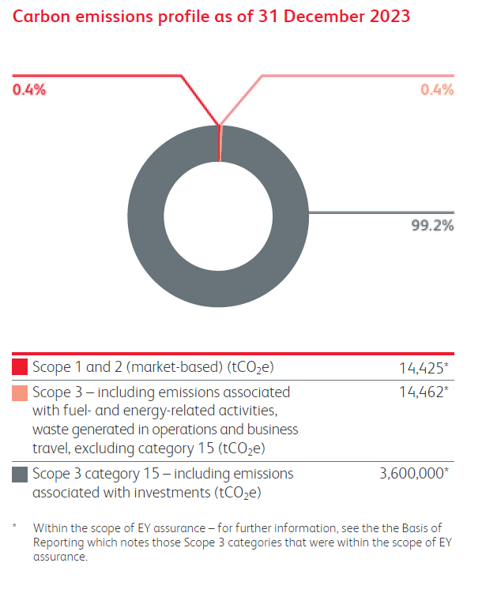
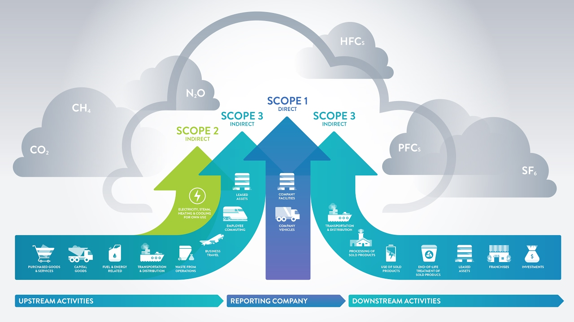
What is Prudential’s carbon footprint?
As a life and health insurer, almost all our carbon emissions are ‘financed emissions’

Slide 15
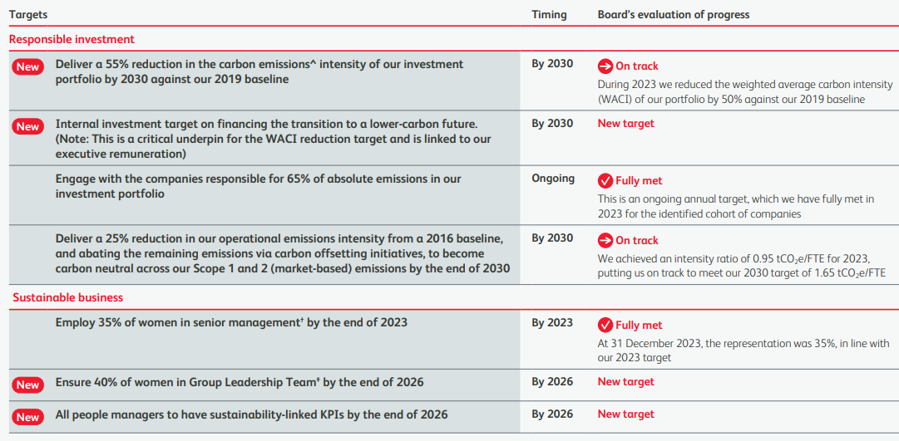
What are Prudential’s sustainability targets?
It is important to use a suite of targets as well as short and long term targets

Slide 16
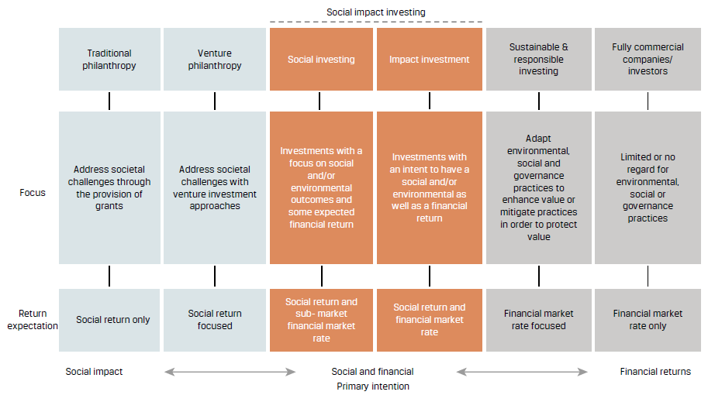
What is responsible investment?
As custodians of policyholder and shareholder funds, we have a fiduciary duty

Slide 17
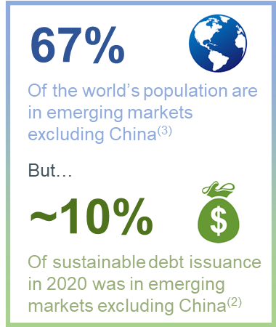
What are the challenges for transition finance?
The main challenge for Prudential is the lack of Financing Transition opportunities across emerging markets.
There are many different reasons cited for this lag:
Lack of localised frameworks
Need for more flexible sources of capital
Lack of robust data

Slide 18
What has been needed for all the above?
Internal governance
Expertise from multi disciplinary teams
Additional data
Engagement capability
Joining networks and bodies

Slide 19
Summary
Get to understand the problem, because Africa is being impacted more than the average
Scenario tests are very useful
Climate change is not just material, but double material
There are risks, but also opportunities to be part of the solutions

Slide 20
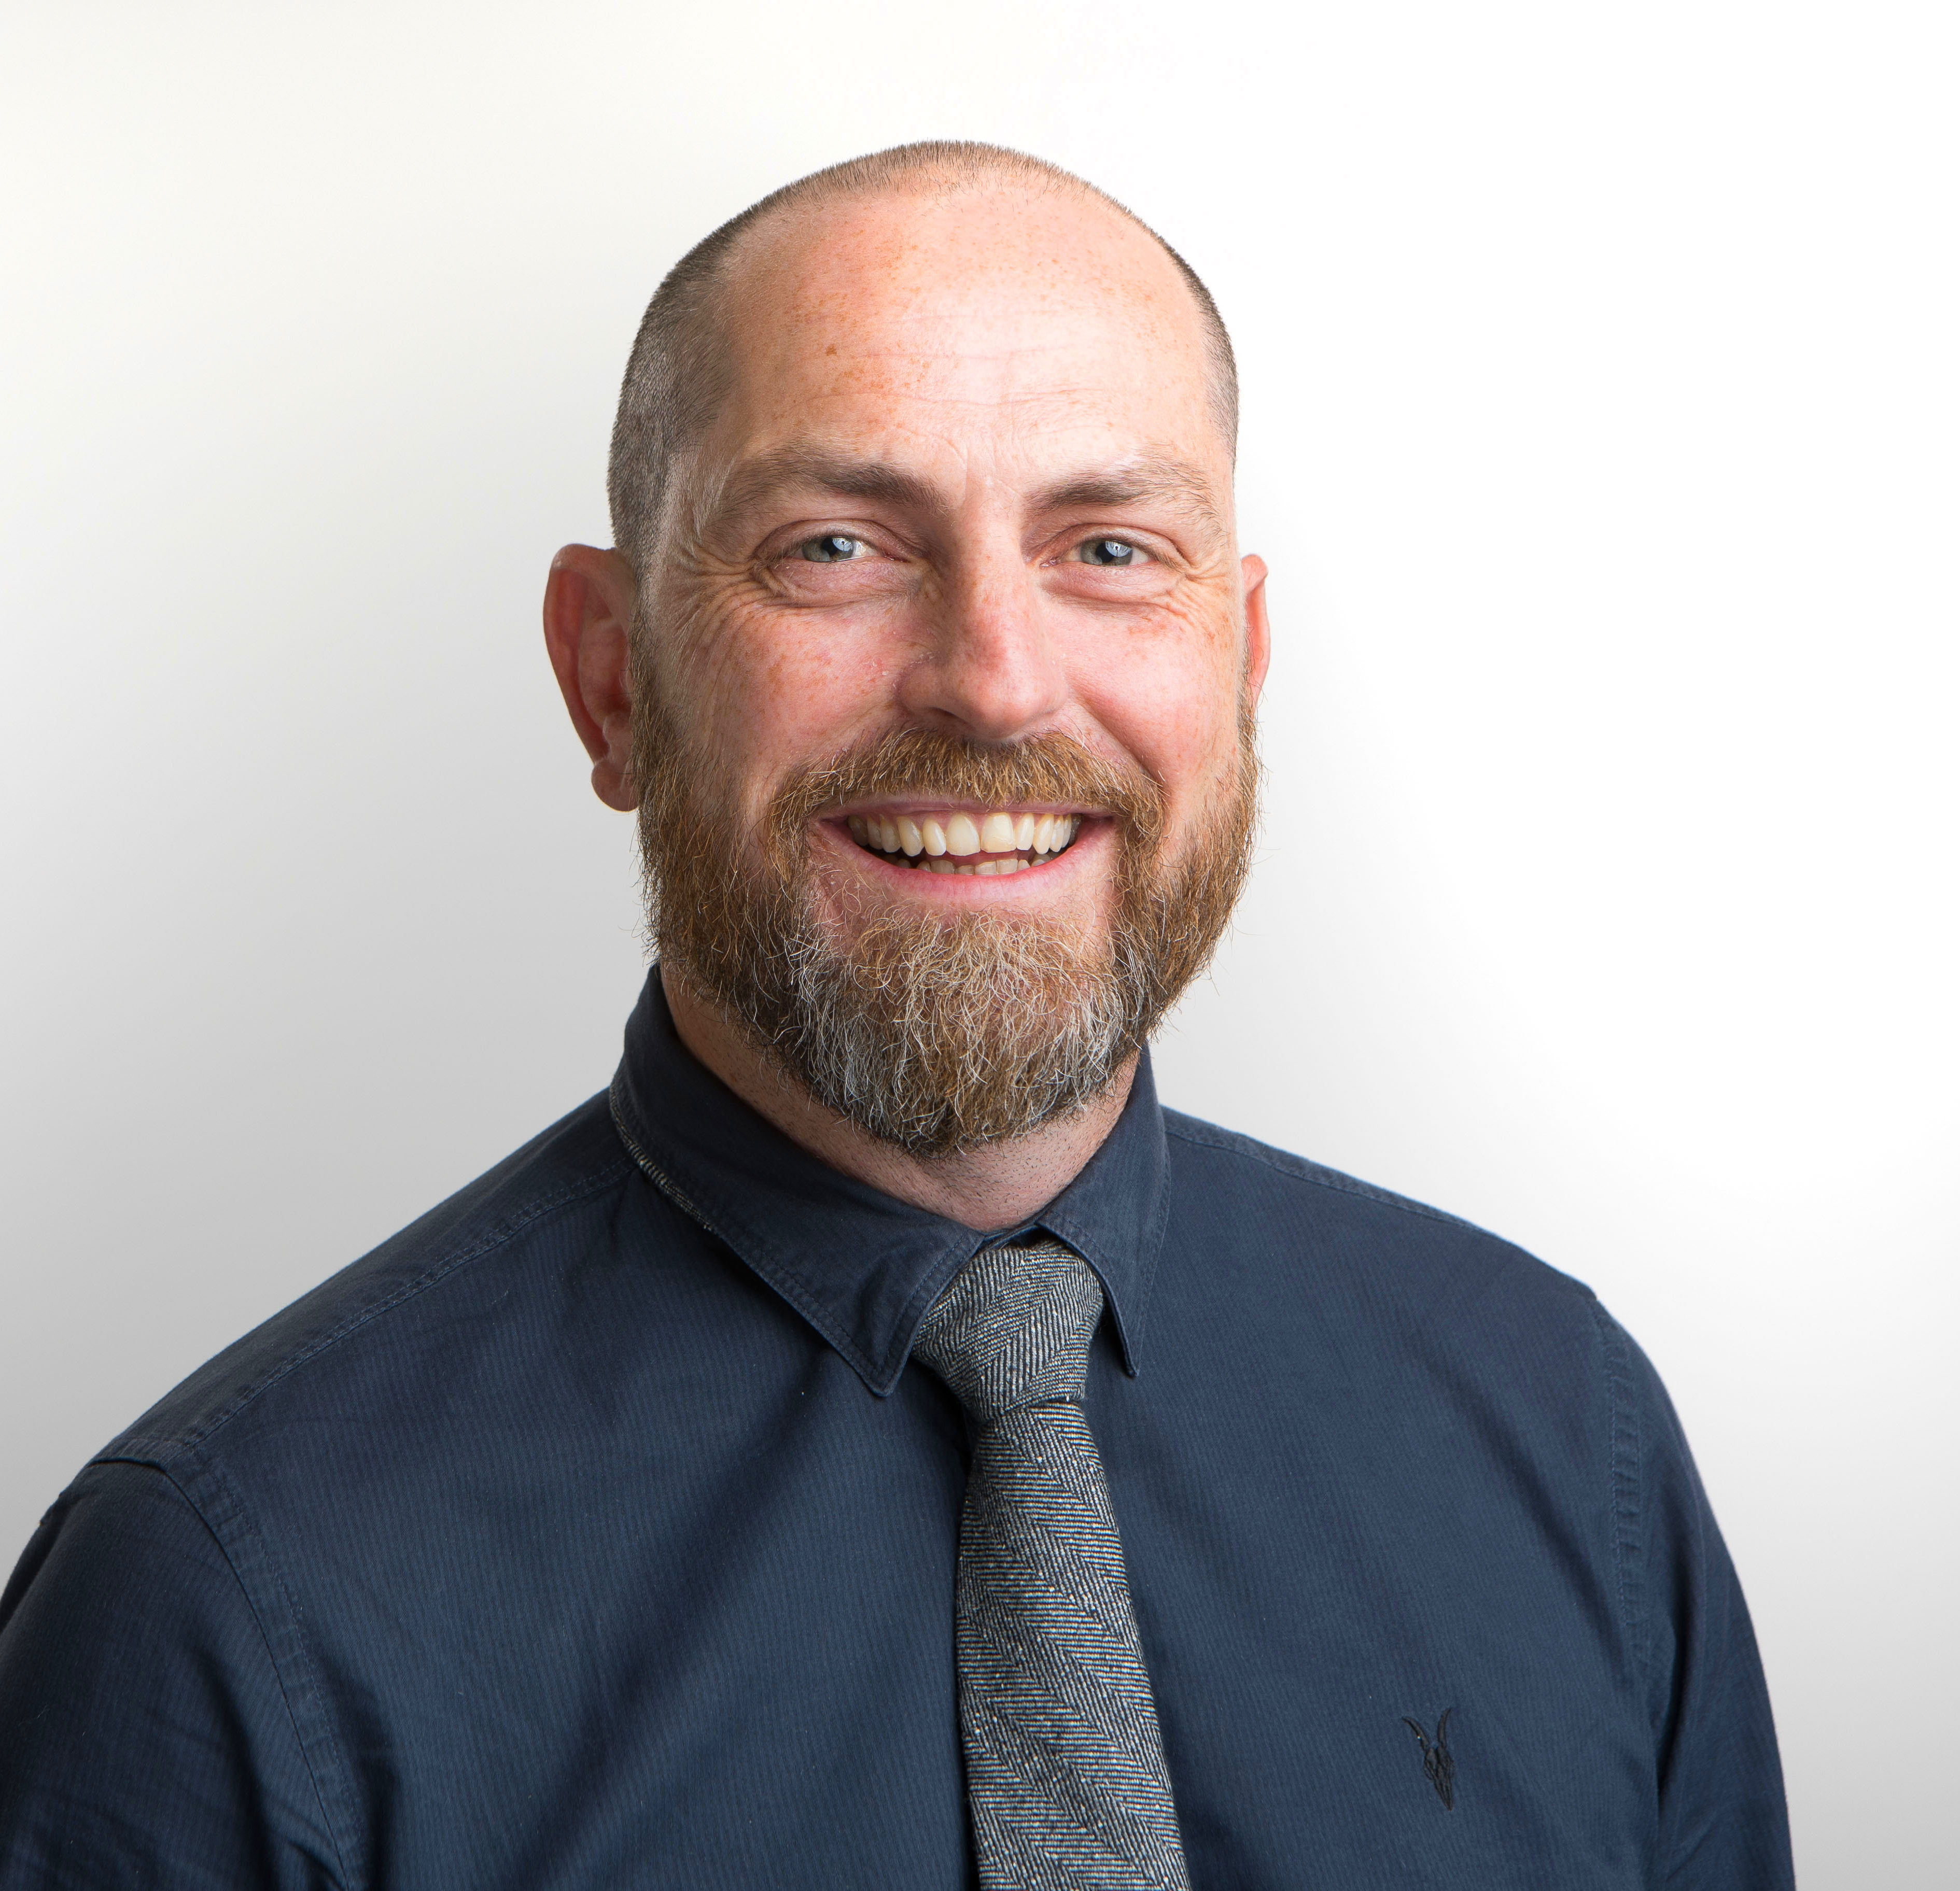
Final comment
“Don’t let perfect
stand in the way of good”

