Slide 1
Africa Insurance Pulse 2024 African insurance sector's critical role in building disaster resilience
Windhoek, Namibia, 3 June 2024
Simone Lauper, Faber Consulting AG

Slide 2
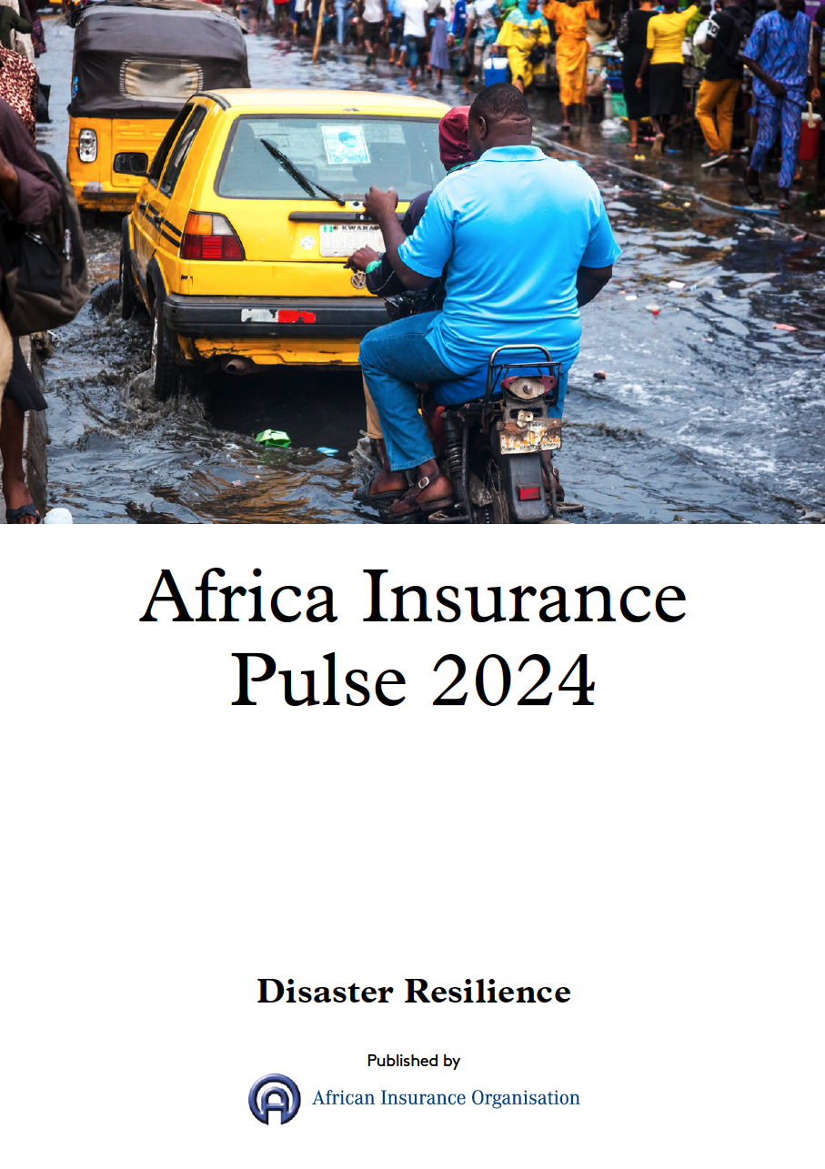
The 2024 edition of Africa Insurance Pulse focuses on disaster resilience
Introductory remarks
Since 2016, the African Insurance Organisation (AIO) has released 13 publications covering issues such as food security, climate change, the African Continental Free Trade Area, digitalisation and re/insurance market trends.
This year's publication highlights the critical role of the re/insurance industry in enhancing Africa's disaster resilience, based on research and in-depth interviews with senior executives.
Faber Consulting prepared the publication to encourage discussion on this important topic at the AIO's 50th Conference and General Assembly in Namibia.

Slide 3
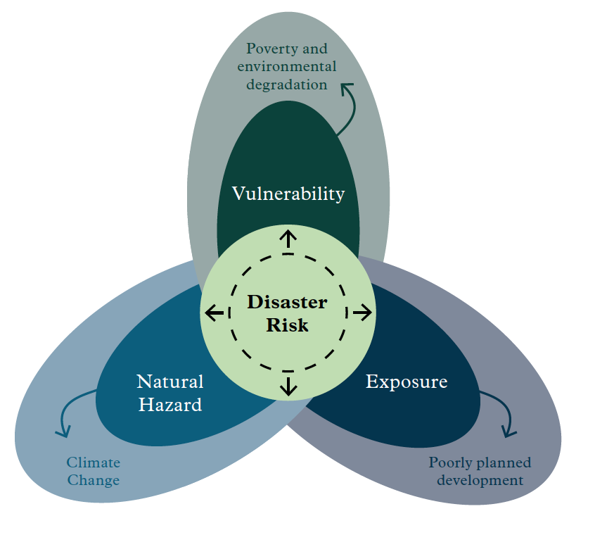
Disaster risk is determined by the interaction of hazard, exposure and vulnerability
Role of hazard, exposure and vulnerability in disaster risk – Source: IBRD, World Bank
Disaster resilience, refers to «the ability of a system, community or society exposed to hazards to resist, absorb, accommodate, adapt to, transform and recover from the effects of hazards in a timely and efficient manner».

Slide 4
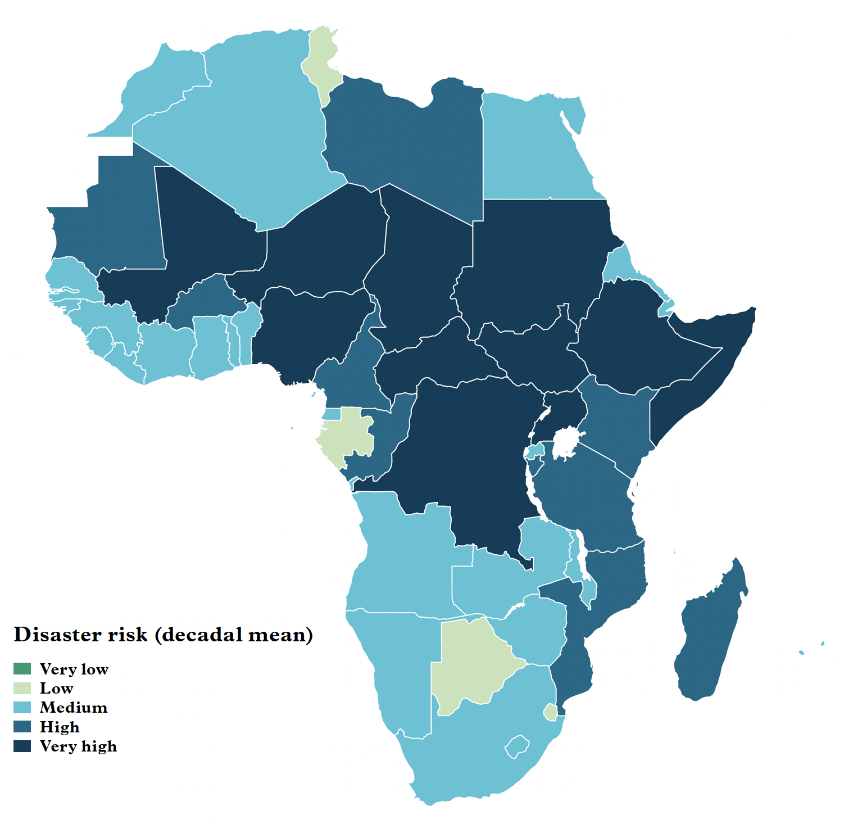
Disaster risks a threat to Africa's economic development
Africa’s disaster risk levels (natural and man-made) – Source: INFORM Risk Index, 2024
Africa is the world's second-fastest-growing economic region, with a projected GDP growth of 3.8% in 2024 and 4.2% in 2025.
However, the World Risk Report 2023 identifies Africa as the most vulnerable continent to disasters. For instance, drought and flood reduced GDP per capita by 0.7% and 0.4% respectively (1990-2019).
Despite low emissions, Africa is highly vulnerable to global warming above 1.5°C, with its agricultural sector exposed to extreme weather; climate change has reduced Africa's agricultural productivity by 34% since 1961, according to the IPCC.
Global geopolitical tensions, regional conflicts and political instability heighten Africa's disaster risks, for instance affecting supply chains, exports and debt servicing.

Slide 5
Twelve of Africa's top 20 GDP earners face high risk of natural disasters
Top 20 African countries ranked by the World Risk Index for extreme nat. cat. & climate change impacts
Countries within the top twenty GDP powerhouses in Africa, based on nominal GDP, IMF, 30 April 2024

Slide 6
The insurance sector is essential for comprehensive disaster risk management
Disaster risk management framework – Source: The Sendai Report, World Bank Group
Pillar 1
Risk identification
Pillar 2
Risk
reduction
Pillar 3
Preparedness
Pillar 4
Financial protection
Pillar 5
Resilient reconstruction
Comprehensive risk assessment & data collection
Sophisticated actuarial & risk modelling techniques
Financial incentives for safer practices
Advocating for stronger safety regulations
Bundling products with risk advice
Investing in preparedness initiatives
Targeting their investments to disaster risk reduction
Providing liquidity for reconstruction
Stabilising economies with rapid payouts
Spreading risk widely
Financially supporting & advocating for improved building standards & practices
Insurance –
Key contributions

Slide 7
Market survey insights We would like to extend our heartfelt appreciation to the 22 senior re/insurance professionals from the following distinguished organisations
Africa Re
Africa Specialty Risks
Allianz Re
CAT Assurance et Réassurance
Compagnie Centrale de Réassurance
Continental Re
Custodian Investment
EllGeo Re
Ethiopian Re
Gallagher Re
NamibRe
Munich Re
PartnerRe
Santam Re & International
Société Nationale d'Assurance
Swiss Re
Trust Re
Tunis Re
ZEP-RE
Their dedication, expertise and cooperation have been invaluable. Thank you for your continued support and commitment to excellence in the re/insurance industry.

Slide 8
Climate change and natural disasters at the forefront of Africa's resilience challenge
Insurers identify key risks to disaster resilience
What are the main risks to the resilience of African societies and economies to disasters? (list top 3)

Slide 9
Joining forces in public-private partnerships to tackle major disasters
Insurers' views on organisations best placed to promote resilience
Which organisations are best placed to help strengthen the resilience of African societies and economies? (list top 3)

Slide 10
Property & agricultural insurance emerge as major defenders against climate risk
Insurers' main business lines promoting disaster resilience
What insurance solutions do you offer in your markets to strengthen disaster resilience? (list top 3)

Slide 11
Insurers in Africa face several challenges in building disaster resilience
Challenges for insurers in providing disaster resilience solutions
What are the main challenges facing the African insurance sector in providing more effective solutions to improve disaster resilience? (list top 3)

Slide 12
Balancing consumer protection and industry growth to reduce the protection gap
Promoting disaster resilience - Suggestions for initiating dialogue between public and private partners
Respondents stressed the urgent need for robust disaster resilience policies, pointing to the inadequacy of current measures across Africa. They criticised weak building codes, land use guidelines and environmental protection standards and called for a long-term strategic approach.
Promote mandatory disaster insurance
Adapt regulation for inclusive insurance
Offer sandboxes to test and accelerate innovation
Foster partnerships with clear roles & responsibilities
Enforce sound solvency standards
Facilitate access to insurance through technology
Promote consumer awareness campaigns
Allow major risks to be spread across borders

Slide 13
Insurance a key player for Africa in promoting disaster resilience
Concluding remarks
The critical role of insurance
The insurance sector, as the risk expert, is a key contributor to improving disaster resilience in Africa, but has yet to fully realise its potential for transformative risk mitigation and transfer efforts
Effective risk management
Effective strategy requires data sharing, uniform and empowering regulations, promoting the value of insurance, targeted research and dissemination of best practices
Harnessing innovation and technology
Urgent need for innovation and advanced technology to enable accurate risk assessment, tailored solutions and broader distribution to address significant protection gaps
Proactive collaboration
Essential coordination between insurance sector and key stakeholders (governments, regulators, international organisations) to respond to major catastrophes and reduce overall vulnerability

Slide 14
Questions? Contact us.
SIMONE LAUPER
T +41 44 256 1081
SL@FABERCONSULTING.CH
HENNER ALMS
T +41 44 256 1082
HA@FABERCONSULTING.CH
ANDREAS BOLLMANN
T +41 44 256 1085
AB@FABERCONSULTING.CH

Slide 15
Severe impact of climate change on Africa
An update based on IPCC Six Assessment Report (2022) and World Meteorological Organization
Accelerating warming: Africa's warming rate has increased to +0.3°C per decade (1991-2022), surpassing the global average of +0.2°C per decade.
Strong regional variations: North Africa warms fastest at +0.4°C per decade; Southern Africa slowest at +0.2°C per decade.
Severe impacts: Climate hazards threaten food security, ecosystems, economies, and increase displacement and conflict.
Agricultural decline: Climate change has reduced Africa's agricultural productivity by 34% since 1961, accelerated biodiversity loss, water shortages, and economic inequality.
Human displacement: Over 2.6 million new displacements in sub-Saharan Africa in 2018, and 3.4 million in 2019 due to weather events.
Future risks: Warming scenarios of 1.5°C to 2°C project severe impacts on food production, economic growth, inequality, and health in Africa.

